Slide 1

August 22, 2019
Investing in Your Career:
Certificate Program Informational Webinar

Slide 2
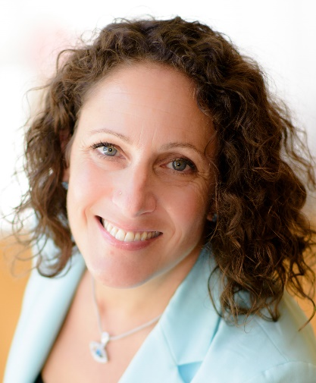
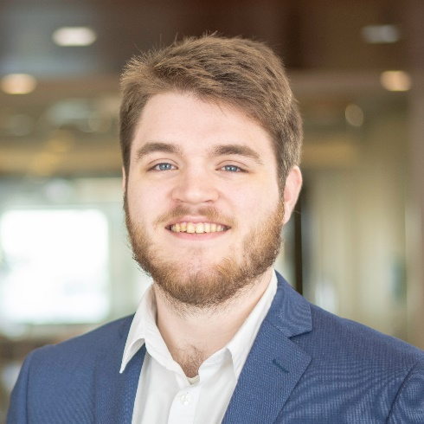
It’s a pleasure to join you!
Stephanie Helsing
Membership Manager
John Kasander
Program Assistant
Sept. 12, 2018
Investing in Your Career

Slide 3

Today’s Agenda
Why the certificate program?
  Scope and benefit of certificates
Program overview:
  PAC & Grassroots Management
  Public Affairs Management
Details, requirements and Q&A
Investing in Your Career

Slide 4
Key Takeaways
A Public Affairs Council certificates will help set you apart and get ahead
You’ll meet professionals you won’t meet in other settings, creating networking and career opportunities
Flexible scheduling means you can fit the program to your schedule
With no application or enrollment fees, and a la carte program registration, our certificates are a low-cost option for professional education
Investing in Your Career

Slide 5
Reason to participate: What participants tell us
To you…
To your organization…
Grow knowledge, expertise in public affairs
Make the case to take on more leadership roles and responsibilities
Build your professional network; be seen as a leader in the public affairs community
Show current/future employers that you have experience in management and compliance best practices
Low-cost means to gain insight into ways to address work challenges and improve programs
Ensure staff have knowledge of best practices, a handle on current trends and are up-to-date on compliance standards
Boost organization’s reputation
Build a network you can call upon for future opportunities/challenges
Investing in Your Career

Slide 6

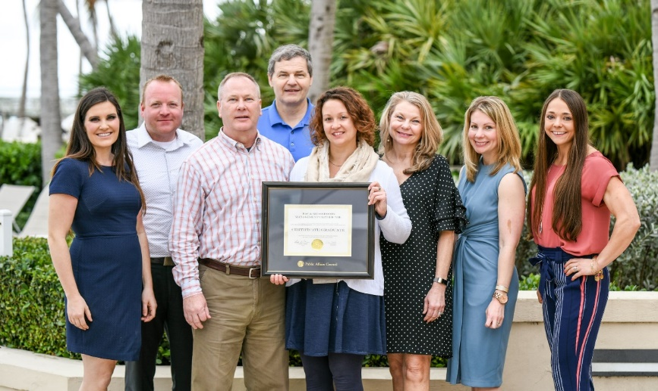
Program Overview: Nearly 450 participants
PAC & Grassroots Management
335 Current participants
82 Graduates
Public Affairs Management
137 Current participants
3 Graduates
Investing in Your Career

Slide 7
Program Overview: Tailored to your needs
PAC & Grassroots Management
Public Affairs Management
Focus: Mid-level public affairs professionals
Goal: Strengthen understanding of and expertise in political action committees or grassroots advocacy
Specialization: Must specialize in one area (can complete multiple certificates and earn both specializations)
Focus: Current and rising leaders in public affairs
Goal: Strengthen knowledge of best practices in public affairs management and enhance expertise in leading an integrated collaborative and strategic public affairs function
Specialization: No specialization, but ability to select electives
Investing in Your Career

Slide 8
Program Overview: Experience and more
PAC & Grassroots Management
Public Affairs Management
Required experience: 2 years in public affairs (not required to be PAC-or grassroots- specific)
Completion window: 2 - 3 years
When to apply: Prior to or within 30 days after attendance at a certificate-eligible program
Required experience: 7-10 years in public affairs with demonstrated responsibility for function management, cross-functional leadership and/or strategy-level decision-making for public affairs
Completion window: 3 - 5 years
When to apply: Prior to or within 30 days after attendance at a certificate-eligible program
Investing in Your Career

Slide 9
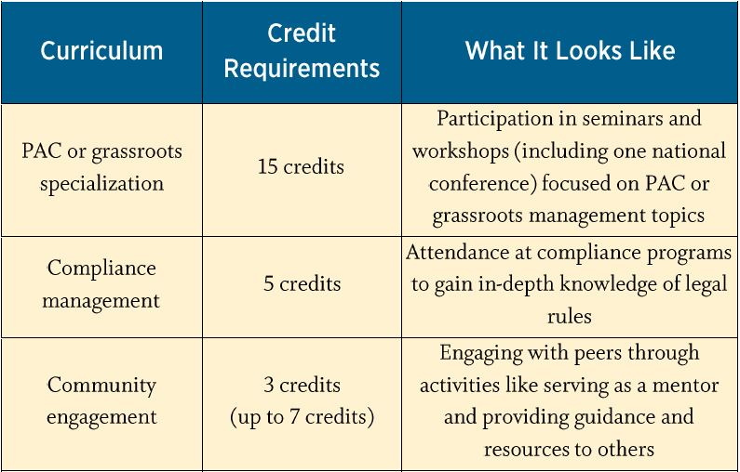
Credit Breakdown
PAC & Grassroots Management
Sept. 12, 2018
Investing in Your Career

Slide 10
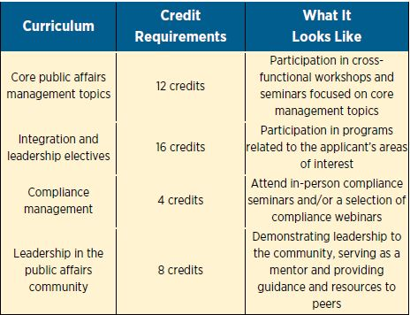
Credit Breakdown
Public Affairs Management
*Institute graduates may request 5 credits toward their elective requirement regardless of graduation date*
Sept. 12, 2018
Investing in Your Career

Slide 11
Costs: Free to apply, regular program pricing
No cost to apply. No administrative fee.
Pay by the course (conference, workshop or webinar)
Cost is spread over 2-5 years
No cost for community/leadership credits
Estimates:
  PAC & GR
    $4000 (member); $5300 (non-member)
  Public Affairs Management
    $5400 (member); $7500 (non-member)
Sept. 12, 2018
Investing in Your Career

Slide 12
Key requirements: attendance and participation
Maximum number of webinars
  PAC & Grassroots: 5 total, recordings not eligible
  Public Affairs Management: 3 total for both Core and Elective credit; recordings not eligible
Passive participation in multi-hour workshops does not count
  Virtual participants must be active for the duration of the program: asking questions, providing feedback and commenting during discussion
Attendance and participation for the duration of an event is required for credit
  Early departure from an in-person workshop will disqualify an attendee from receiving credit
Investing in Your Career

Slide 13
Earning Community Credits
PAC & Grassroots Management
One year as a mentor in the Council’s mentoring program (1 credit)
One year on the advisory committee for any major conference (1 credit)
Sharing PAC or Grassroots related resources for the Council’s library (5 resources for 1 credit, max of 2)
  Individual resources could be different documents or a chapter in a larger piece. What qualifies is left to the discretion of the manager of our resource library
Speaking at a Council program
(1 credit)
Writing an article or tip sheet for use in a Network Newsletter (1 credit)
Posting to Council Connect (1 Credit for every five substantive posts, max of 1)
Sept. 12, 2018
Investing in Your Career

Slide 14
Earning Community Credits
Public Affairs Management
Sharing Resources and Information (1 credit)
  Samples and resources for the Council’s virtual resource library
  1 credit per 3 resources submitted
  (Max of 2 possible credits earned)
Speaking at a Council program
(1 credit)
Posting to Council Connect (1 Credit for every five substantive posts, max of 1)
Insight-Sharing Guidance (2 Credits each)
  One-year mentorship through the Council’s mentoring program (required)
  Writing an article or tip sheet that provides guidance to help peers manage their function.
Demonstrating Thought Leadership
(3 credits)
  Develop a detailed white paper or case study on topics such as strategic planning, departmental organization, and other initiatives and industry advancement (required)
Sept. 12, 2018
Investing in Your Career

Slide 15
Easily check your status on pag.org
PAC & Grassroots Management
1. Go to members.pac.org and sign in
2. Select “Transcript” from the drop-down menu in the top-left corner of the screen
Public Affairs Management
1. Download self-tracking form at www.pac.org/certificate/pa
2. After each program worth credit, note the date, name of the program and credit value
3. Connect with John Kasander (jkasander@pac.org) biannually or as needed to double-check count and plan future coursework
Investing in Your Career

Slide 16
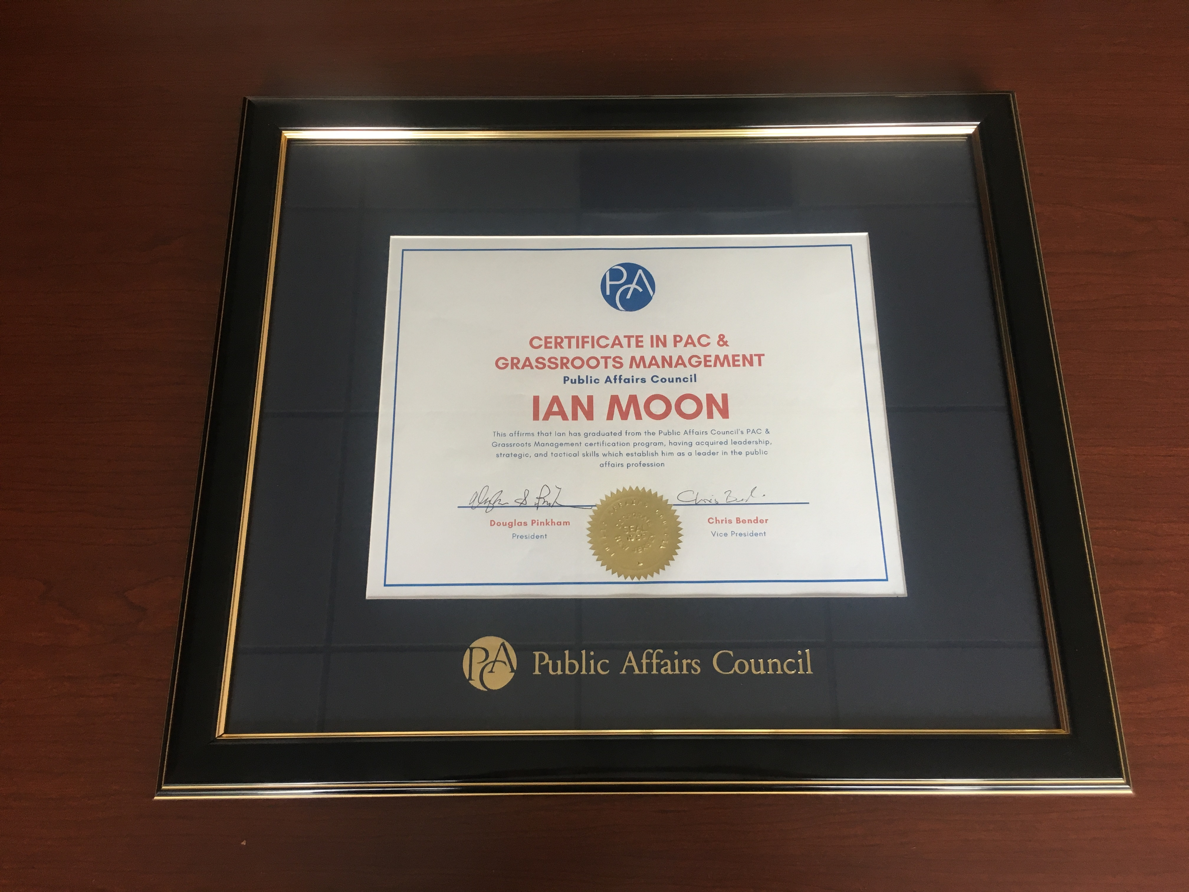
Congrats, grad!
No re-certification requirement
Framed certificate
Notification to supervisor on request
Spotlight on pac.org and the Council’s social media channels
Ability to list certification on your LinkedIn profile
Sept. 12, 2018
Investing in Your Career

Slide 17

Questions? Apply now!
Visit www.pac.org/certificate
Select your program
Return your application to John Kasander (jkasander@pac.org)
Investing in Your Career

