Slide 1

Importance of Association PACs

Slide 2

PACs are the most popular and transparent form of campaign finance.
Importance of ASSOCIATION PACs

Slide 3


A PAC is power in numbers
Legal means of political participation
Corporations and associations are prohibited from directly contributing to federal candidates – but they may operate a PAC.
PACs are strictly regulated A PAC is regulated by the FEC and only allows for voluntary, individual contributions under stringent guidelines for participation.
PACs are legal, transparent and federally monitored
PACs allow associations to express united interests with one powerful voice.
Importance of ASSOCIATION PACs

Slide 4
What is a PAC?
Combine resources to support candidates who support the company’s interests and issues
Connected by issues, beliefs or employment
Like-minded individuals
Doug Pinkham President, Public Affairs Council
Sept. 12, 2018
Importance of ASSOCIATION PACs

Slide 5

Debunking myths: super PACs vs. association PACs
An association PAC is not a super PAC
Super PACs:
Individual and corporate money spent on uncoordinated ads and communications
Money is not contributed directly to candidates
Traditional, connected PACs:
Other than individuals, traditional PACs are the only entities that can give to candidates
Association PACs avoid Super PAC involvement. Only 8% contributed to Super PACs in the 2023-2024 election cycle according to the 2025 Association PAC Benchmarking Report
Importance of ASSOCIATION PACs

Slide 6
Where does the PAC fit?
Lobbying team monitors top legislative priorities & opportunities and informs grassroots and PAC teams of issue champions in Congress
Lawmakers and agencies are lobbied on organization’s legislative priorities & educated on impact of legislation
Grassroots team educates membership on priority issues; asks for action alert, grasstops response
The PAC supports the re-election of industry-friendly legislators
Post-election, stakeholders provide input on legislative priorities to help develop legislative agenda
Importance of ASSOCIATION PACs

Slide 7
Association PACs in 2025:
Fast Facts
3,111
connected PACs registered with the FEC
(association, labor, cooperative or corporation)
33%
were association PACs
Source: FEC.gov
Importance of ASSOCIATION PACs

Slide 8
PACs are transparent and limited Contribution limits for 2025-2026
 |  | Recipient
 |  | Candidate committee | PAC (SSF and nonconnected) | Party committee: state/district/local | Party committee: national | Additional national party committee accounts
Donor | Individual | $3,500 per election | $5,000 per year | $10,000 per year (combined) | $44,300 per year | $132,900 per account, per year
 | Candidate committee | $2,000 per election | $5,000 per year | Unlimited transfers | Unlimited transfers
 | PAC: multicandidate | $5,000 per election | $5,000 per year | $5,000 per year (combined) | $15,000 per year | $45,000 per account, per year
 | PAC: nonmulticandidate | $3,500 per election | $5,000 per year | $10,000 per year (combined) | $44,300 per year | $132,900 per account, per year
 | Party committee: State/district/local | $5,000 per election (combined) | $5,000 per year (combined) | Unlimited transfers | Unlimited transfers
 | Party committee: national | $5,000 per election | $5,000 per year | Unlimited transfers | Unlimited transfers
Source: FEC.gov https://www.fec.gov/help-candidates-and-committees/taking-receipts-pac/contribution-limits-nonconnected-pacs/
Importance of ASSOCIATION PACs

Slide 9
Association PACs are voluntary and give a voice to their members
17%
average association PAC participation rate
5%
from association senior management
80% of PAC contributions come from general association members
11%
from members of the association’s board of directors
2%
from association staff
Importance of ASSOCIATION PACs

Slide 10



Association PACs have strong governance structures
88% of PACs have formal contribution criteria
45% have a formal process for reevaluating criteria
(most common frequency is annually)
94% have a PAC
board of directors
Importance of ASSOCIATION PACs

Slide 11
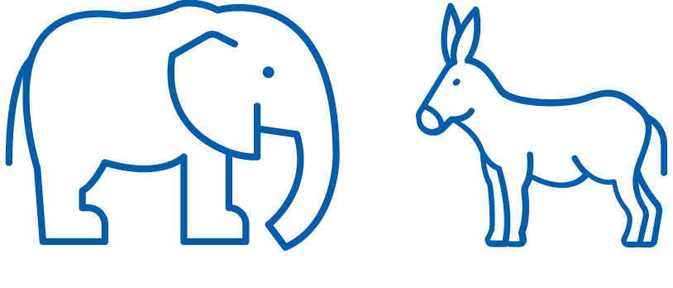
PACs are bipartisan
On average, in the 2021-2022 election cycle, corporate PACs contributed:
49% to Democrats
51% to Republicans
Source: Public Affairs Council 2025 Association PAC Benchmarking Report
Importance of ASSOCIATION PACs

Slide 12

Legislative priorities drive support choices
Leadership and committee membership are key contribution factors Eighty-six percent (86%) of PACs consider leadership position and membership on key legislative committees as top factors in their contribution criteria.
Source: Public Affairs Council 2025 Association PAC Benchmarking Report
Importance of ASSOCIATION PACs

Slide 13
PAC Positives
Build relationships with candidates
Increase audience’s understanding of political process
Connect donors with candidates to educate them on issues/org
Provide election/political information to further good government
Advance organizational/ government affairs priorities
Importance of ASSOCIATION PACs

Slide 14


PAC benefits
Individual
Access to political process
Information source
Gifts/recognition
Special events
Political involvement
PAC charitable match
Company
Proactive measure
Supplement government relations efforts
Elect the right people
Be a visible player
Good government
Importance of association PACs

Slide 15
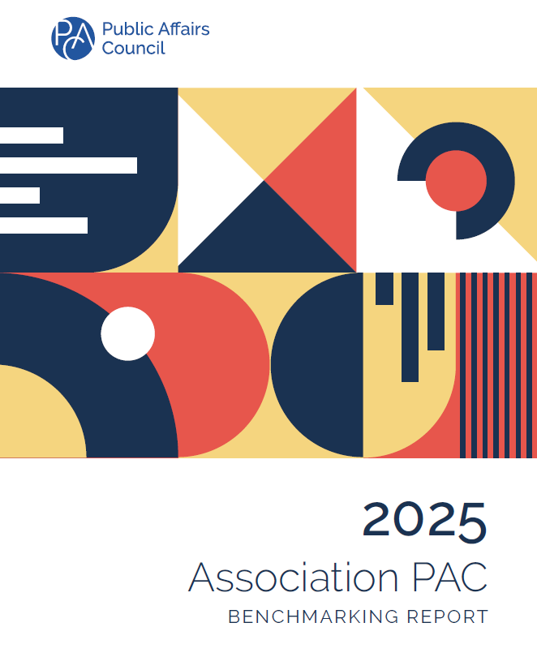
Purchase the full report and access additional Council research at pac.org/research
Importance of ASSOCIATION PACs

Slide 16


Kristin Brackemyre
Senior Director, Public Affairs Practice
kbrackemyre@pac.org
Public Affairs Council Support
IMPORTANCE OF ASSOCIATION PACS

