Slide 1

May 6, 2026
Proving Government Relations Value in Dollars and Cents - Measuring in the Language of Business
Anna Platt
Senior Manager, Government Relations

Slide 2
Agenda
Why measuring is important
Different types of metrics
Knowing your audience
Ways to communicate the value
PROVING GOVERNMENT RELATIONS VALUE IN DOLLARS AND CENTS
Notes:
This is what we’re going to talk about today, as we discuss how to demonstrate the value of government relations – why measuring the value is important; how to go about actually doing the measuring; the importance of knowing who you’re trying to explain the value to (i.e., your audience); and different ways to go about demonstrating the value and how best to communicate that value using everyone’s favorite topic – metrics!

Slide 3
Measuring the Value
Why?
Measuring gives you the tools you need to showcase the value
of your function within your organization.
Avoid being labeled a ‘cost center’
Increase, or at least maintain, a budget
Stronger voice in the decision-making process
Get recognition from senior leadership
Measurement tools can be used to increase efficiency
and allocate resources more wisely
Source: Managing Business Performance: The Metrics That Matter, PriceWaterhouseCoopers, 2008
PROVING GOVERNMENT RELATIONS VALUE IN DOLLARS AND CENTS
Notes:
Let’s start with why → why is it so important to measure the value you bring to your organization as a public affairs team or function?
You need to have agreement among your top leadership on what drives the business. If that’s not clear, you’re fundamentally nowhere. Measuring the value of your function is an opportunity to demonstrate what government relations does day to day to help improve the bottom line.
Once you do the measuring, you have the tools and information you need to demonstrate/showcase/highlight what the government relations function brings to the table.
Doing the benchmark measuring enables you to be more nimble as an organization – to be agile and to pivot quickly when facing crises and controversies or changing market conditions - because if you’ve optimized efficiency and there’s a level of oversight on that, it’s easier to change direction.
Knowing your function’s value also helps you make the case for your budget → if you can’t justify the budget you advocate for or think you need, why would leadership in your organization consider giving you one?
Demonstrating your value also means that leadership will listen to your voice/viewpoint more in the decisionmaking process → if they can’t readily grasp and understand the value of your function, they’re not going to stop and think “we should check to see what the government relations team thinks about X before proceeding.”
Relatedly, on the flip side, once they do understand the value of your function, you get that recognition from leadership.
Measuring tools can also help you see where you’re spending your time/allocating your resources and, with that information, you can make any adjustments you may need to or want to → enables continuous improvement.

Slide 4
Why This is Difficult
Measuring the value of government relations can be tricky. Why?
Objectives are long-term/take time = monthly or annual data showing success or failure may not be available.
Many goals involve managing risks (e.g., avoiding harmful legislation or preventing a crisis).
Strategies to achieve goals are often executed in concert with other parties, such as trade associations and coalitions, which makes it difficult to identify your team’s contributions.
Objectives often shift during the year.
Many of the strategies employed government relations professionals are difficult to evaluate because they are not transactional — they involve engaging stakeholders and building alliances.
PROVING GOVERNMENT RELATIONS VALUE IN DOLLARS AND CENTS
Notes:
Measuring the value of government relations can be difficult, and there are several reasons why:
1. Government relations takes time – it’s not like measuring efficiencies for accounting or sales, based on how quickly you close invoices, etc. Government relations doesn’t always have clear beginnings and ends. For example, we know that small things take time (getting a member to sponsor or cosponsor a bill; send a letter to an agency with an ask that’s related to an issue of importance to your organization) and big things (getting a bill passed; cultivating a Congressional champion) take EVEN MORE time → data showing success or failure simply might not exist yet.
2. Many goals and objectives in government relations involve managing risks rather than creating business opportunities. A lot of the time, you’re working to PREVENT or AVOID something from happening, and opening new spaces for business opportunities can be harder (or again, take a lot of time and cultivation). Sometimes your biggest win for the year is something NOT happening. Again, that makes the data collection piece tricky, because how do you measure that?
3. Goals achieved with other parties (coalitions; trade associations) = great, but it can be hard to determine out exactly what your team contributed in a meaningful, clear way.
4. Things change over the course of a year. What you thought was going to be a non-issue in terms of your government relations work can suddenly become an issue (and, conversely, something you thought was going to happen could not happen at all). I’m not going to elaborate on that point too much, as the speakers for the second part of the workshop are going to dive into how you navigate when that happens and how you can still measure progress.
5. Similar to the first point, that government relations work takes time, lots of strategies and actions undertaken by government relations professionals are hard to evaluate and quantify or are “soft” touch points, they’re not transactional and done and dusted all at once - you can’t build a relationship with a lawmaker’s office overnight and have it simply check a box. How do you “measure” that? You need to…

Slide 5

PROVING GOVERNMENT RELATIONS VALUE IN DOLLARS AND CENTS
Notes:
Develop your Value Proposition!
This is probably the most importance piece. Well, what is a value proposition to begin with?

Slide 6
Understanding the Value Proposition
Freedom to Operate
Preventing constraints to where and how the business is operated
Laws, regulations, community opposition, competition and other factors can affect one’s freedom to operate
Cost Avoidance
Preventing increases in operating costs
Tax increases, permitting expenses, new regulations and other factors can affect costs of doing business
Market Opportunity or Advantage
Speed and Productivity
Political and Reputational Risk Management
PROVING GOVERNMENT RELATIONS VALUE IN DOLLARS AND CENTS
Notes:
- Let's say your senior management comes to you and says, “Ok, we want you to create a value measurement system because we really don’t have one.”
If they’re coming to you with that task, what they’re doing is questioning your inherent value or whether you should exist as a function – whether you should be scaled back, exist elsewhere in the company, or questioning what you do and bring to the table as an individual (“do we really need this Full Time Employee?”).
If that’s happening, you need to understand why they’re asking the question, because it’s going to affect your response. You need what is called a Value Proposition.
A Value Proposition is a statement about the value you create for the organization.
Here are the key categories or components:
Freedom to Operate - a lot of what you do as a government relations professional is to prevent constraints on how you do business and where you operate. A lot of what government relations does is protecting or expanding that Freedom to Operate.
Cost Avoidance – This component of the value proposition should detail how your work is helping to prevent increases in operating costs or tax increases; or preventing new regulations from being put into effect.
Creating New Market Opportunities – This one is pretty straightforward, encompassing things like getting the FDA to approve a new drug; reducing community opposition to opening a new processing plant, or something along those lines → all these things are creating new business opportunities
Speed and Productivity - largely already covered and is straight forward
Political and Reputational Risk Management – One of the key points here is you need to speak the language of business. You need to talk in terms that senior management will understand because business leaders understand enterprise risk → a lot of what you're doing in your role is to protect the company or organization from heightened political and reputational risk - that’s risk management.
If you shape your Value Proposition using some of these key components, people will understand the value you create. Let me show you an example on the next slide.

Slide 7

Case Study: Caterpillar
Working collaboratively with internal and external stakeholders in identifying public policy and commercial issues of critical importance to Caterpillar;
Building and utilizing Caterpillar’s brand image, political capital and presence as a premier, U.S. manufacturing company to obtain favorable policy and commercial results; and
Maintaining disciplined cost control while retaining the company’s traditional value proposition.
PROVING GOVERNMENT RELATIONS VALUE IN DOLLARS AND CENTS
Notes:
Here’s an example of a Value Proposition that was shared with us.
Here we have Caterpillar – a big global company; heavy equipment that’s expensive to ship and operate; they’re pretty heavily regulated and deal with multiple conflicting regulatory schemes around the world.
Their Value Proposition talks about:
1. Working together with all kinds of stakeholders to identify key issues
2. Building on the company’s brand image, political capital, and presence as a U.S. manufacturing company (hopefully to be viewed positively by policymakers)
3. Because it’s a cost-conscious company, their government relations team very smartly included a point in their Value Proposition about maintaining cost-control while retaining the company’s traditional value proposition → that shows that they’re part of the team and can speak in the language of the company.
- This also leads to the point that whatever you do in your government relations planning and measuring system, it should be done in sync with your company’s strategic plan → read the objectives, read the wording that’s used, and replicate it where you can in your own plan. You don’t want your plan to be viewed as an outlier.

Slide 8
Measuring the Value (cont.’d)
Quantitative vs. Qualitative
Is the number meaningful or are you just running up the score?
Not every policy result is easy to quantify → look at its qualitative significance and assess its general impact.
Remember to look at what/how your gov’t relations peers are measuring (i.e., benchmark).
Metrics should…
Serve to track improvement, not as a way
to justify the department’s existence.
Speak the language of management.
Reflect a company’s culture.
Focus on impacts, not actions
PROVING GOVERNMENT RELATIONS VALUE IN DOLLARS AND CENTS
Notes:
Alongside with knowing your Value Proposition and having it in hand, you should measure your value using metrics. The metrics you use should be a way to clearly track and demonstrate progress, not as a way to argue that your government relations function should continue to exist. The metrics should be more substantive and meaningful than that.
It’s important that the metrics you use “speak the language” of the audience → know how your leadership likes to receive information and know what “language” they speak. Think about how you communicate with the different groups of people in your life → how you speak to your family probably differs from how you speak with your coworkers, right? How you speak to any kids in your life is probably different from how you speak to your friends, right? So, it makes sense that the language of business is different than the language of government relations. So, you want to be thinking about, “how can you explain what you’re doing in a way that makes sense to those that speak the language of business?”
Your metrics should also reflect the organization’s culture, and you want to separate your impacts vs. your actions (more on that in a second).
Related to all of this, you should think about quantitative vs. qualitative when it comes to your metrics. What does the number or statistic actually represent, and how is it meaningful? We know that policy results can be hard to quantify, so you want to think through how else you can speak to its impact. And do your homework first – see what your peers are measuring.

Slide 9
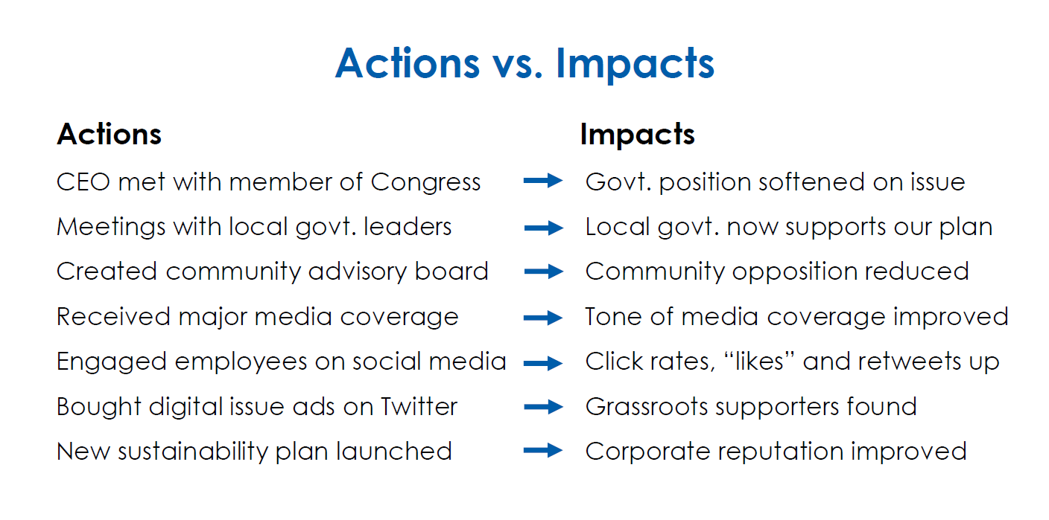
PROVING GOVERNMENT RELATIONS VALUE IN DOLLARS AND CENTS
Notes:
- So many times, people only talk about actions. But you really want to focus on the IMPACTS, those tangible results, the goal.
Here you can see some examples of how to differentiate between actions and impacts. [READ THROUGH EXAMPLES]
Yes, you took all of these actions, but the impact is what counts and what leadership will care about as an end result of all of those actions.

Slide 10
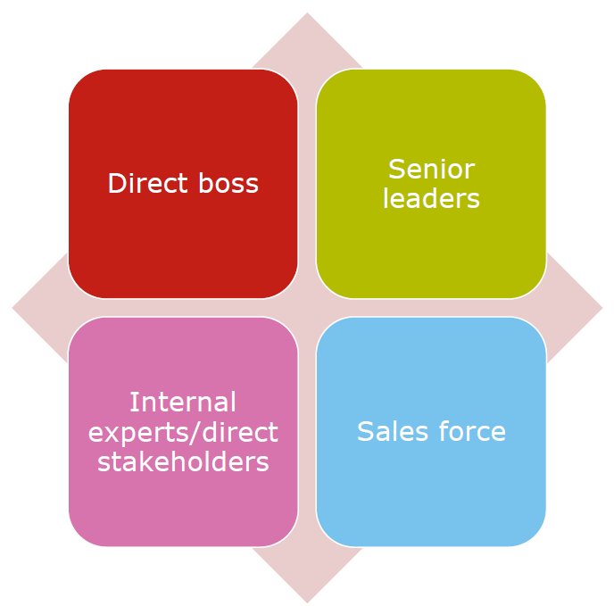
Communicating the Value
Who is your audience?
You want to speak in their language.
PROVING GOVERNMENT RELATIONS VALUE IN DOLLARS AND CENTS
Notes:
As I mentioned earlier, it’s really important to think about who your audience is when communicating the value of your government relations work. The way you speak about it to internal stakeholders, i.e., peers on other teams at a similar career level to you, should be different than how you speak about work with your direct manager, which should be different than how you speak about it with senior leadership. Right?
And, on top of that, how you communicate the value of your work should be different when you’re speaking with those in your organization focused on sales. They speak in an entirely different language. So, you want to think about, ok, who am I trying to have understand the value of the work I do, and what language do I need to speak in? This is going back to thinking about the different groups of people in your life and how you speak with each of them – siblings vs. kids vs. friends, and so on.

Slide 11
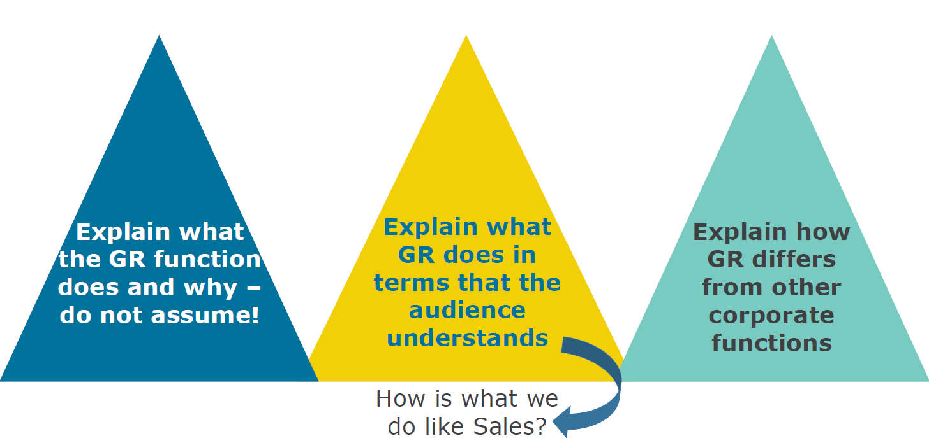
Communicating the Value (cont.’d)
PROVING GOVERNMENT RELATIONS VALUE IN DOLLARS AND CENTS
Notes:
You can think of these triangles as the pillars or key points when it comes to communicating the value of what you do.
You want to start with the basics → explain the role you play as a government relations professional, the work you do, and why it’s important. Do not assume they know! They have their own expertise, and you have yours. Why would you assume you know exactly what’s needed to work in accounting or communications – I myself don’t know the first thing about accounting! Maybe you do, and that’s great, but don’t assume that the person you’re trying to communicate with understand government relations. So, start with the basics.
You may be picking up on a theme here → in your explanation, think about and use language, terminology, examples, and/or framing that will make sense to the audience. Think about their perspective and how they see the world or what your organization does/the role they play into it → how do you fit in that perspective? How can you help them to see how you fit in that perspective?
You’ll also want to highlight how government relations differs from other functions in the organization. What about your work is unique (and by unique, indispensable)? Because that’s really the question you’re trying to answer here.

Slide 12
Communicating the Value (cont.’d)
Be concise when communicating with non-government relations colleagues:
Issue description
Significance to the organization
Action being taken
Be transparent about policy and government relations objectives, their degree of difficulty, and progress made toward achieving them – from start to finish.
The more non-government relations colleagues you engage with about your work, the more likely it is that your function’s value will be perceived.
PROVING GOVERNMENT RELATIONS VALUE IN DOLLARS AND CENTS
Notes:
All that being said, you don’t want to talk their ear off. Try to be as concise as possible.
You can pick an example of a political or policy issue you tackled or blocked. What was the significance of it to the organization? Why did you decide to take action, and what’s the action being taken? What’s one key takeaway you want this person to walk away from your conversation knowing?
It’s important to remember that the more non-government relations colleagues are engaged with and aware of your work, the more likely it is that your function’s value will be perceived.
You may not want to get your colleagues engaged on every issue, but you want to, strategically, have a way for them to know what you’re doing and why it’s important to the organization.
- But don’t oversell it – be honest and clear about your government relations objectives and goals, the likelihood of them happening, and where progress is being made. We know work in the government relations arena can take time and you don’t want people thinking things can change overnight (which, sometimes they can but we know the reality).

Slide 13
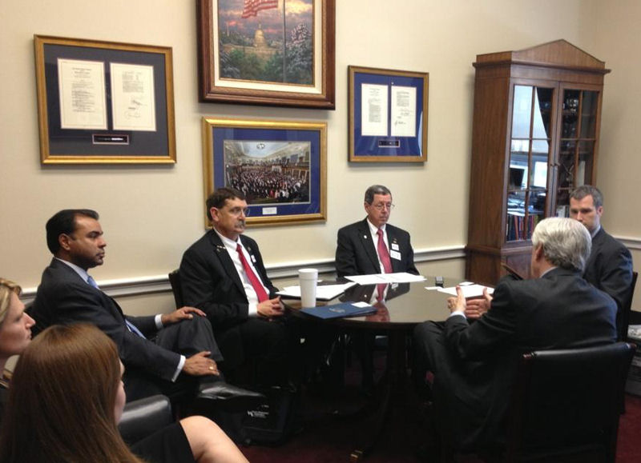
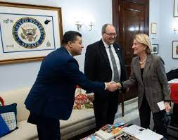
Communicating the Value (cont.’d)
When appropriate, engage internal stakeholders and leadership in your work → creates buy-in for your value.
PROVING GOVERNMENT RELATIONS VALUE IN DOLLARS AND CENTS
Notes:
Again, It’s important to remember that the more non-government relations colleagues are engaged with and aware of your work, the more likely it is that your functions value will be perceived.
You may not want to get your colleagues engaged on every issue, but you want to, strategically, have a way for them to know what you’re doing and why it’s important to the organization.
Do you want to activate your C-suite? vs. employee's writ-large on an issue? Used appropriately, both can be effective and creates and helps build buy-in for your function’s value.

Slide 14
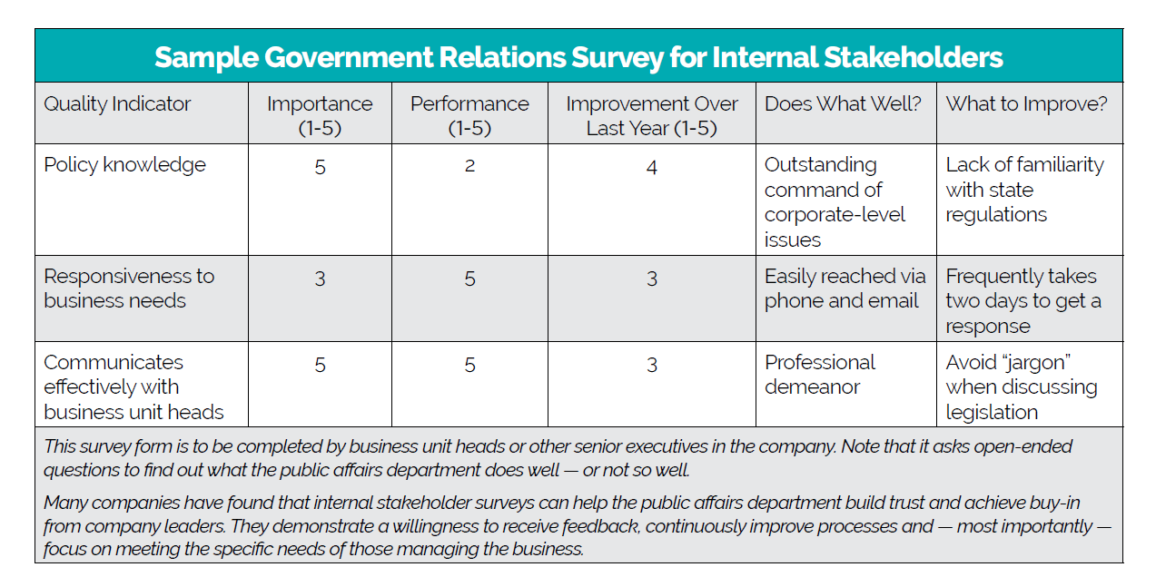
Communicating the Value (cont.’d)
PROVING GOVERNMENT RELATIONS VALUE IN DOLLARS AND CENTS
Notes:
This is an example of an internal government relations survey form that was used by an organization to gauge how others felt the government relations function was performing.
You can see the categories included policy knowledge, responsiveness to business needs, and if there was effective communication with business unit leads, as well as what the function does well in each and what could be improved on.
Surveys like this are helpful to simply garner feedback from others in your organization – it demonstrates a willingness for feedback and desire to improve where needed – and build trust and buy-in when it comes to your government relations function.
It also demonstrates for others that you’re focused on meeting the needs of those managing the business, which is absolutely a win.

Slide 15

Communicating the Value (cont.’d)
• Email
• Breaking news updates
• Weekly or monthly newsletter
• Company intranet
• Articles; social media posts
• Teams/Zoom meetings with internal partners
• Webinars for broader internal audiences
• In-person meetings
PROVING GOVERNMENT RELATIONS VALUE IN DOLLARS AND CENTS

Slide 16
Are These Public Affairs KPIs?
Example #1: An energy association recruits 10 organizations to join a coalition.
Example #2: A utility forms community advisory boards in cities and towns where services and facilities are being expanded.
Example #3: A tech company recruits a grassroots network of 100 employees who are prepared to respond to calls for action.
Example #4: Through digital advertising, a pharmaceutical company recruits a diverse group of 5,000 people to become champions for government support of bio-pharma research.
PROVING GOVERNMENT RELATIONS VALUE IN DOLLARS AND CENTS
Notes:
Many years ago, KPIS were not a thing.
KPI is an acronym for Key Performance Indicators.
In essence, KPIs are a specific activity or achievement based on an activity that is strongly correlated with positive results.
The same idea can be applied to public affairs work.
What would make the first example, on an energy company recruiting 10 organizations to join a coalition, an even stronger a KPI is that not only did you get 10 organizations to join, but its also that you got diverse stakeholders (if you’re energy or gas company, you got enviro groups to join). That shows real buy-in and will get attention because you don’t often see those groups joining together.
Example #2, of a tech company of 500 employees recruits a grassroots network of 100 employees – maybe that’s a KPI? I think it’s a “meh” KPI.
Example #4, the digital marketing one, is actually a real-life example. The pharmaceutical company successfully recruited academics, retired people, people with health care or engineering backgrounds, etc, people who had never been involved in advocacy before, the company asked them to engage, and it was huge. That’s a very big KPI.

Slide 17
Most Common Measurement Tools
Measurement Tool | When to Use It | Advantages
Objectives Achieved | Most companies use this tool in conjunction with other approaches. | Objectives can support company priorities such as easier market access, reduced costs or lower regulatory risk.
Internal Stakeholder Satisfaction | Companies with cultures that emphasize internal customer service, or in which business units' contract with public affairs, often use this tool. | Interaction creates opportunities for buy-in, feedback and collaboration with senior management.
PROVING GOVERNMENT RELATIONS VALUE IN DOLLARS AND CENTS
Notes:
- So now let's talk about some common measurement tools.
These come from a major survey we conduct every three years called the State of Corporate Public Affairs. The report is the most robust benchmarking study we conduct to our member companies – it has information on staffing trends, budgets, what functions are in the public affairs portfolio, how much of your budget is spent on consultants, and much more.
One of the things we look at in the report is measurement tools. Most companies use more than one tool.
First, we have Objectives Achieved – virtually everyone has some sort of metric that relates to objectives achieved.
If you use it in conjunction with other approaches, it shows that you are objective-focused. Folks in senior management will like that and it makes it easier to justify your other approaches.
Next, we have Internal Stakeholder Satisfaction as another common measurement tool.
If you have not recently asked the heads of business units and others in the company what you can do to help them, what are some of the obstacles they’re facing and how you can help – things like improving your business operating environment or eliminating unnecessary regulatory risk - ask them what their problems are (as people, we all love to talk about our problems!).
If you can help them – that’s a win! You’ve made a friend and ally.
There are different ways to go about it, but the general topic of Internal Stakeholder Satisfaction is a widely used approach.

Slide 18
Most Common Measurement Tools
Measurement Tool | When to Use It | Advantages
External Stakeholder Satisfaction | Major brands frequently conduct external polls. Some firms survey thought leaders to see if their voice is being heard on public policy matters. | Data are useful for benchmarking perceptions about the company’s influence and reputation with specific audiences.
Legislative Wins/Losses | This method is often used to evaluate government relations staff, but political gridlock can make it problematic. | Clear legislative goals provide clarity about success or failure of advocacy efforts.
PROVING GOVERNMENT RELATIONS VALUE IN DOLLARS AND CENTS
Notes:
- Next is External Stakeholder Satisfaction
Some CEOs care more about what others think about them, the company, or the brand (there may be very good reason for that – if there’s an ongoing recovery from a controversy or crisis, for instance). You want your name associated with positive things.
You’re going to want to benchmark for that and show improvement.
Polling has become easier to contract for. It’s still costly but there’s nothing like real numbers to show how you’re perceived. A lot of companies use “thought leader surveys” where they ask leaders in a given industry what they think of X company and how they’re perceived.
- The next most commonly used measurement tool is Legislative Wins and Losses.
We’ve talked about what that can look like – a bill advancing, stopping a bill from advancing; a Committee holding a hearing or not, and so on.
One of the tricky points with this tool is that a lot of the time, you don’t have clear wins and losses, you’re actually looking at interim victories, so that’s something to keep in mind.

Slide 19
Most Common Measurement Tools
Measurement Tool | When to Use It | Advantages
Costs Avoided/Reduced | Firms use this method to tally savings associated with actions taken to affect legislation, regulations or inefficient business practices. | This approach can be particularly effective in heavily regulated and data-driven companies.
Revenue Created | Firms use this method to track new revenue associated with efforts to improve market access or directly support the sales function. | Public affairs teams that work globally or in support of government sales often have opportunities to create revenue.
Return on Investment (ROI) | If accurate data exist to support costs reduced/avoided or revenue created, then this method can be extremely useful. | Senior management understands ROI. Much of the time, however, public affairs teams lack data to prove ROI.
PROVING GOVERNMENT RELATIONS VALUE IN DOLLARS AND CENTS
Notes:
Next, we have Costs Avoided and Reduced – If you can do this, GREAT. For companies, if you can show that you had a clear victory and here are the costs savings, that’s what this will look like.
- Again, its best if used in conjunction with other measurement methods.
The next measurement tool is looking at Revenue Created – If you’re dealing with market access, getting a new product out there or a product to be used for an additional or different purpose, that obviously helps the sales and marketing function, and you get credit (hopefully) for the revenue created.
Return on Investment (ROI) – ROI is probably the hardest measurement to achieve. If senior management is insisting on ROI, you need to diplomatically try and change the subject to something you can actually accomplish.
From an academic standpoint, true ROI is looking at total costs (supplies, office rent, salaries, benefits, dollars spent on advocacy, and more) and did you actually recover in both managing risk and cost savings and opening new markets to cover that cost every year.
Most of the time, you’re not going to do that. Over the long term, you might.
It may be that 5 years from now, an influential person who would have previously been on the other side of an important issue because they didn’t really understand your business, now understands your business and has decided that what you do is good for their constituents, good for the country, and so on, and they’re not going to oppose you (but you’re never going to capture those dollars).

Slide 20

Common Questions
What’s the most common misalignment between government relations reporting and C-suite expectations?
How do you handle data that undercuts your narrative?
PROVING GOVERNMENT RELATIONS VALUE IN DOLLARS AND CENTS
Notes:
[Read the question] – I think the most common misalignment between reporting expectations is just that – the expectations. Going back to the earlier point, you want to ensure that when you’re discussing the work you do and why it’s important, that you talk in the language of the C-suite. If they care about dollars and the bottom line, and don’t really care why a sign-on letter about an issue that’s important to your industry or organization matters, frame in in how that letter gets back to the bottom line. Connect the dots for them, don’t assume they know.
- [Read the question] – This continues the framing piece. If the data undercuts your narrative, how can you re-contextualize the data, or change the framing or the narrative? Stories change all the time, so how can you use the data you have to reframe that story, how can you think about it in a different way.

Slide 21

Common Questions (cont’d)
What can you do to build credibility with your C-suite or Board when it comes to measuring and communicating the value of your government relations efforts?
What makes what you’re sharing resonate with leadership?
PROVING GOVERNMENT RELATIONS VALUE IN DOLLARS AND CENTS
Notes:
[Read the question] – Don’t oversell it or over-promise!
Have the data to backup what you’re talking about
Show results, or the path to results and the progress you’re making along the way
Remember to speak their language
[Read the question] – Know what they care about and what your organization cares about.
Going back to the Value Proposition – what language, what phrasing that your organization uses can you replicate and repeat, to show your alignment? It’s like in school, when answering a written question – I was taught to repeat the phrasing used in the question in your answer to show you know exactly what you’re talking about.

Slide 22

Key Points to Remember
Having a measurement system benefits everyone.
It’s difficult — but not impossible — to measure government relations.
Metrics should serve as a way to track improvement.
Metrics should reflect a company’s culture and speak the language of management.
Metrics should focus on impacts and business goals.
PROVING GOVERNMENT RELATIONS VALUE IN DOLLARS AND CENTS
Notes:
To sum up:
Having a measurement system is not something you should fight; you should embrace it – in the long term, it will benefit you and the organization.
It can be difficult to measure government relations, but it’s not impossible (for all the reasons we’ve just discussed). Make sure to stay on the lookout for new approaches.
Metrics should track your improvement (and metrics should speak the language of your management and leadership).
Your metrics should focus on impacts and business goals.

Slide 23

For More Information
PROVING GOVERNMENT RELATIONS VALUE IN DOLLARS AND CENTS
Notes:
If you want to learn more measuring and communicating the value of public affairs, not just government relations, our Foundation for Public Affairs issued a report on this topic in 2023. It’s full of really interesting insights and information (and it’s free!). It’s available on our website but if you have any issues finding it, just let me know and I’m happy to send it to you.

Slide 24

Anna Platt Senior Manager, Government Relations Practice https://pac.org/ aplatt@pac.org
Contact Information
PROVING GOVERNMENT RELATIONS VALUE IN DOLLARS AND CENTS

