Slide 1
Communicating the Value of Advocacy
May 2026

Slide 2
Today’s Topic
The value of preventing harmful legislation/policies/budgets.
Demonstrating the investment necessary to achieve positive results, and why.

Slide 3
Government-mandated Nurse Staffing Ratios

Slide 4
What we did:
Had some luck—workforce shortage survey.
Intentional work—polling and member cost survey.
Provisional work—message testing and development.

Slide 5
Cost of Government Mandated Nurse Staffing Ratios
$1 billion for staff time and penalties.
Nursing workforce shortage:
  More than 8,000 in 2023.
  More than 4,700 in 2024.

Slide 6
Think it Through Campaign
Close 5,100 beds.
Increase wait times.
Expensive, unsustainable staffing solutions.
Let’s think this through…

Slide 7
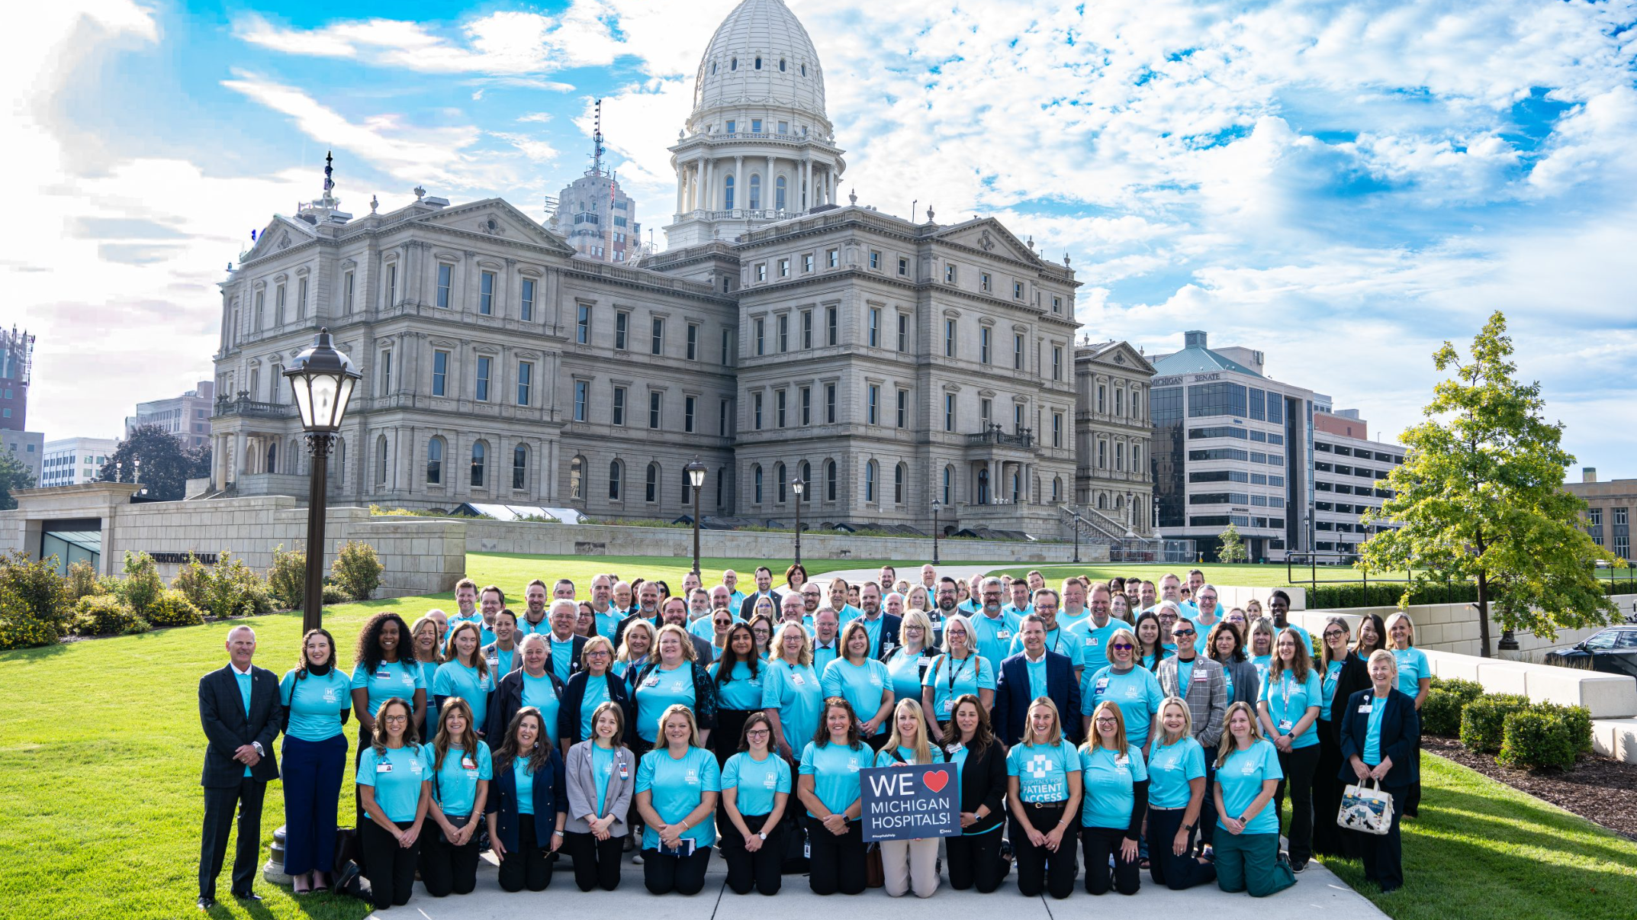

Slide 8
Medicaid State-Directed Payments

Slide 9
Achieving Improved Medicaid Funding
Recognized the opportunity early.
Connected with Michigan Medicaid Actuarial Division—marginal interest.
Contracted with independent actuary.
Assisted with application to CMS.
Early request for help from members of Congress.

Slide 10
Showing our work
More frequent messaging to MHA Board.
Follow-up with Medicaid staff—new investment v. what’s preserved.
Conversations with CEOs, CFOs, member Government Relations Officers.

Slide 11
Good Luck/Bad Luck
Significant appreciation from MHA board members.
New funding levels quickly became routine.
Some members haven’t recognized benefit.
Clear value of advocacy to achieve delay of Medicaid cuts in HR 1.

Slide 12
Laura Appel
Executive Vice President
lappel@mha.org
mha.org

