Slide 1

June 17, 2026
Proven Strategies for PAC Peer-to-Peer Campaigns
Monica Day

Slide 2
Agenda
Why peer-to-peer campaigns drive PAC fundraising and engagement
Key elements of a successful campaign strategy, including goals and metrics
Priority activities for launching and scaling your campaign
How to set realistic short – and long-term benchmarks for success
Proven Strategies for Peer-to Peer Campaigns

Slide 3

Power of Peer-to-Peer
Peer-to-peer solicitations signaled a stronger PAC. PACs using peer-to-peer solicitors raised more than those that didn’t.
Over 80% of PACs used peer-to-peer solicitations and 64% of PACs list it as one of the three most effective solicitation approaches
From the 2025 PAC Benchmarking Report
Proven Strategies for PAC-to-PAC Campaigns

Slide 4
Peer-to-Peer conversations connect the dots
Career
Company
Cause
Proven Strategies for Peer-to-Peer Campaigns

Slide 5
Corporate PAC use of Peer-to-Peer
From the 2025 Corporate PAC Benchmarking Report
Proven Strategies for PAC Peer-to-Peer Campaigns

Slide 6
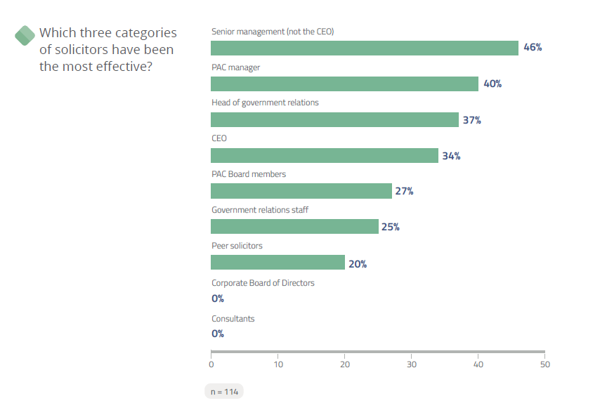
Corporate PAC use of Peer-to-Peer
From the 2025 Corporate PAC Benchmarking Report
Proven Strategies for PAC Peer-to-Peer Campaigns

Slide 7
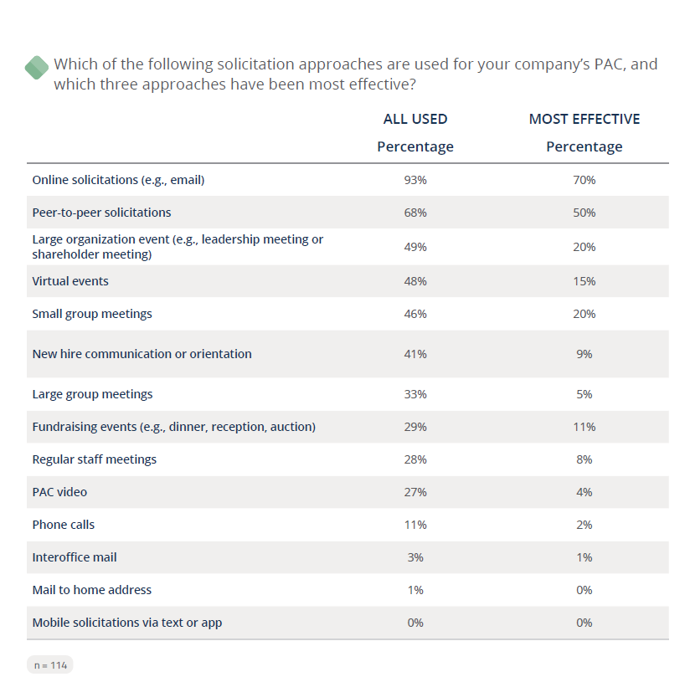
Corporate PAC use of Peer-to-Peer
From the 2025 Corporate PAC Benchmarking Report
Proven Strategies for PAC Peer-to-Peer Campaigns

Slide 8
Corporate PAC use of Peer-to-Peer
From the 2025 Corporate PAC Benchmarking Report
Proven Strategies for PAC Peer-to-Peer Campaigns

Slide 9
Association PAC use of Peer-to-Peer
From the 2025 Association PAC Benchmarking Report
Proven Strategies for PAC Peer-to-Peer Campaigns

Slide 10
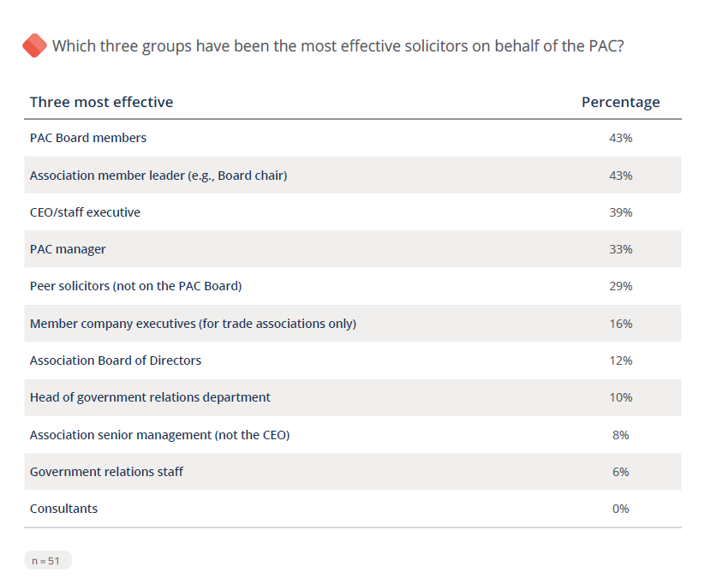
Association PAC use of Peer-to-Peer
From the 2025 Association PAC Benchmarking Report
Proven Strategies for PAC Peer-to-Peer Campaigns

Slide 11
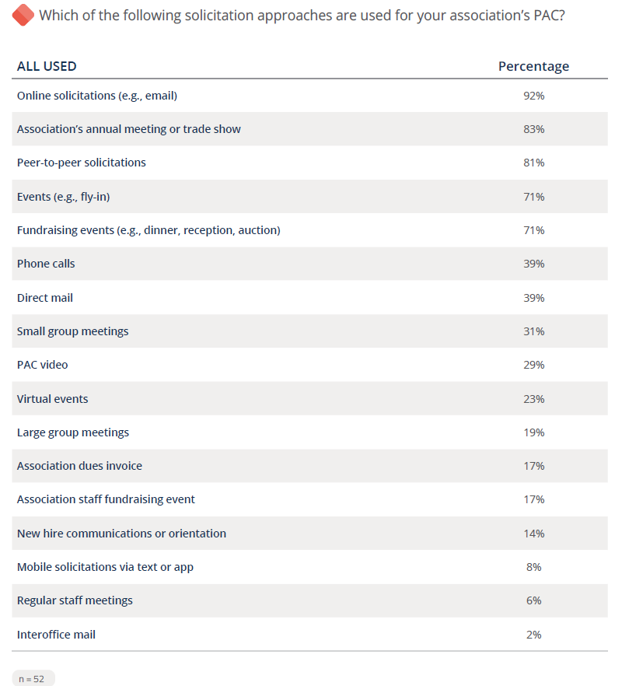
Association PAC use of Peer-to-Peer
From the 2025 Association PAC Benchmarking Report
Proven Strategies for PAC Peer-to-Peer Campaigns

Slide 12
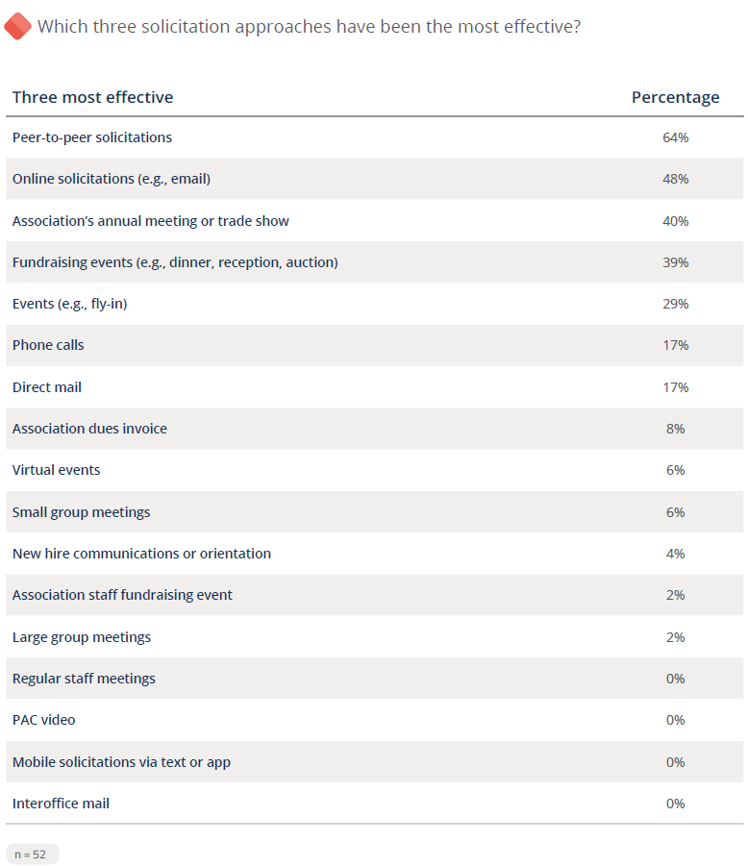
Association PAC use of Peer-to-Peer
From the 2025 Association PAC Benchmarking Report
Proven Strategies for PAC Peer-to-Peer Campaigns

Slide 13

Establishing a Peer-to-Peer Program
Step 1: Gather your information
Before recruiting peer champions, build a strong foundation by understanding your PAC's current landscape.
Know Your Opportunity: Compare the number of eligible employees to current PAC contributors. Which groups have the greatest untapped potential for growth?
Understand Giving Trends: Review average contribution levels and participation rates. This data will help you set goals that are both ambitious and achievable.
Take the Pulse of Your PAC: Assess employee perceptions and attitudes toward the PAC through observations, conversations, and surveys. Understanding common questions, motivations, and concerns will help you better equip peer solicitors for success.
Proven Strategies for PAC Peer-to-Peer Campaigns

Slide 14
Establishing a Peer-to-Peer Program
Step 2: Start at the Top
Strong peer-to-peer programs begin with strong leadership support.
Identify Your Champion: Recruit a visible advocate—such as a board member, CEO, senior leader, PAC chair, or current contributor—to lead by example.
Secure Leadership Buy-In: Active support from leadership helps build credibility, generate excitement, and sustain momentum throughout the campaign.
Define the Ask: Be clear about how leaders can help, whether it's hosting a kickoff event, identifying peer champions, sending introductory communications, or encouraging participation across their teams.
Proven Strategies for PAC Peer-to-Peer Campaigns

Slide 15
Establishing a Peer-to-Peer Program
Step 3: Recruit the Right People
Your best ambassadors aren't always the loudest—they're the ones others trust and follow.
Look for Influencers: Identify employees and members who are respected by their peers and lead by example.
Find the Go-Getters: Seek out individuals who are proactive, enthusiastic, and willing to take initiative.
Leverage Connections: Recruit friendly, well-connected team members who can engage colleagues across departments and networks.
Choose Persistent Champions: The most effective peer solicitors are motivated, resilient, and committed to helping the PAC succeed.
Proven Strategies for PAC Peer-to-Peer Campaigns

Slide 16
Establishing a Peer-to-Peer Program
Step 4: Find the Motivation
Keep your ambassadors energized by tapping into what inspires action.
Spark Friendly Competition: Use team goals, leaderboards, or challenges to build excitement and momentum.
Offer Meaningful Incentives: Recognize participation with small rewards, special access, or other perks that feel personal and fun.
Create Opportunities: Give ambassadors chances to lead, connect, and make a visible impact.
Say Thank You Often: A handwritten note, public shoutout, or personal thank-you can go a long way in keeping champions engaged.
Proven Strategies for PAC Peer-to-Peer Campaigns

Slide 17
Establishing a Peer-to-Peer Program
Step 5: Equip, Launch, and Track Success
Give your ambassadors the knowledge, confidence, and structure they need to succeed.
Train for Success: Cover PAC rules, key issues, effective fundraising techniques, public speaking tips, and how to handle tough questions.
Practice the Pitch: Help ambassadors feel comfortable sharing the PAC story and making the ask with confidence.
Set Clear Goals: Establish a timeline, define success metrics, and create a plan to keep the campaign moving forward.
Track Progress: Check in regularly, monitor results, and maintain a system for follow-up and accountability.
Stay Flexible: Be ready to answer questions, celebrate wins, and adjust your strategy as you learn what works best.
Proven Strategies for PAC Peer-to-Peer Campaigns

Slide 18

Questions?
Proven Strategies for PAC Peer-to Peer Campaigns

