Slide 1



Public Affairs in Africa
The Southern African Dimensions
Public Affairs Council Webinar, 28 May 2026
Abdul Waheed Patel, CEO
info@ethicoregroup.com
ethicoregroup.com

Slide 2

Opening Context
Opening context
Understanding Localised, Politically Sensitive, and Context-Driven Engagement

Slide 3




Premise
Public Affairs is
not universal
Global frameworks are not immediately translatable
Distinct market realities.

Slide 4
The Problem of Imported Frameworks
The Lens
EMEA constructs approach African public affairs through Anglo-EU-Western centric frameworks.
The Cookie Cutter
Expectations of public affairs execution to function uniformly across jurisdictions.
Market learning curve
Resultant early learning curve when entering African and Southern African markets.
Similar challenges. Differentiated solutions.
Challenges appear similar globally, but the required strategies, tactics and support are
not.

Slide 5
Political Fluency
Transcends understanding legislation or policy documents.
Requires understanding institutional, stakeholder and political power
relations, motivations, sensitivities and opacity.
Each market contains unique governance traditions and decision-making processes.
Strategic engagement requires navigating both visible and invisible political realities.

Slide 6


The Africa shift
Sub-Saharan Africa public affairs paradigms

Slide 7

Sub-Saharan Africa
40+ distinct public affairs, socio-cultural, political and economic environments
governance and electoral systems
institutional maturity
regulatory cultures
political histories
languages
media ecosystems
civil society constructs
state-private dynamics

Slide 8
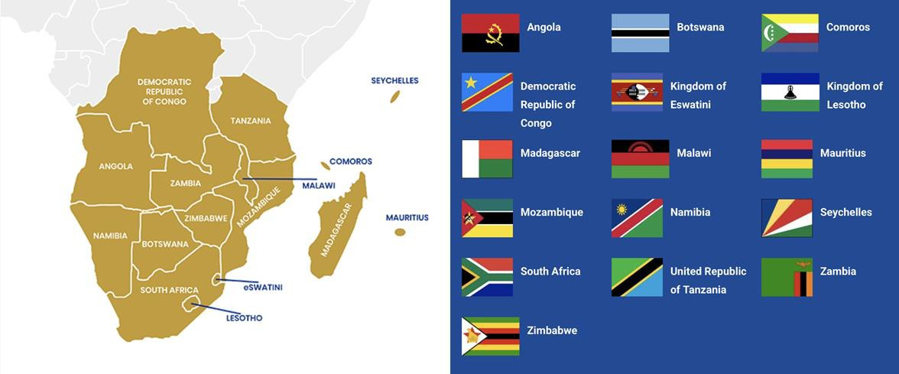
Southern-Africa
10 – 16 countries depending on statistical and geographical definitions
Source: Southern African Development Community Secretariat

Slide 9
Rising Regulatory Assertiveness
digital governance
competition policy data sovereignty taxation
labour standards platform regulation ESG accountability industrial policy
local economic participation

Slide 10

Key Challenges

Slide 11



The ‘Helicopter’ Approach Challenge
African governments and institutions are rarely receptive to transactional engagement only.
Short-term interventions risks securing enduring local commitment.
Sustainable stakeholder and institutional cultivation and after-care remains central to effective public affairs.
Markets expect engagement beyond crisis, cycles, moments, events and outside-purely commercial interests.

Slide 12
Correcting Misconceptions
African markets are procedurally flexible or informal.
Public affairs processes and institutional methodologies do exist — even when unfamiliar to external actors.
Professional public affairs’ role is translating and contextualising these systems for clients.
Clients often mistake unfamiliarity for absence of process.

Slide 13
Three Key Challenges
1. Assuming the domino effect and adoption of external global standards
2. Managing remote global principals directing African market strategies from abroad.
3. Over-reliance on peer-to-peer government comparisons + underappreciation of political and institutional diversity within sub-regions nationally or regionally without contextual location

Slide 14

Conclusion
Best Practice Principles, Lessons and
Insights

Slide 15

Key Best Practice Principles
01
Pre-execution mandate due diligence.
02
Prioritising contextual assessments.
03
Providing realistic expectations — no guarantees or quick wins.
04
Exercising caution on success-fee models and perceptions of trading access as a service.

Slide 16
Lessons from Experience
Advisor First. Executer Second.
We position ourselves as trusted advisors before implementers.
Clients receive strategic counsel, not simply execution services.
We provide risk-based advice, even when it challenges client assumptions.
Professional integrity requires advising against unsuitable approaches where necessary, at the cost of short-term unsustainable wins.

Slide 17
Actionable Insights
01
Local political realities cannot be substituted with imported assumptions.
02
Long-term trust, institutional understanding, and strategic counsel remain essential.
03
Public affairs success in Africa is driven by localisation, not replication.

Slide 18

Thank You…

