Slide 1
Recruiting and Activating Peer Champions
Public Affairs Council
June Pennell
June 17, 2026

Slide 2

Purpose and Values

Slide 3
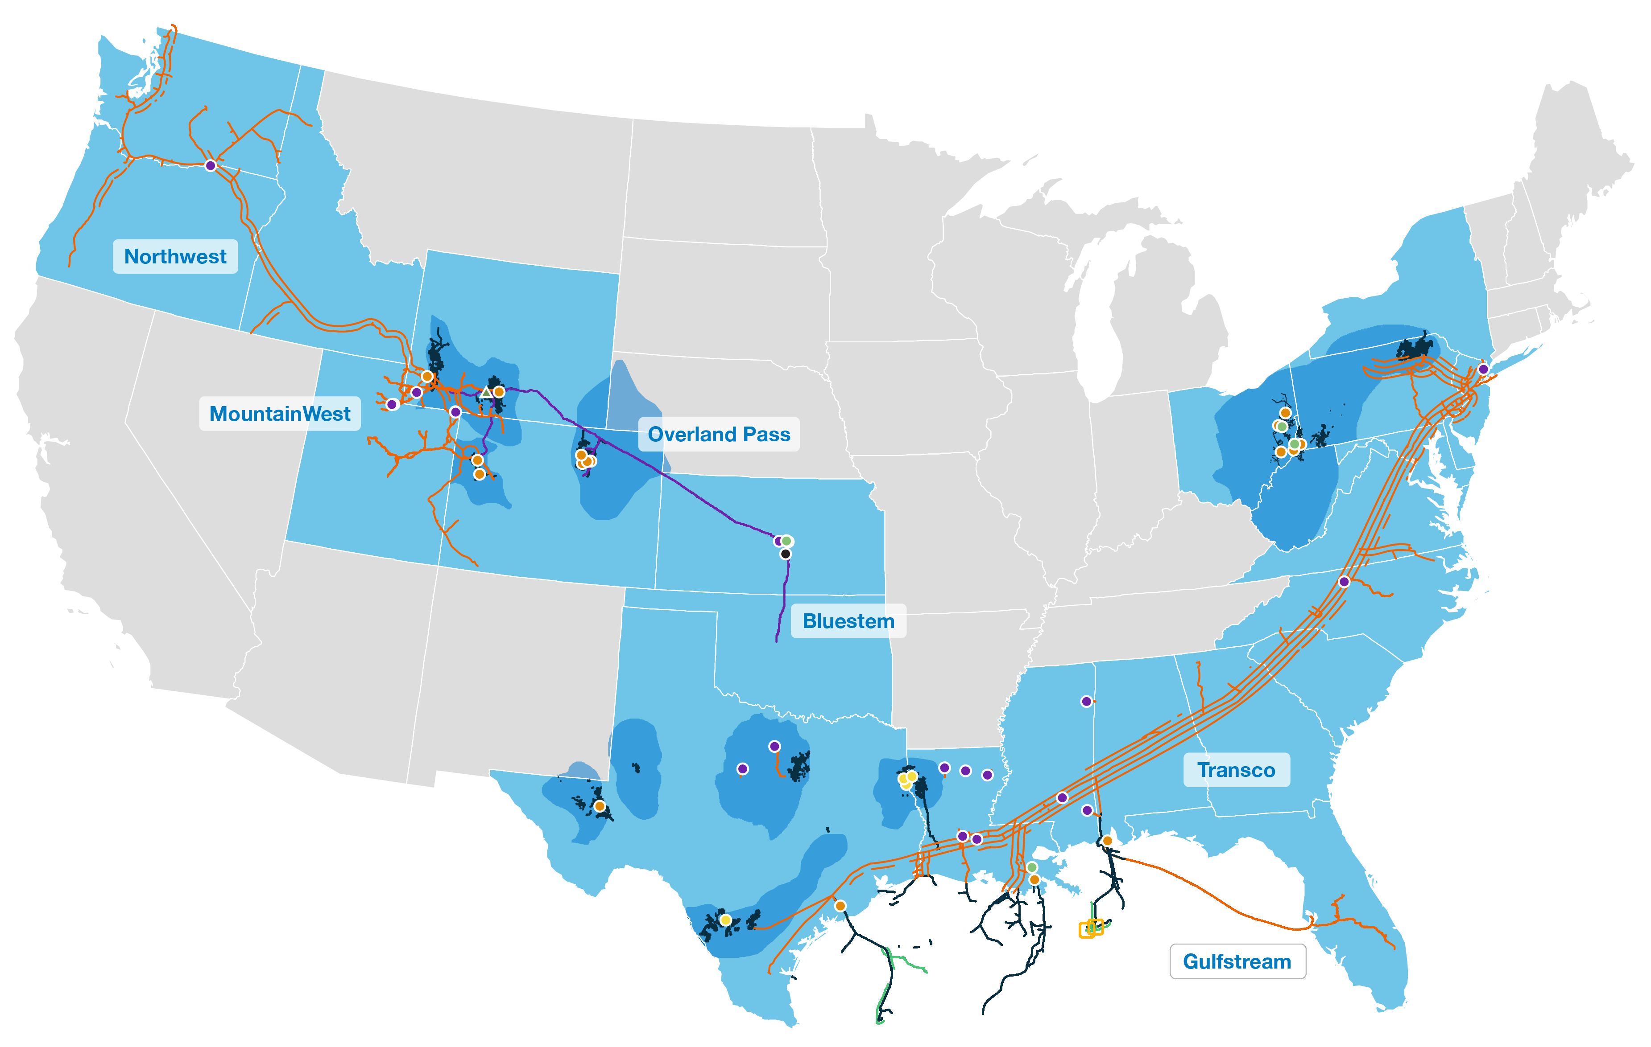
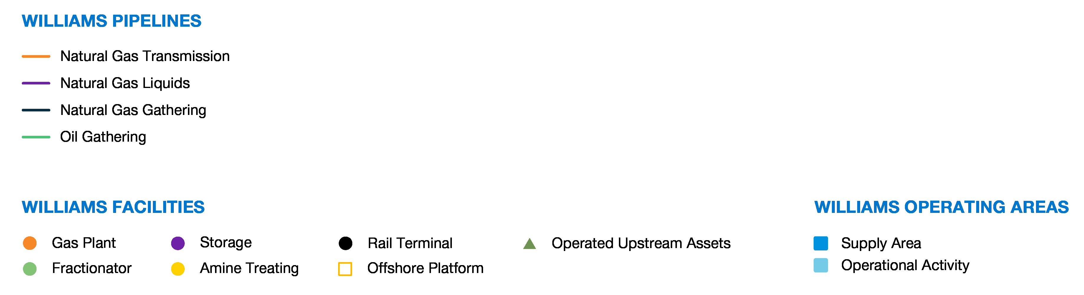

Slide 4
Our PAC Profile

Slide 5

The WILLCO PAC
Our PAC is led by an advisory board comprised of employees who are passionate about our company and its public policy voice.
Eligible Class
4699
Participation
857
18.2%
Board of Directors
100%
Max out annually
C-Suite & VPs
100%
C-Suite all give at the recommended level
Source:

Slide 6
Recruiting and Activating Peer Champions

Slide 7
Ongoing Success
Communicate (Long-term Champions)
Who did you speak with most?
Who was the most positive?
Who wants to keep going?
Recruitment
Have a plan
Have Leadership identify Champions
Fill in the gaps
Follow up
Call Champions
Track each Champion’s progress
Communicate
Their role
Timelines & goals
Communicate
Provide updates
Give shout outs!
Be a shoulder to lean on
Train
Compliance
Be honest
Be a resource

Slide 8
Peer-to-Peer Works

Slide 9
Receipt Growth
Source: Federal Election Commission

Slide 10
Questions?

