Slide 1

Impactful
PAC Content
Workshop
Cody Schoonover
Stephanie Sheridan

Slide 2
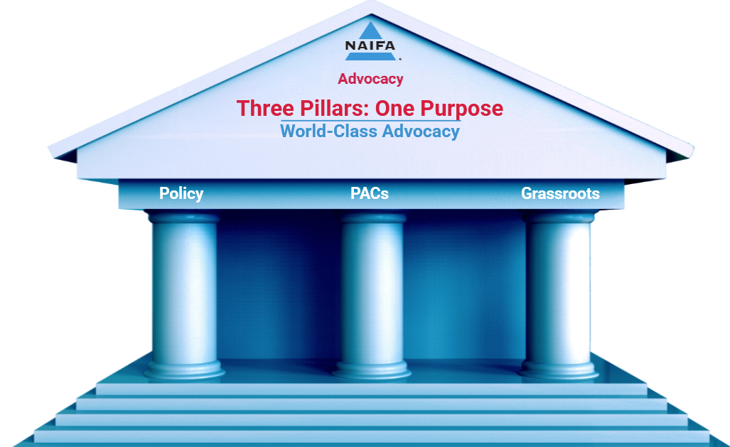
National Association of Insurance and Political Advisors (NAIFA) PACs
Founded in 1890, NAIFA is the leading association for financial professionals in the United States.
NAIFA’s PACs were established in 1966 with the creation of the Life Underwriters Political Action Committee (LUPAC), eventually rebranded to NAIFAPAC on the federal level and our state PACs, Insurance and Financial Advisors Political Action Committees (IFAPACs) for every state and Washington, D.C.
Notes:
NAIFA Federation -
NAIFA's first success story for engaging our members to educate lawmakers goes all the way back to 1914 where NAIFA members met with President Wilson and a few days later the favorable tax treatment of retirement products was saved. This began NAIFA's legacy of world class advocacy.
So it is only natural that NAIFA be amoung the first few associations whose Board voted to start not only a federal PAC LuPAC now NAIFAPAC but a system of state IFAPACs and one in the District. NAIFA members recognize it takes an large base of citizen advocates who support and educate lawmakers coupled , professional lobbing to truly provide a world class expierence.

Slide 3

Annual PAC Strategy
NAIFA’s annual fundraising strategy breaks the year into quarters and relies on our volunteer members to assist in our campaigns.
Q1: Annual increase and new contributor focus – March Madness
Q2: Fly-In Season – Members focus on lapsed contributors and annual increases + driving engagement for NAIFA’s Congressional Conference
Q3: Summer Check-in – Members are encouraged to meet their elected officials in-district during Congress’ summer recess; national summer solicitation campaign
Q4: Lapsed Contributor and annual increase focus. If an election year, Congressional turnover drives PAC solicitation strategy.
Notes:
Unlike other places we fundraise top down.

Slide 4
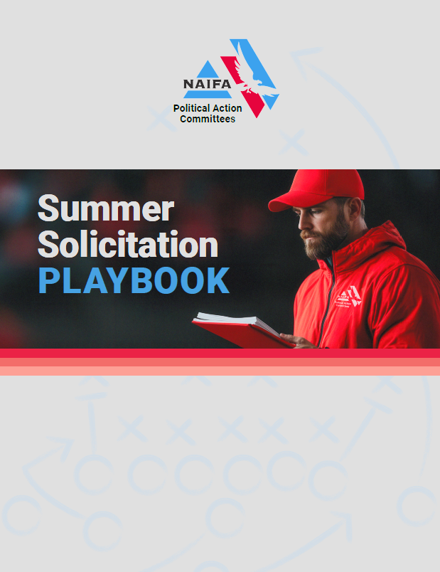
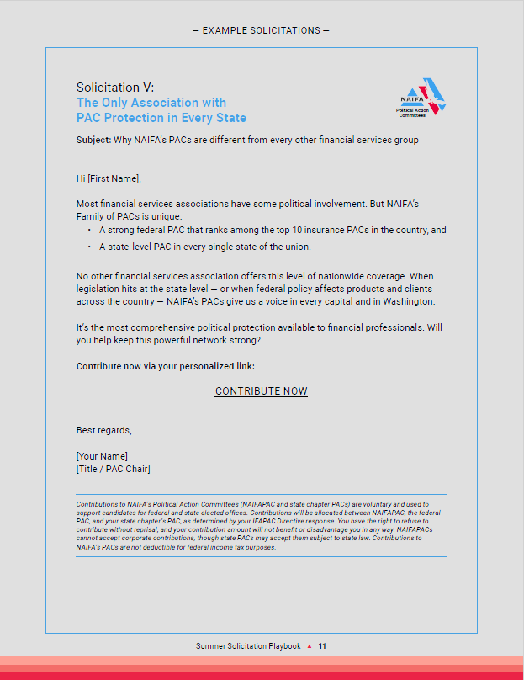
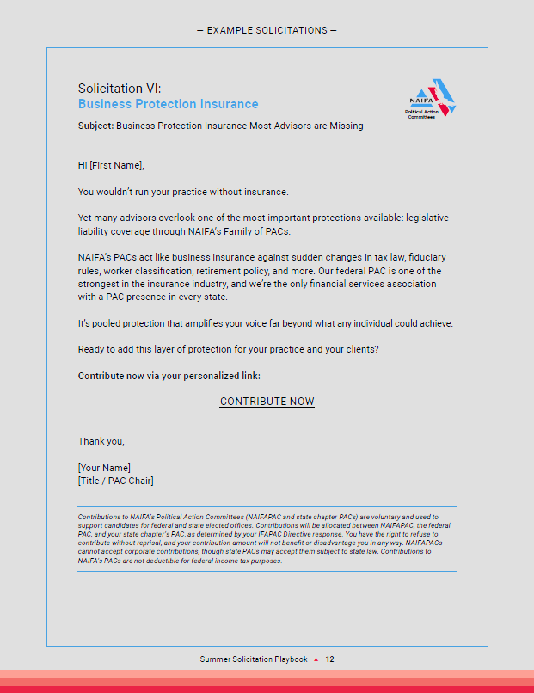
PAC Campaign Strategy
Notes:
Transititon SLide
Part of strategy is relying on our Chapter Chairs to be our feet on the ground. So Cody has devised this awesome guide for solicitaitng our members feed them what

Slide 5
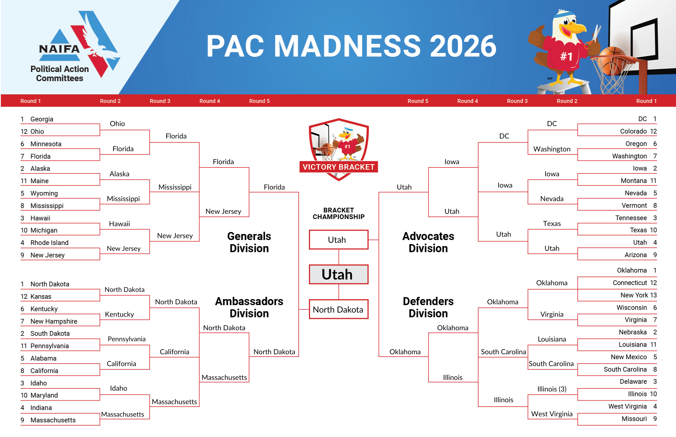
PAC Madness: How it works
Campaign begins in March, lasting until mid-April.
Chapters are divided into four divisions based on performance in the previous year’s campaign.
Round lasts one week, beginning on Tuesdays and ending the following Monday.
Double Elimination Game – The goal is to give chapters as much incentive as possible to raise PAC dollars; chapters who are knocked out of their first game drop into a second bracket.
Notes:
Inter-department cooperation – needed to compile a planning document/explainer for communications.

Slide 6
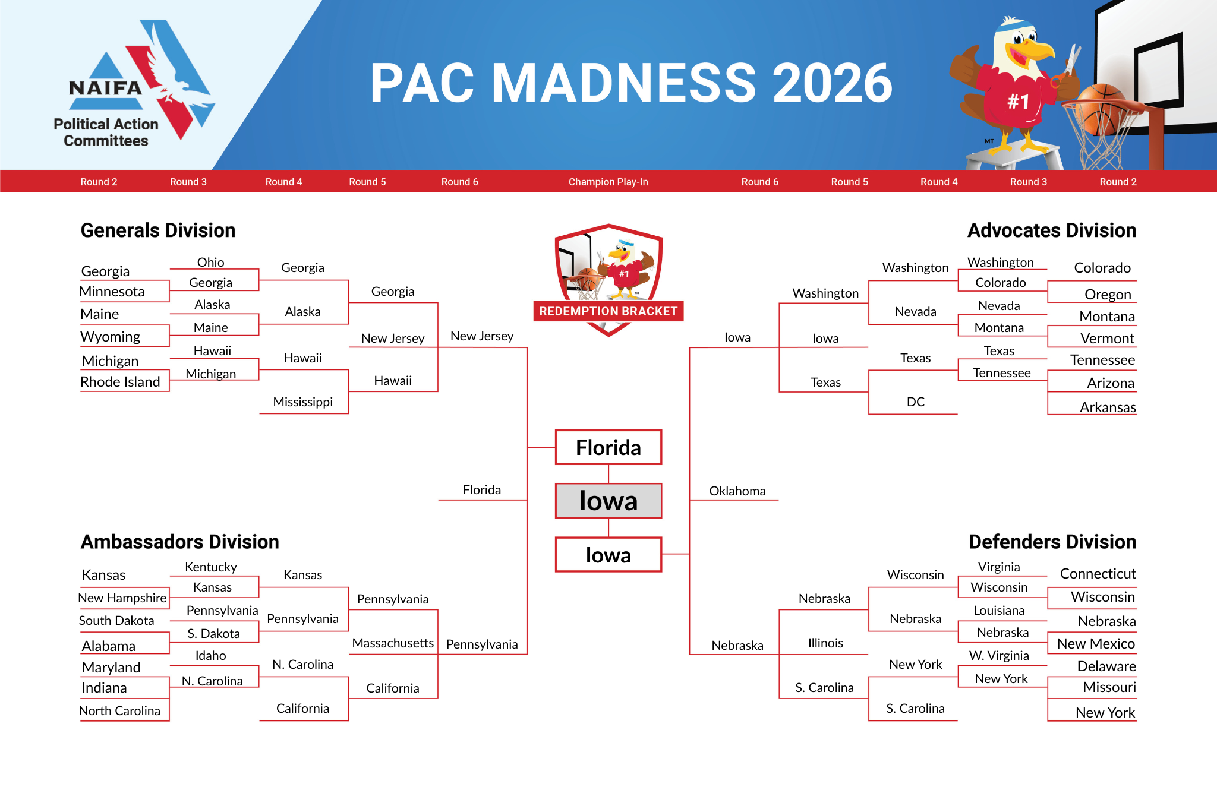
PAC Madness: How it works
Scoring:
  Every $30 raised = 1 point
  New Contributor = 10 points
  Returning Lapsed Contributor = 5 points
Scores are tabulated on Mondays, posted, and solicitations with round updates are set to send Tuesday AM
The winning chapter(s) and PAC volunteers are recognized in-person at NAIFA’s annual Fly-In.

Slide 7
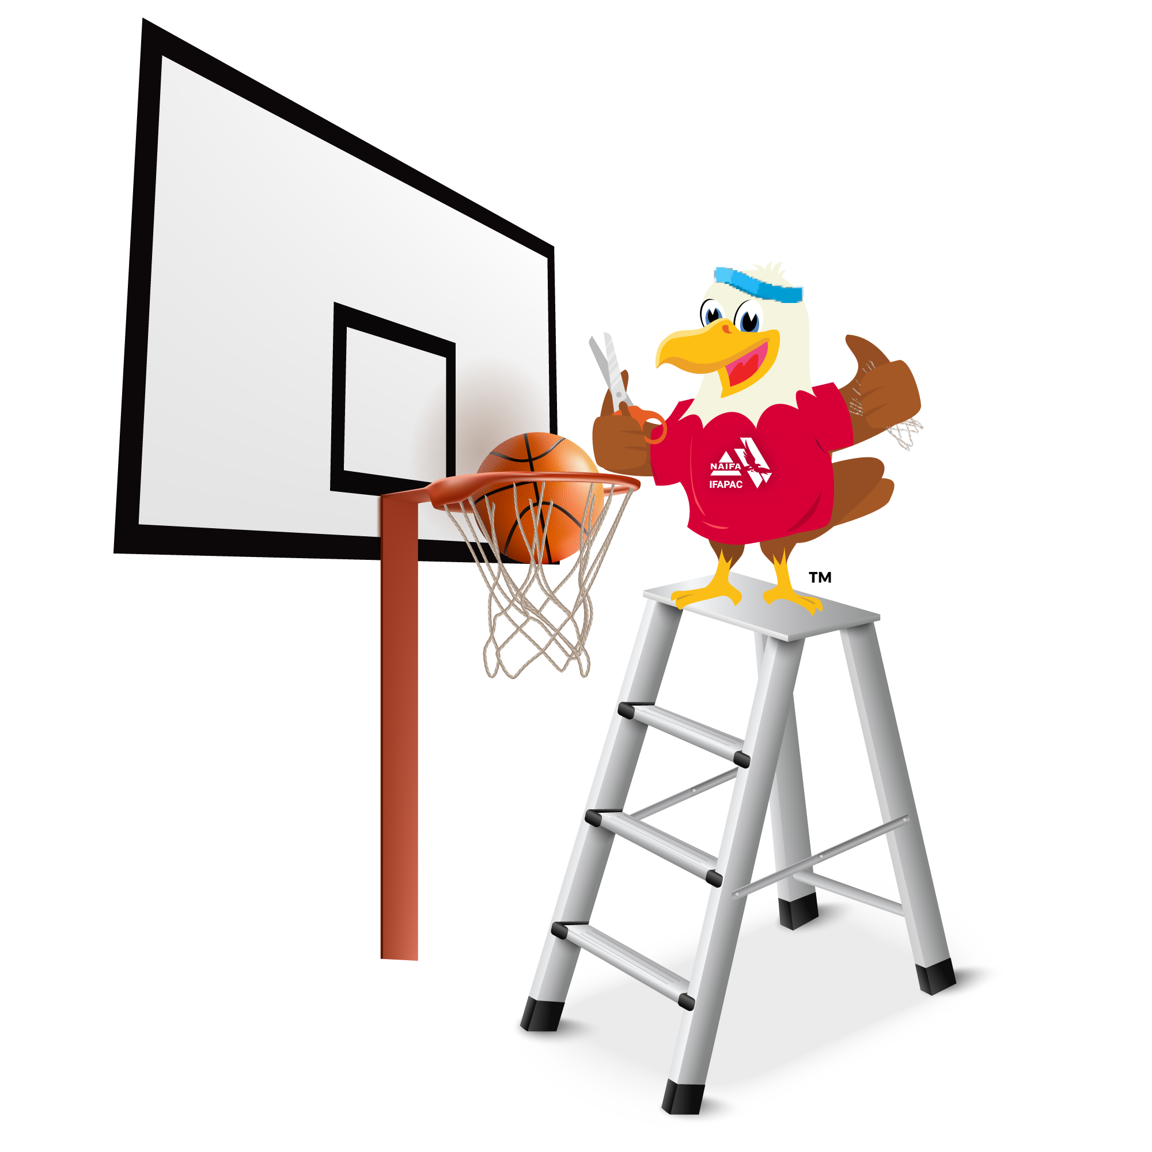
PAC Madness 2026
2026’s PAC Madness raised $142,300 .
  2025: $130,800.
  2024: $110,000.
What’s different this year?
  2024 and 2025 campaigns were conducted based on which chapter could secure the most dollars, 2026 saw a focus on new/lapsed contributors.
  Left alone, NAIFA’s PACs will see about 40 new contributors per year, PAC Madness’ new contributor emphasis saw 80 new contributors in a month
Notes:
86 new contributors and 85 lapsed

Slide 8
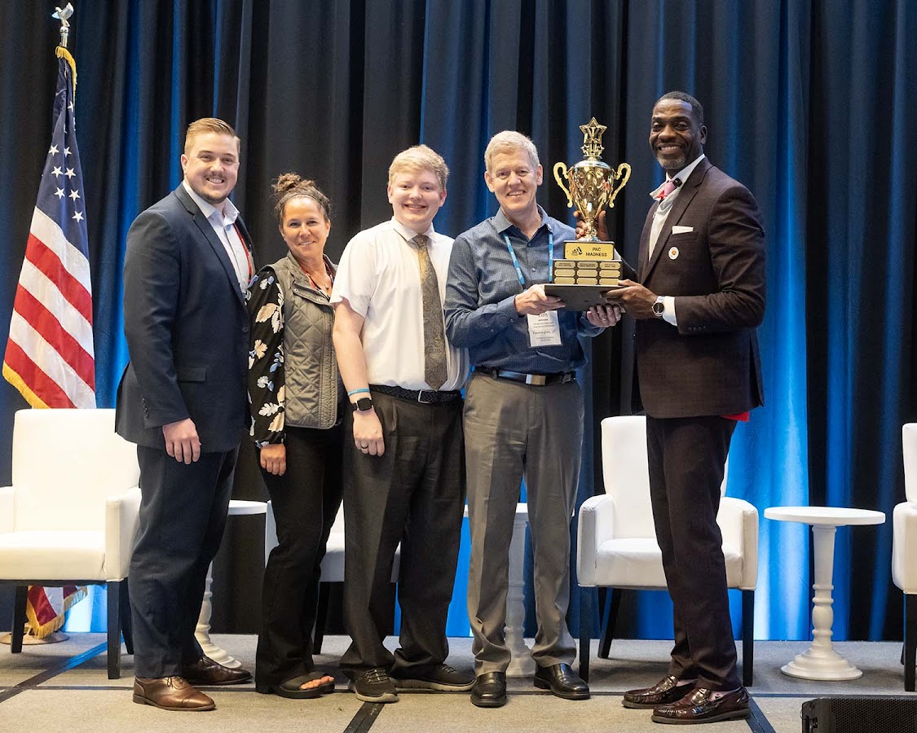
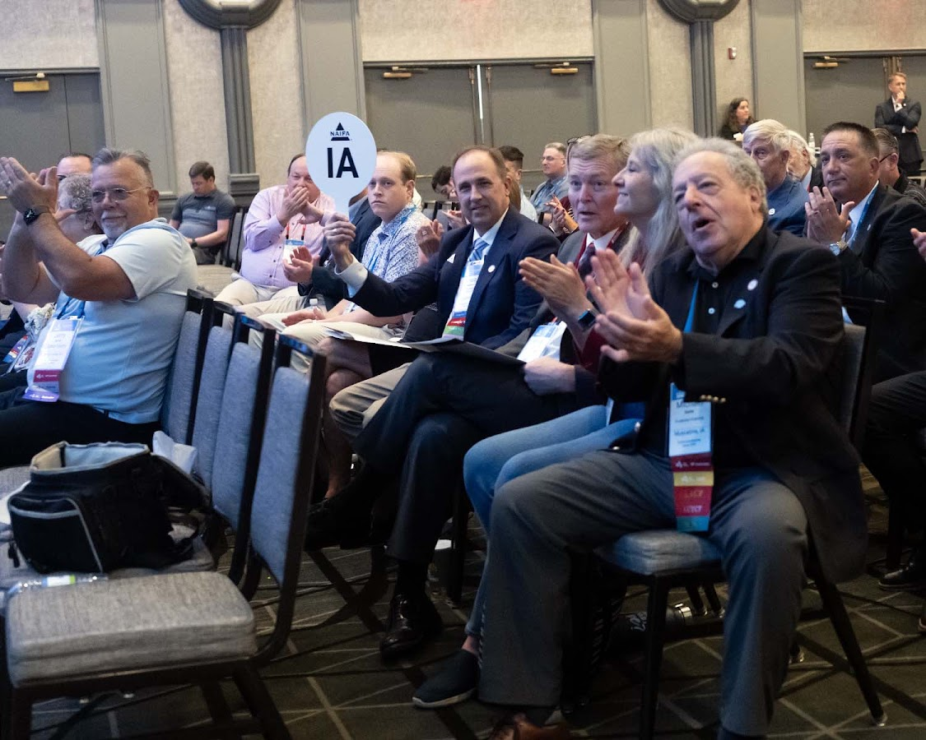
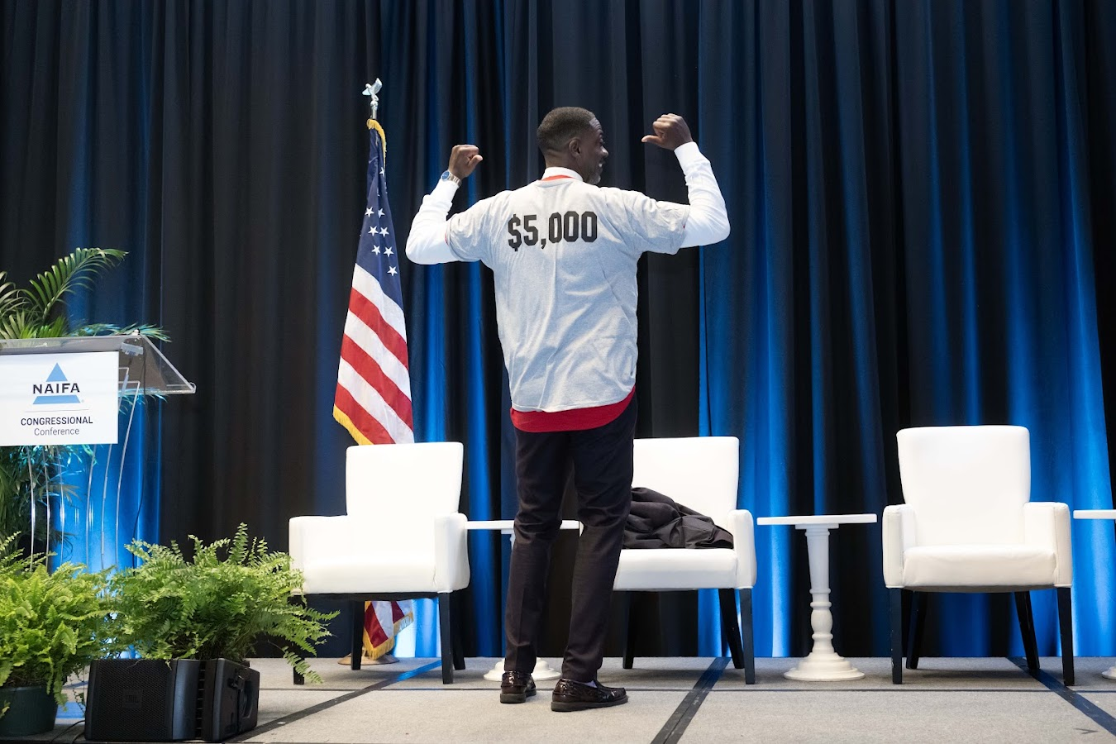
PAC In-Person
NAIFA’s Congressional Conference
  Annual Fly-In & PAC Fundraising Opportunity
National Leadership Conference
  Educate volunteer members on PAC’s importance
Notes:
CC – Terry Headley
NLC – Joint Chiefs 100K
Leaders leading from the front – world class
Use PAC to help – Dianes new intiative with Jayne name

Slide 9
