Slide 1

August 24, 2021
Membership Orientation

Slide 2

Today’s Agenda
Introduction
  Who we are
Resources and Services
  Executive Education
  Expertise
  Community
How to get involved
MEMBERSHIP ORIENTATION

Slide 3
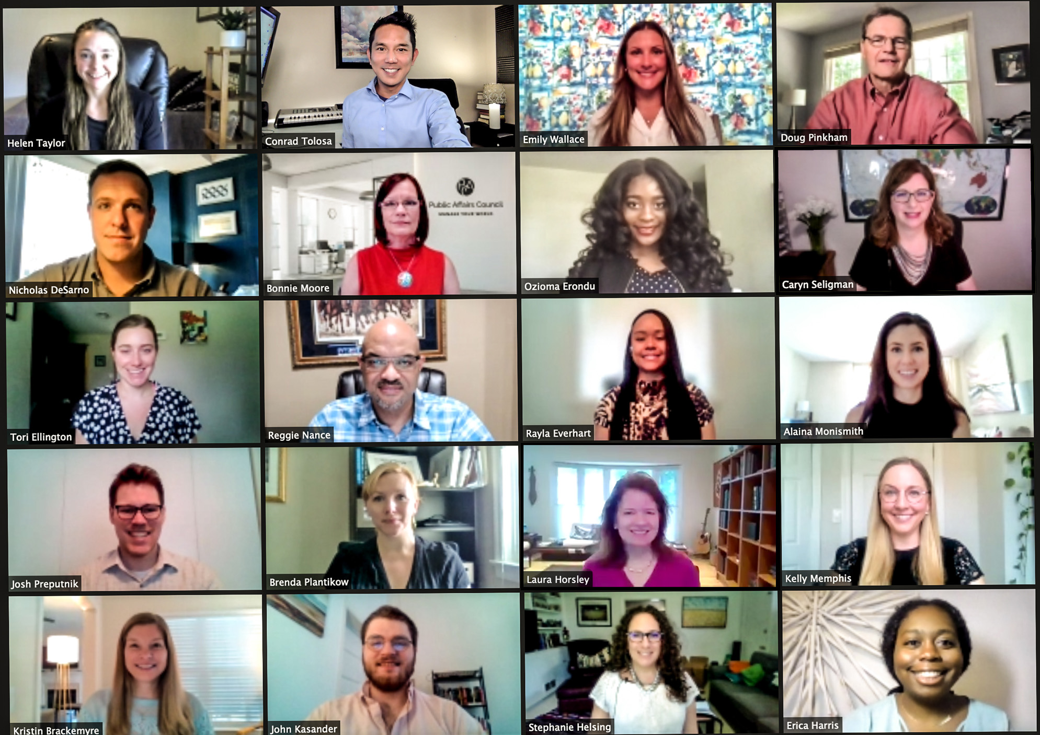
Public Affairs Council Profile
11,000 PUBLIC AFFAIRS PROFESSIONALS
700+ MEMBER ORGANIZATIONS
7 OF THE FORTUNE TOP 10 COMPANIES
HEADQUARTERS IN Washington & Brussels
MEMBERS FROM MORE THAN 25 countries
MEMBERSHIP ORIENTATION

Slide 4















You’re in Good Company
MEMBERSHIP ORIENTATION

Slide 5
A Diverse Community
MEMBERSHIP ORIENTATION

Slide 6



Where are Your Peers?
United States (Non-DC) 52%
DC Area
35%
International
13%
MEMBERSHIP ORIENTATION

Slide 7

Manage Your World
MEMBERSHIP ORIENTATION

Slide 8


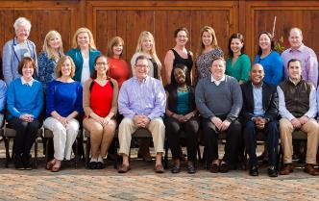

Membership Benefits
Executive Education
Expertise
Community
MEMBERSHIP ORIENTATION

Slide 9

I. Executive Education
MEMBERSHIP ORIENTATION

Slide 10
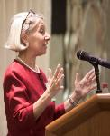





Hallmarks of Council Events
Peer-to-peer learning
Unparalleled networking opportunities
Practical advice you can implement immediately
Benchmarking opportunities with best in class
Resource materials to continue your learning
MEMBERSHIP ORIENTATION

Slide 11
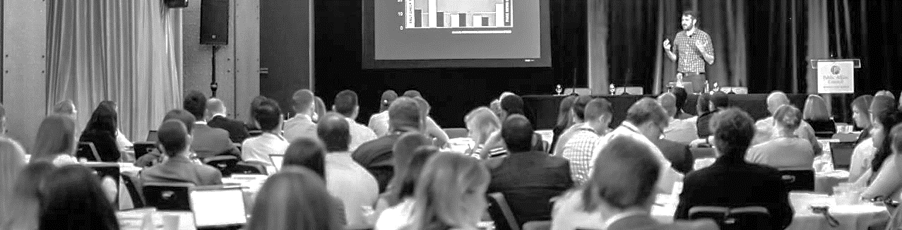
Signature Events
The Advocacy Conference
National PAC Conference
Digital Media & Advocacy Summit
State & Local Government Relations Conference
Spring Executive Meeting
Public Affairs Institute
MEMBERSHIP ORIENTATION

Slide 12

60+ Free Webinars (& Recordings) for Members
www.pac.org/webinars
Building and Managing Diverse Global Teams
Proving the Value of State Government Relations
Leveraging Employee Resource Groups for Internal Progress
PAC Charitable Match Programs
Managing Up: Leadership Skills for Any Level
MEMBERSHIP ORIENTATION

Slide 13

Certificate Programs
PAC & Grassroots Management
Government Relations & Lobbying
Public Affairs Management
MEMBERSHIP ORIENTATION

Slide 14

II. Expertise
MEMBERSHIP ORIENTATION

Slide 15
Knowledge Areas
Government relations strategy & management
Grassroots & ally development
PACs & campaign finance
Communications
Digital & social media
Issues management
Corporate social responsibility
Global public affairs
Legal & ethics compliance
Measurement & evaluation
MEMBERSHIP ORIENTATION

Slide 16
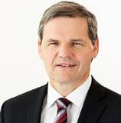







Staff Experts
Doug Pinkham
Andras Baneth
Kristin Brackemyre
Erica Harris
Tori Ellington
Nick DeSarno
Kelly Memphis
João Sousa
MEMBERSHIP ORIENTATION

Slide 17


Stride: A Social Impact Summit
November 9, 2021
Virtual

Slide 18

Questions We Can Answer
MEMBERSHIP ORIENTATION
Notes:
What’s the benchmark for average PAC participation and giving rates?
How can we use visual storytelling for advocacy?
What are best practices for integrating social responsibility and public affairs programs?
How can I create and implement a global public affairs plan?
Can you recommend speakers for our Washington fly in?
How can I optimize and effectively report on our digital advocacy efforts?

Slide 19

Guest Speakers for Your Meetings
MEMBERSHIP ORIENTATION
Notes:
Corporate Public Affairs Best Practices
Effectively Using Social Media for Public Affairs
Public Affairs and Corporate Citizenship: Finding Common Ground
Best Practices in PAC Fundraising and Communications
The Five Pillars of Grassroots
Considerations for Staffing a Global Function
Strategic Planning for a Public Affairs Team

Slide 20

Legal Guidance
Prominent election law attorney,
Ken Gross, is available to members for legal advice on federal & state issues:
  PAC & campaign finance
  Lobbying registration (including grassroots)
  Ethics laws
MEMBERSHIP ORIENTATION

Slide 21

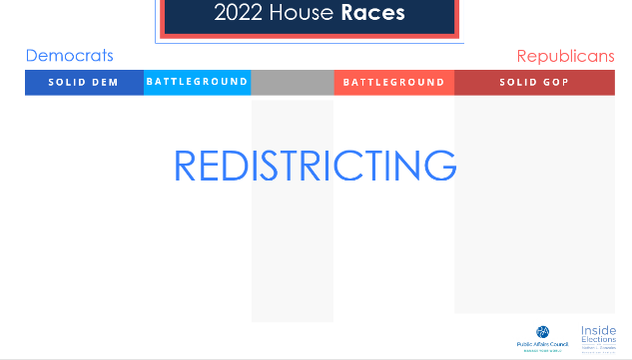

Political Intelligence from Inside Elections
Nathan Gonzales
Editor & Publisher
Inside Elections
MEMBERSHIP ORIENTATION
Notes:
The Public Affairs Council in partnership with Nathan Gonzales, editor and publisher of Inside Elections, is excited to share with you slide decks of Nathan’s election analyses. Updated quarterly, the slides will analyze changes and trends in the political environment to help you develop strategy and navigate your organization’s political involvement. As a member, you can incorporate these exclusive slides and insights into your presentations and projects.

Slide 22

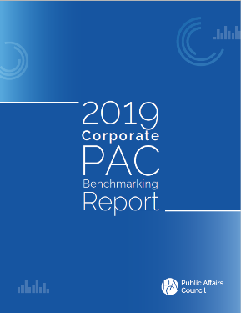
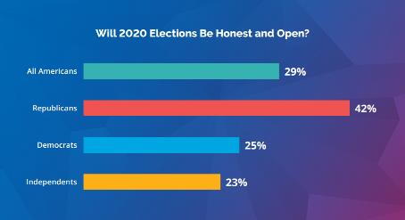
Research & Benchmarking
Visit pac.org/publications for complete list
MEMBERSHIP ORIENTATION

Slide 23




Foundation for Public Affairs
Through workforce development initiatives focused on diversity and inclusion, and by conducting research on emerging issues and trends, the Foundation invests in the future of the profession
MEMBERSHIP ORIENTATION

Slide 24
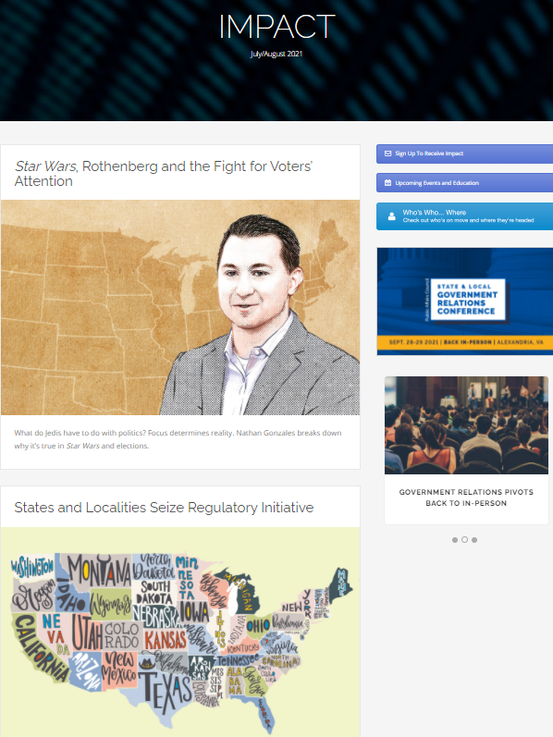
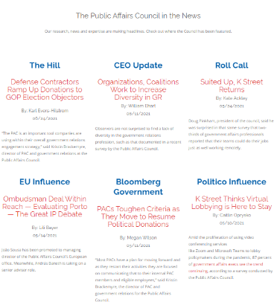
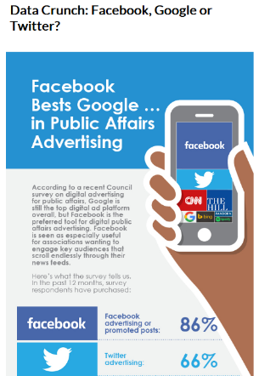
News & Analysis
MEMBERSHIP ORIENTATION

Slide 25
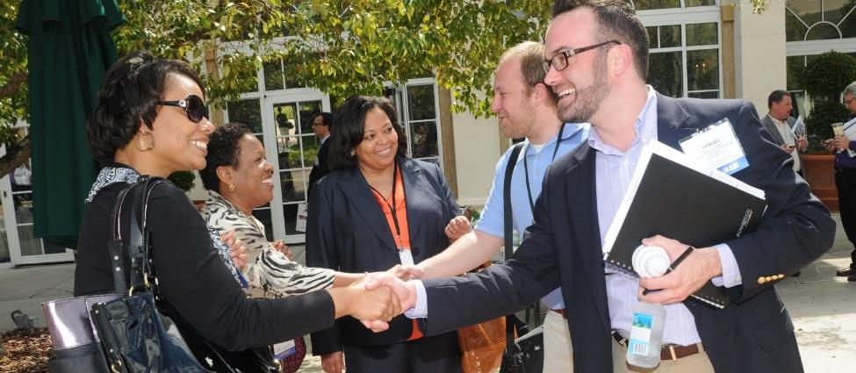
III. Community
MEMBERSHIP ORIENTATION

Slide 26

Mentoring
MEMBERSHIP ORIENTATION

Slide 27

Professional Networks
Political Involvement
International Network
Social Responsibility
State Government Relations
Association
Emerging Leaders
MEMBERSHIP ORIENTATION

Slide 28





Social Media
Follow us: @PACOUNCIL
MEMBERSHIP ORIENTATION

Slide 29
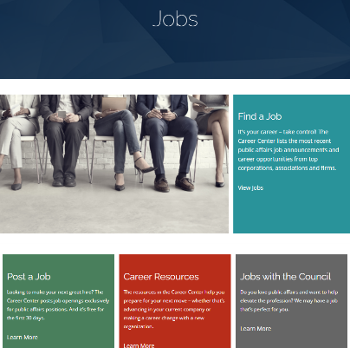
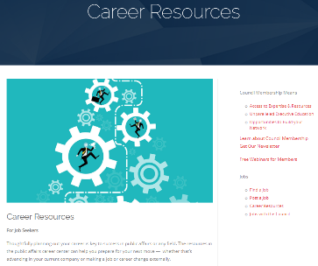
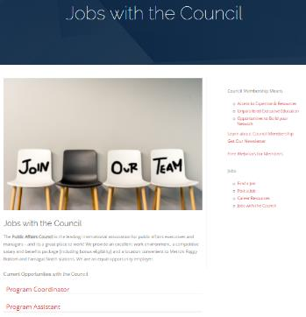
Jobs Page
MEMBERSHIP ORIENTATION

Slide 30
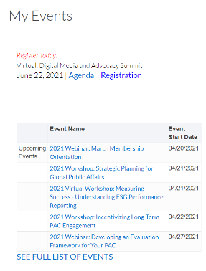
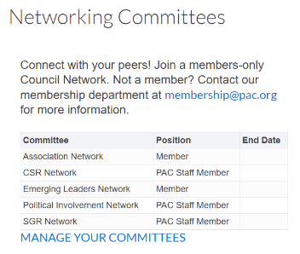
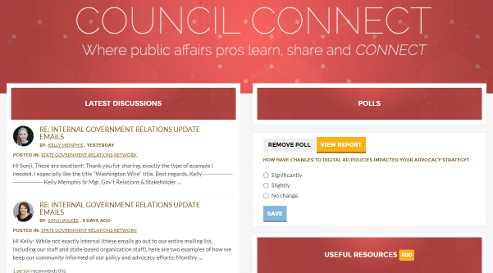
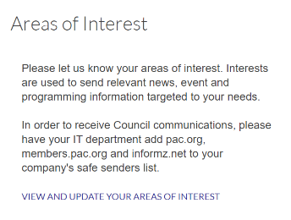
Accessing the Members-only Portal & Council Connect
MEMBERSHIP ORIENTATION

Slide 31
Get Involved Today
pac.org/engagement
Expertise
  Download resources at Council Connect (community.pac.org)
  Get to know our staff experts (pac.org/experts)
Executive Education
  Sign up for an event (pac.org/events)
  Enroll in a certificate program (pac.org/certificate)
Community
  Become a mentor or mentee (pac.org/mentoring)
  Join a professional network (pac.org/networks)
MEMBERSHIP ORIENTATION

Slide 32


Contact Us
Erica Harris
Public Affairs Associate
eharris@pac.org
202.787.5977
Stephanie Helsing
Manager, Membership
shelsing@pac.org
202.787.5967
Emily Wallace
Manager, Member Engagement
ewallace@pac.org
202.787.5962
U.S. Office
2121 K St. N.W., Suite 900 | Washington, DC 20037
(+1) 202.787.5950 | pac@pac.org
European Office
Square Ambiorix 7 | 1000 Brussels
europe@pac.org
MEMBERSHIP ORIENTATION

