Slide 1
FamMedPAC
Making it Personal
in a Virtual Environment
Heather Cutler, Sr. Manager, Political Programs & Members Engagement

Slide 2
Roadmap
About FamMedPAC / AAFP Advocacy
Family Medicine and COVID
Crisis Management: January 6th, 2021
PAC Solicitation Tactics
Communicating with Prospects
Staying Connected with Donors
Looking Ahead for FamMedPAC

Slide 3
AAFP Advocacy Goals / Objectives Influence Policy / Legislation, Thought Leadership, Member Engagement, Demonstrating Advocacy ROI
Influence Policy / legislation
Drive legislative activity
Influence congressional votes
Direct messaging from Family Physicians
Constituent component
Thought leadership
Recognized authority in primary care
Sought-after Subject Matter Expert
Innovation
Build credibility
Brand management / promotion
Unique perspective
Member engagement
Revitalize Key Contact Program
Deliver value to members
Grow pool of advocates
Robust communications
Demonstrating return on investment
Communicate Campaign outcomes
Directly connect advocacy and legislative influence
Enhance FamMedPAC engagement
Improve member survey results

Slide 4
Made up of 12-person Board, staggered terms
Daily operations run by AAFP Government Relations Department
Supports federal candidates / incumbents in House & Senate
Operates on 2-year election cycle budget
PAC supports re-elect campaigns, leadership PACs, and party committees
Congressional & Senatorial Committees

Slide 5
Roadmap
About FamMedPAC
Family Medicine and COVID
Crisis Management: January 6th, 2021
PAC Solicitation Tactics
Communicating with Prospects
Staying Connected with Donors
Looking Ahead for FamMedPAC

Slide 6
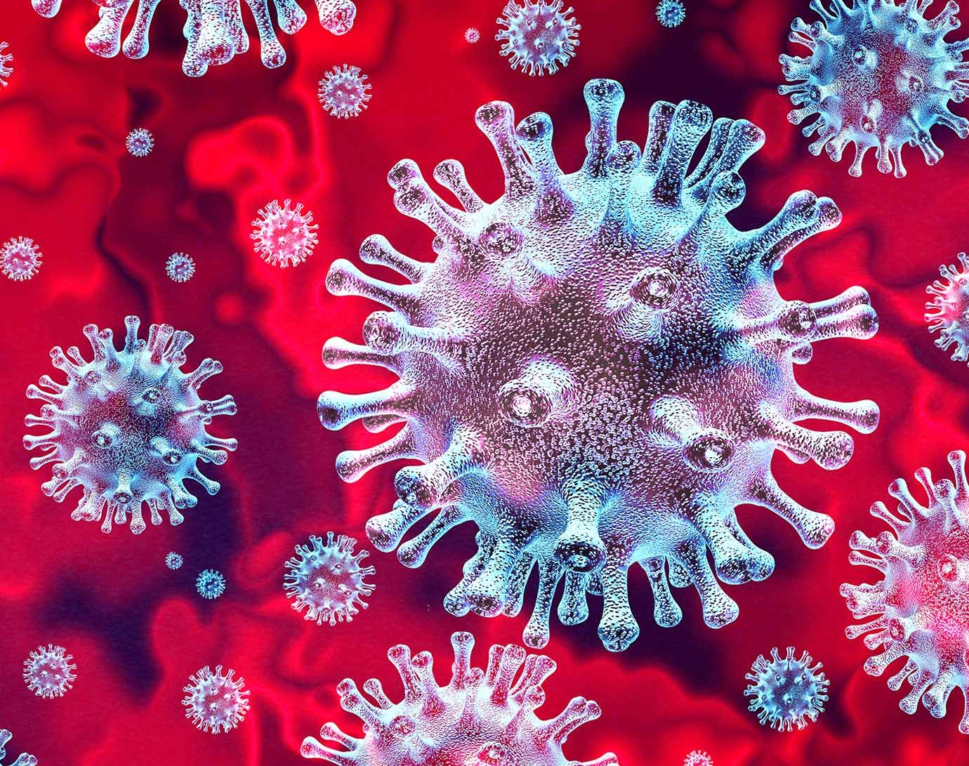
Family Medicine and COVID
Family Physicians on front line of diagnosing & treating COVID
80% of family physicians began offering virtual visits for the first time during COVID
More than 50% of family physicians had a family member or co-worker that had COVID
Many experienced a decrease in income, over 20% of practices reduced staff
In deference to our membership, FamMedPAC suspended solicitations for most of 2020

Slide 7
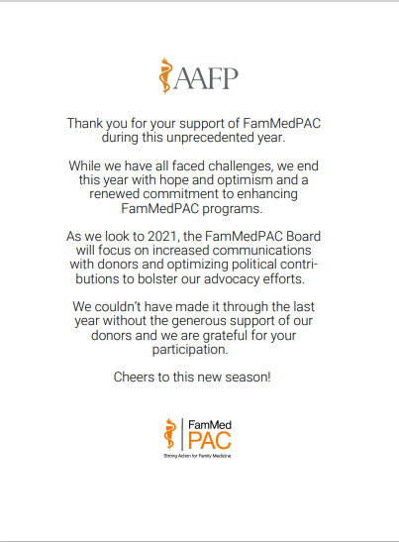
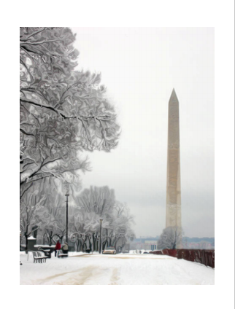
Year-end Acknowledgement

Slide 8
Roadmap
About FamMedPAC
Family Medicine and COVID
Crisis Management: January 6th, 2021
Updates to PAC Administration
PAC Solicitation Tactics
Communicating with Prospects
Staying Connected with Donors
Looking Ahead for FamMedPAC

Slide 9
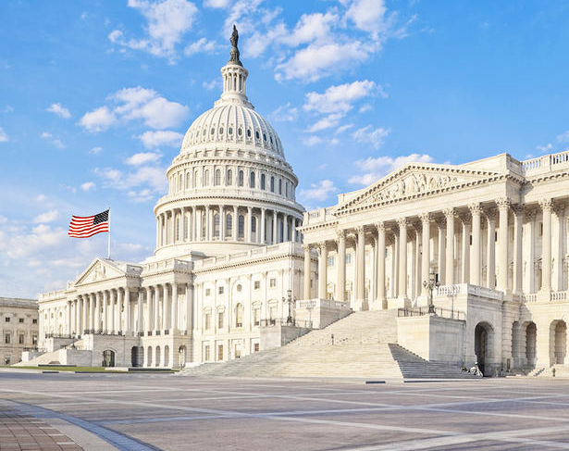
Crisis Management / January 6th, 2021
PAC Board met within a week
Paused all political activity
Communicated with AAFP Board
Statement on PAC website
Review of contribution criteria
Rebalanced party contribution ratios
Fielded inquiries from PAC donors

Slide 10
FamMedPAC Contribution Criteria

Slide 11
Roadmap
About FamMedPAC
Family Medicine and COVID
Crisis Management: January 6th, 2021
PAC Solicitation Tactics
Communicating with Prospects
Staying Connected with Donors
Looking Ahead for FamMedPAC

Slide 12
PAC Solicitation Tactics
Condition the audience
Pre-mail with all solicitations
Clear / concise language
Identify fundraising goals
Accessible to everyone
Timed email solicitations during meetings

Slide 13
Roadmap
About FamMedPAC
Family Medicine and COVID
Crisis Management: January 6th, 2021
PAC Solicitation Tactics
Communicating with Prospects
Staying Connected with Donors
Looking Ahead for FamMedPAC

Slide 14
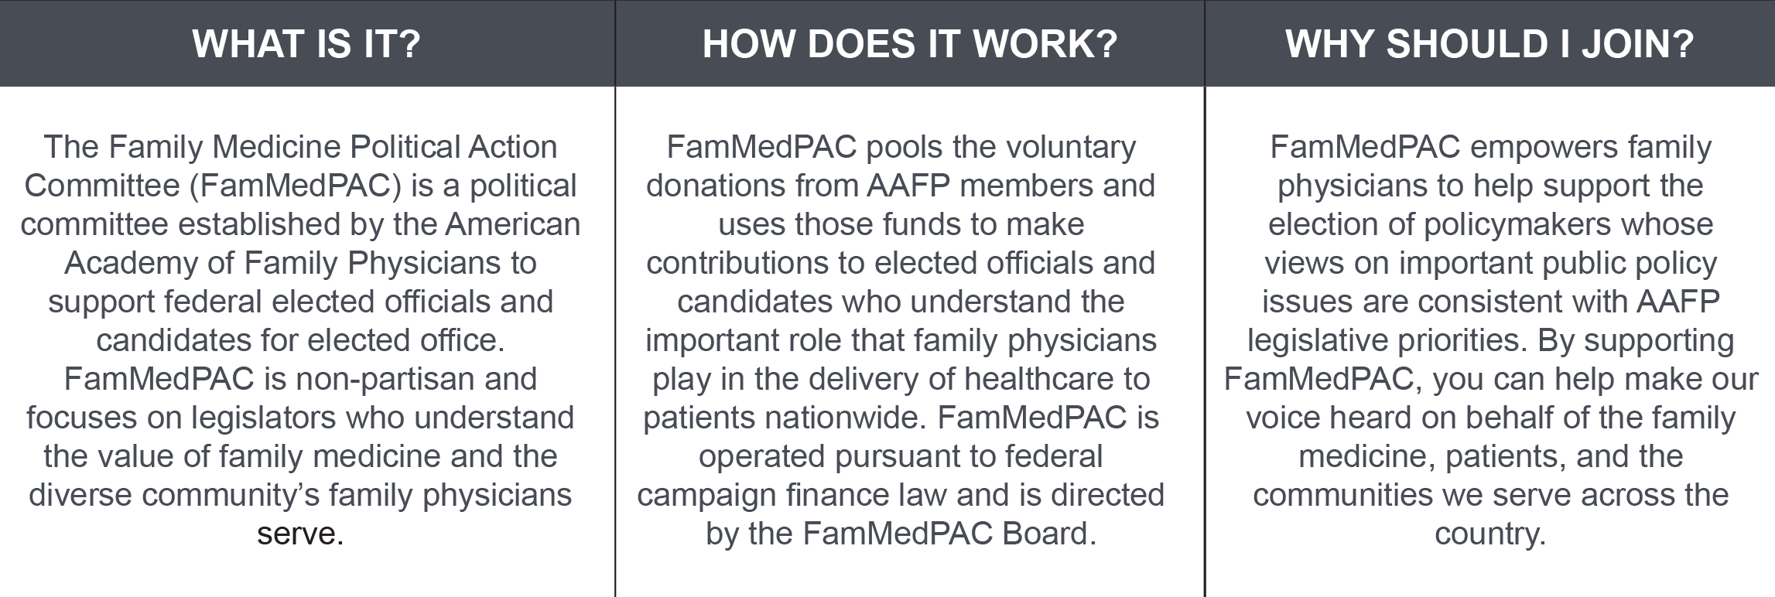
Why does AAFP have a PAC?

Slide 15
Legislative / Policy Priorities

Slide 16
Roadmap
About FamMedPAC
Family Medicine and COVID
Crisis Management: January 6th, 2021
PAC Solicitation Tactics
Communicating with Prospects
Staying Connected with Donors
Looking Ahead for FamMedPAC

Slide 17
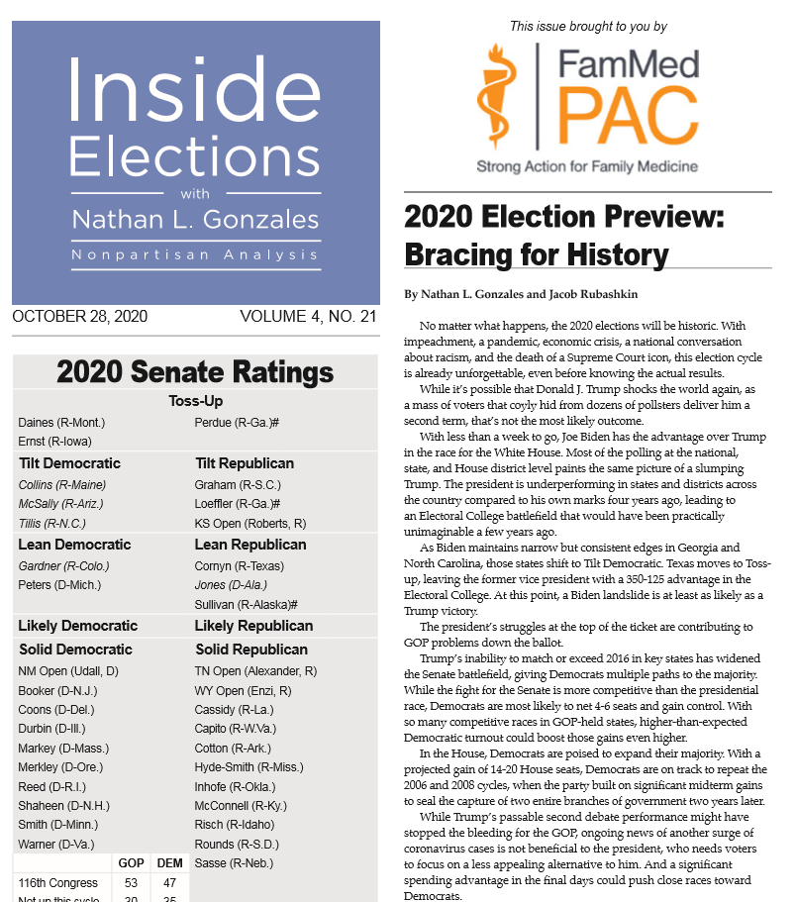

Slide 18
Roadmap
About FamMedPAC
Family Medicine and COVID
Crisis Management: January 6th, 2021
PAC Solicitation Tactics
Communicating with Prospects
Staying Connected with Donors
Looking Ahead for FamMedPAC

Slide 19
“Advocacy Comes in Many Forms”
Creative revamp of advocacy programs
Electronic vs. hard copy?
Return to in-person meetings
Prospecting with non-donors
Developing next generation of PAC donors

Slide 20
Questions?
Heather Cutler
Sr. Manager, Political Programs & Member Engagement
American Academy of Family Physicians
1133 Connecticut Avenue, NW
Suite 1100
Washington, DC 20036
hcutler@aafp.org
o. 202/655-4911
c. 571/213-7887

Slide 21
21

