Slide 1

March 16, 2021
Webinar: Advocacy Database Basics
Sponsored by Quorum

Slide 2

Thank You to Our Sponsor!
Public Affairs Council

Slide 3

Certificate Programs: Advance your career
The Certificate in Public Affairs Management helps strengthen knowledge and expertise in management, leadership and strategy.
The Certificate in PAC and Grassroots Management helps improve skills and strengthen expertise in two key components of any political program: political action committees and grassroots advocacy.
The Certificate in Government Relations and Lobbying is designed for federal, state, or regulatory lobbyists or government relations professionals seeking to deepen their expertise in the best practices and strategies needed to influence policy and to be leaders in the field.
www.pac.org/certificate
Public Affairs Council

Slide 4

Helpful Resources
Learn. Share. Connect!
Get connecting at community.pac.org
Public Affairs Council

Slide 5
Today’s Agenda
What is a database?
How should you use it for advocacy?
Data best practices
Practitioner Perspective and Case Studies
Database Management

Slide 6
Why use a data base?
Making the case for using an advocacy database:
Allows you to keep your data clean and updated
Serves as a central location for managing your advocacy program
Allows you to increase targeting, segmenting and optimization
Helps you make decisions about your program
Helps you learn more about your advocates
Allow for reporting, measuring ROI and communicating success
Database Management

Slide 7
Database types
Where should your data live?
Customer Relationship Management
Association Management System
Content Management System
Advocacy or Government Relations Management
System Tools:
Email Marketing
Event Management
Content Management
Performance Measurement/ Ad tracking
Goal Tracking
Fundraising
Forms/ Surveys and Inbound Messaging
News and Legislative Information
Database Management

Slide 8

Choosing an Approach to Database Tools
Benefits of one single system?
Data is all in one place
No need for integrations
Easier for single-sign-on
Downsides of a single system?
Limited tools or functionality
Lower user experience
Database Management

Slide 9
Database Hunting
Are you compliant with data privacy rules and best practices?
What is your most used tool or function?
What is your least used tool or function?
What are your future plans and is your company actively developing?
Basic questions you should consider:
What can this software program do and what was it created to do?
What challenge does this database or tool solve?
Where is my data going to live?
Who do you integrate with? Does it come with additional costs? How do you define integration?
Database Management

Slide 10
Creating a Data Plan
Data Maintenance
Remove duplicates
Track open and unsubscribe rates
Use a unique identifier number
Ensure your email doesn’t end up in SPAM
Operate a yearly scrub
Automation
Bounce-back rules
Activity tiers or scoring
Use forms
Sync with other databases
Database Management

Slide 11

Using Data for Emails and Action Alerts
Create a plan:
Set realistic goals
Ensure you have the proper infrastructure and technology
Establish legal and opt-out guidelines
Create a content calendar
Integrate email campaign with other digital communications
Implement the plan
Insights
Conversion or Action
Targeting
Content
Database Management

Slide 12
Collecting Data
Collect data from targeted audience using:
Surveys
Forms
Social Lead Generation
Social Media Scraping
Internal CRM
Content Marketing
Event Marketing
Google Analytics
Buying Lists and Data
Vendors Include:
Aristotle
L2
RAP Index
Resonate
Targeted Victory
i360
Database Management

Slide 13
Data Types
Political Characteristics:
Party Affiliation
Voter Registration
Voter Propensity
Advocacy Characteristics:
Group Memberships
Political and Non-Profit Donor History
Interests
Values
Past Attendance at Events
Demographics:
Age
Gender
Education Level
Occupation
Location
Career Level
Income
Communication History:
Personal Email Open Rate, Click-through Rate, and Action Rate
Social Media Use
Opt-in date
Database Management

Slide 14
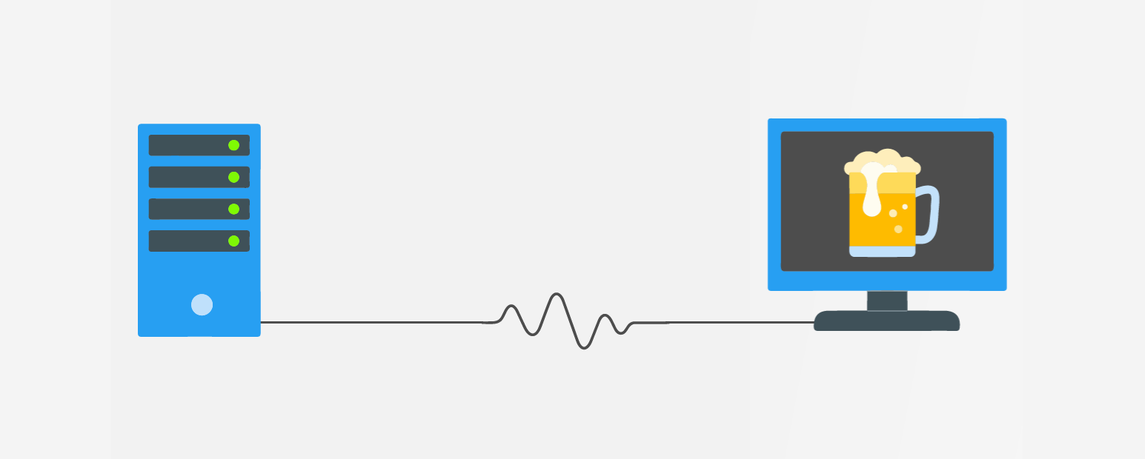
Database Analytics
What are your goals?
Total subscribers
Open Rate
Click Rate
Action Rate
Opt-Out Rate
Other Trackable Statistics
Lawmakers Contacted
Emails Personalized
Inactive Subscribers
Potential Champions
Database Management

Slide 15
Key Takeaways for Using Your Advocacy Database
Decide why you need a database
Import and maintain key data
Do not keep data you don’t intend to use
Determine what the data is telling you
Remember those tiny details (like leading zeros in Excel)
Database Management

Slide 16
Thank You to Our Sponsor!
Public Affairs Council

