Slide 1
Your Database
John Coleman
Director, Advocacy, ICBA

Slide 2
John Coleman
Director, Advocacy
Notes:
I’ve worked in advocacy for both the public and private sector for about a decade. I started, going door-to-door petitioning residents in a DC neighborhood for speed bumps and was Ward volunteer captain on two mayoral campaigns. More recently, I’ve managed grassroots and Advocacy for the Ambulatory Surgery Center Association, the Pancreatic Cancer Action Network and ABA.
I’ve built 2 advocacy databases from the ground up and am familiar with Aptify, netForum, Blackbaud, Aristotle, DDC, Luminate Online, VoterVoice, Phone2Action, Quorum and I’m sure a few others I’m forgetting.

Slide 3
What do you want to do with your data?
Get it all into a database?
Do you have a wider advocacy program?
How much will other departments be involved?
Do you have other software to put on top of it?
Have you done this before? / Will you need help?
Notes:
When building your database, the first thing you need to do is define the reason you are setting one up and/or adding software on top of a one.
<Read Questions>
Take a long-term view. What decisions can you make today that will help you in the future? The decisions you make now will only compound over the years…. Good or bad.

Slide 4
HI-TECH
HI-TOUCH
Notes:
One of your primary goals should be to provide the right contacts the right information at the right time.
This means using technology (your database and any additional software) to provide the best experience/empowerment of your contact/user. You want to be able to know that John in Flagstaff Arizona loves chocolate milk and to send him a box on the first day of chocolate milk month.
With the right database, set up the right way, you’ll be able to get this granular and delicious.

Slide 5
MAKE A PLAN
Notes:
After answering those questions, pull together a plan with a timeline.
So, for example, if you want to join data from a bunch of disparate sources into an easily manageable system that you can lay advocacy software on top of… map that out. What are your needs today? What will they be?
Where is that data?
Are there any laws you’ll need to comply with?
Research and demo advocacy software for your needs.
Do you need a mobile version?
Do you need clicktail tracking or a facebook pixel?

Slide 6
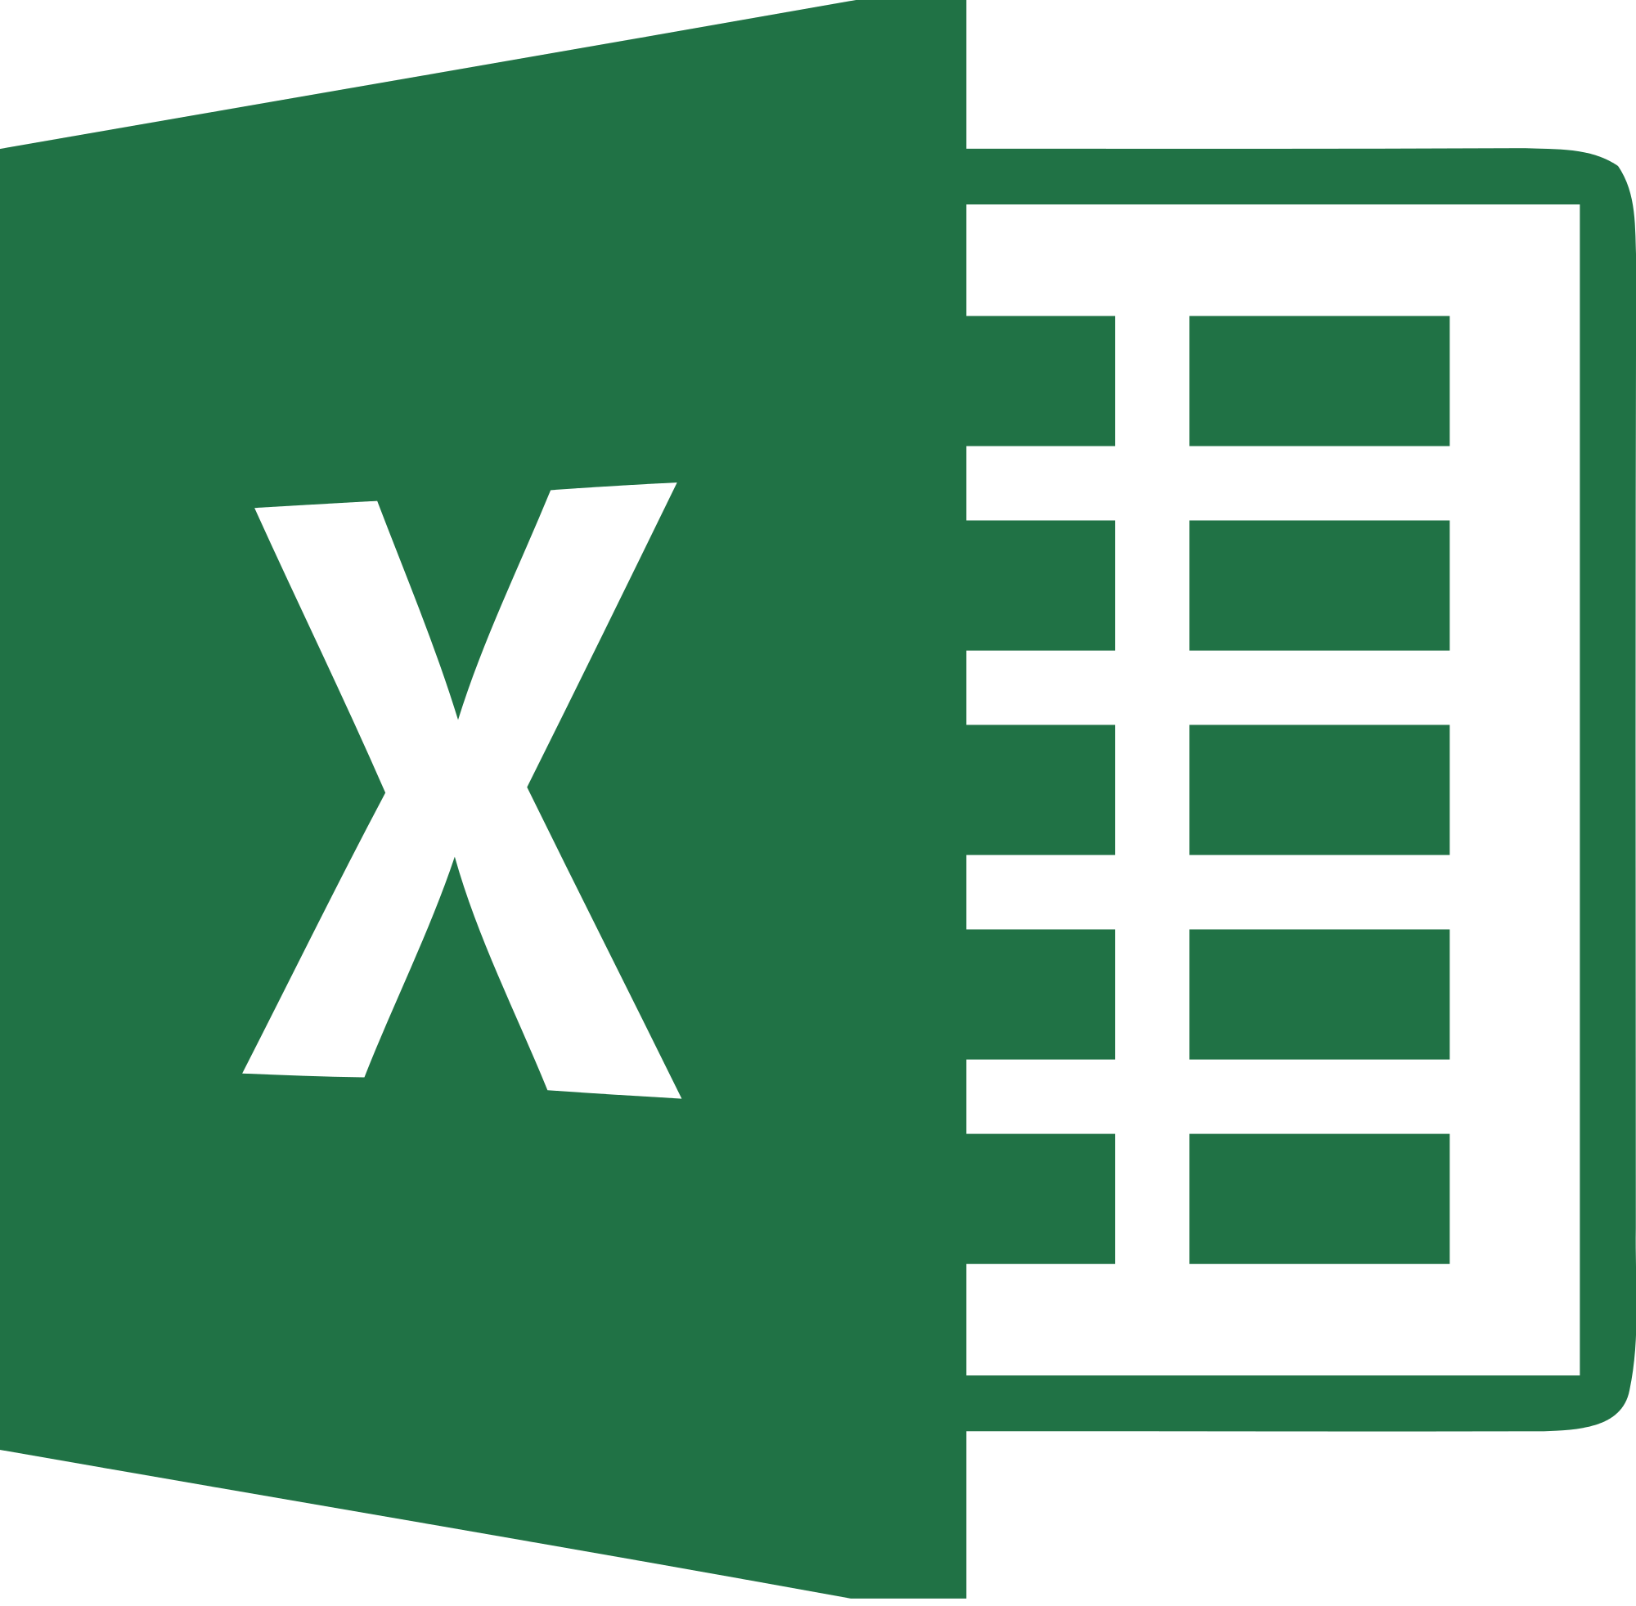
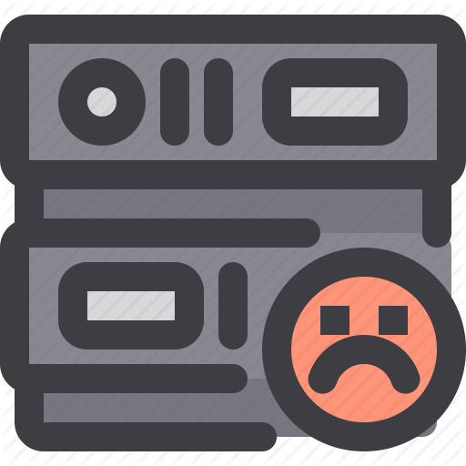
Where is your data now?
Excel sheets?
Old databases?
Paper?
No data?
Notes:
Now, you’ll need to figure out who you know and where their info lives.
<click>
Format it all the same way.
Dedoop them (might want to hire a consultant to do this)… you can do this based on a few fields, ID, first name, last name, address, city, state, county, email…
YOU GET ONE SHOT AT THIS. It is worth taking the time and spending the money to get it right. Errors are logarithmic. A duplicate now will be 10x as worse in a few year. So, be careful. Formatting is very important. You want your starting data perfect because it’s only going to get messy from there.
<then no data slide>

Slide 7
IT Legal Other Depts
Notes:
Your database and software is going to integrate with other parts of your organization and a breach will affect everyone. So, start with a wide net and solicit feedback, particularly from IT & Legal.
IT, legal, the executive team and other relevant departments are going to be very irked if you don’t follow your internal and the external (laws) rules. Involve them from the beginning. They’ll have insight and will be helpful indefinitely.
Specifically IT. There is always friction between IT and databases or programs they are not directly running. Don’t go behind their back. IT is responsible for your internet security so help them do their job. It can slow down the process, but this is about 5-10 years from now.
And contact legal, make sure you are following laws in your city, state and country.

Slide 8
GDPR & CCPA
Notes:
In particular, GDPR and CCPA.
Compliance is critical. Is your organization GDPR & CCPA compliant? This software most certainly will need to be.
GDPR - General Data Protection Regulation
Changes how contacters, us, must treat users.
It was passed in 2016 the EU and went into affect in 2018.
Since the internet is international, it affects you.
Things like opt-ins vs. opt-outs. So boxes cannot be checked automatically.
You must have an unsubscribe link in every email sent to one of your contacts.
In America, California passed the California Consumer Privacy Act last year, this does similar things to GDPR. One difference, is that GDPR does not care where you are.
These two laws involved things like.
The right to be forgotten.
Know if your info is being used and who it is being shared with.
This means you can’t share the name, address, email of a contact without anyone—even an affiliate— w/o their permission.
And, a user is not be penalized in price because of an opt-out
Contact your legal office to understand these laws. They might not apply directly to you and your business right now, but it is very likely that some form of them will in the future. It is important you anticipate this and make it part of your good data management routine.
You know those little pops ups you’ve started to get in the last year or two on websites asking if they can spy on you? (i.e. drop cookies on your computer)
Most large companies, for example, MailChimp, already comply with both of these.

Slide 9
Software companies
Due diligence
GDPR/CCPA
Security
Integration
Questions
Walk through steps you’ll do
How will you use different components?
How do additional data fit integrate?
How easy is it to use?
Notes:
After you’ve compiled your data, complied with laws and checked with IT, you’ll need some software.
Do your due diligence on these software companies.
Make sure they are GDPR & CCPA compliant.
Make sure the integrate with the database of the rest of the system. Ask to see their API. Do not put up with that STMP junk or a manual sync with a .csv file. You want an API and you want your IT folks to be able to play with it before you sign a contract.
Make sure their security is top notch; IT will be able to help you here.
Negotiate.
Some questions to ask them:
Can you show me how to launch a campaign from the beginning?
How do I pull a report? What format?
How often do you update your MoC data?
What happens to unsubscribes? What is your unsubscribe function like?
Can your software split targets?
How do I tag/sort/track contacts?
Do you have an email system integrated? (Confirm with your IT you can use it.)
What data overlays and data crunching does this software let me use to IT my top advocates?
How easy is your UI? (Goal is to make it as easy as possible for a user on the front end to do what you want and then easy for you on the back end.)

Slide 10
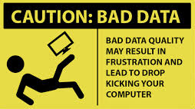
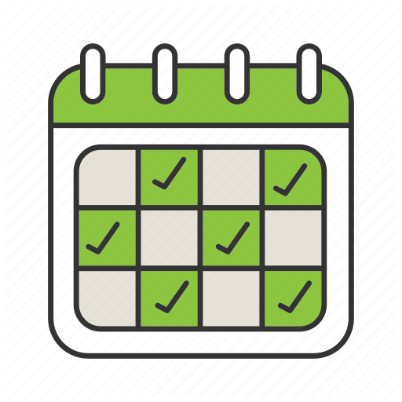
Data maintenance
Humans are bad at handling data
Data audits
Have a maintenance/update plan
Notes:
Once you’ve got a vendor and your data is uploaded, it’s important to maintain it well.
So, have as little human touching of data as possible. Force users to only have one account. Consider asking them periodically to update their information. Data integrity is key and that starts with the chain of custody of your data.
Periodically do a data audit. You, or a user, will, in some way, screw something up. How will you deal with this? How will you deal with future duplicates? How will you overlay new data?

Slide 11
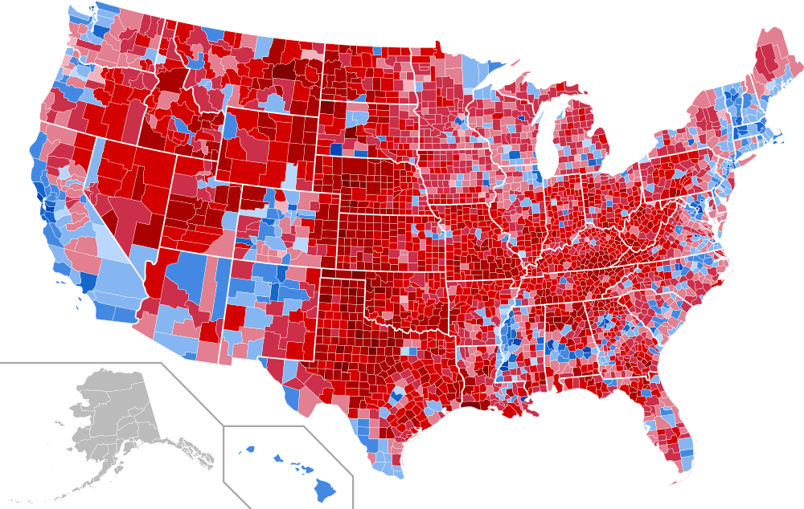
Next Steps
Additional data
Internal
External
Sorting
Notes:
Now that you’ve got a great protocol for managing your data, you aren’t breaking any laws and you’ve got some awesome software, it’s time to layer info on top of it.
Some of this new data will be provided by your users, but also can be solicited by you. Send them a survey asking about important issues; then, tie those responses to their records. You can now target them more specifically.
Other cool data you can get from the census bureau or voter databases. Then, overlay that data on your contacts for an added level of intrigue.
Now you can sort and filter this data, finely tuning in on the right people at the right time.
You can now provide your users/contacts/members with the Hi-tech/Hi-touch empowerment they deserve.

Slide 12
Fin.

