Slide 1

January 22, 2020
Lobbying During an Election Year
Webinar

Slide 2

Public Affairs Council

Slide 3
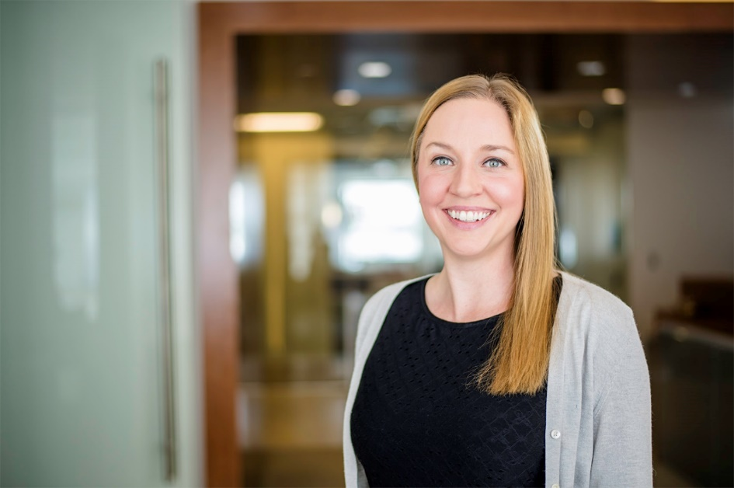

Kelly Memphis
Government Relations Manager
kmemphis@pac.org
Twitter: @kelly_memphis

Slide 4
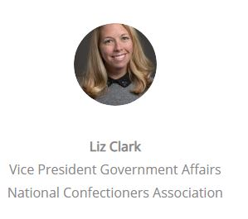
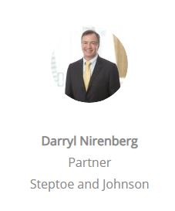
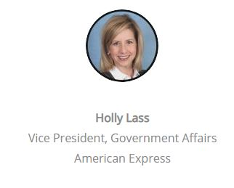

Slide 5
Darryl Nirenberg
Partner at Steptoe & Johnson
35 Years Experience in Public Policy
20 + Years Lawyer/Lobbyist
  Practice focused on Consumer Products and Services
14 Years – U.S. Senate Staff
  Senator Jesse Helms (R-NC)
  Senate Foreign Relations Committee
  Senate Agriculture Committee
  Senator S.I. Hayakawa (R-CA)

Slide 6
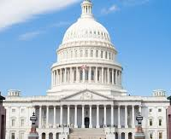




Holly Lass
GOV’T AFFAIRS
TAX

Slide 7




Nice to Meet You!

Slide 8
Landscape

Slide 9
In 2020
Federal
White House
States
11 states holding gubernatorial elections
All states except 6 have one or both houses up for elections
435 House seats
35 Senate seats
MARKETING AND COMMUNICATIONS

Slide 10

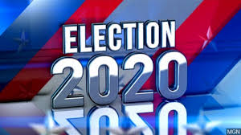
Assess the landscape
Membership/Company appetite and resources
Hot issues
  Debates
  Campaign promises

Slide 11

Elections Drive Washington
The Domino Effect
New Chair
Ratio
Subcommittee
Agenda
Schedule
Notes:
Vacancies: Duffy (R-Wi), Collins (R-NY), Cummings (D-MD), Hill (D-CA)
Moderate House Dems announced they would support impeachment process:

Slide 12
Lobbying Success in an Election Year
Big Train Left the Station
  FY 2020 Appropriations Christmas Tree
Fewer Session Days/Longer Recesses Through Election Day
Impeachment Distraction
Opportunities Exist
  Appropriations Process
  Likely Lame Duck
  Foundation Building

Slide 13
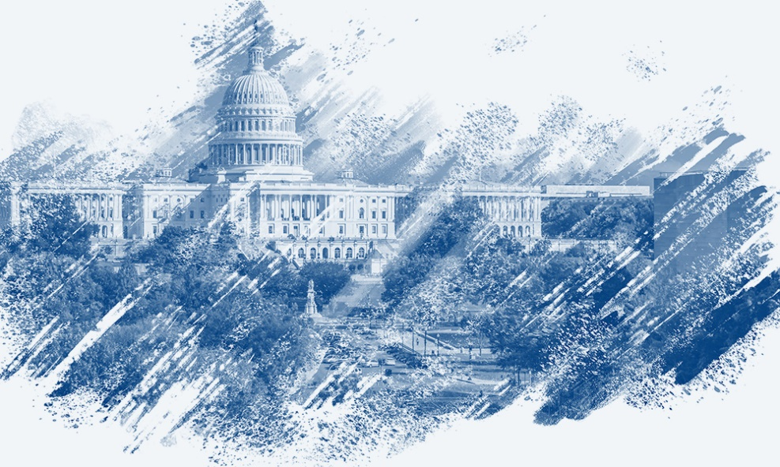
Lobbying Congress

Slide 14

Lay the Groundwork!
Data
Strategy
Coalitions
Staff
Educate
Relationships

Slide 15
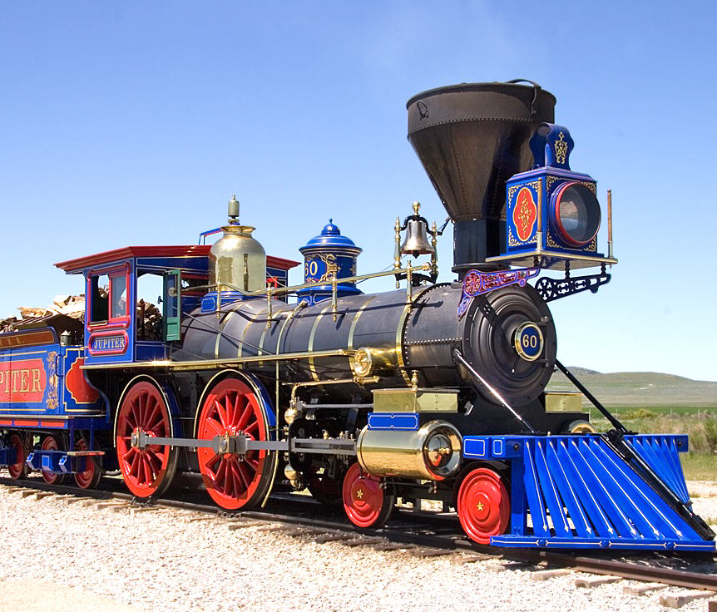
What is the Train?
Big Picture
Politics
Members
Driving Forces
Leadership
Schedule
2019 GOVERNMENT FUNDING
Notes:
10 legislative days before Nov. 21
Add USMCA: maybe House vote before thanksgiving
SECURE: facilitate MEPPs, safe harbor for annuity provider, required min distribution age up from 70 ½ to 72
Technicals: write-off bonus for qualified improvement property and modifications to NOL carry forwards, carrybacks and refund for overpayments of 965-repatriation tax

Slide 16
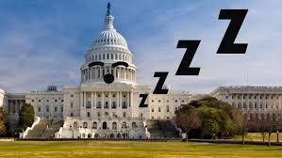
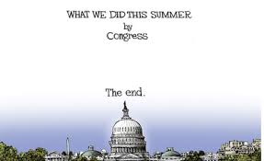
Challenges
Fewer legislative vehicles and opportunities
MOCs taking positions on new issues
Fundraising
Retirements

Slide 17
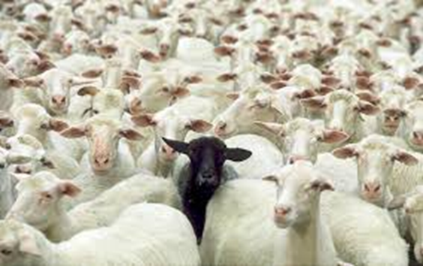

Opportunities
Build Coalitions
Partner with National Groups
Opposition rests
Get creative
Keep it local

Slide 18
Non-Profits and Lobbying in an Election Year
House Races More Driven than Senate by National Politics
“All Politics are Local”
  Members will be Home More
  Members will Listen More
Seize the Opportunity

Slide 19
More Strategy Considerations

Slide 20
Support Your Friends
Election years are the best time to organize “Thank You” op-eds, LTE’s, etc. to praise your biggest champions.
Step up your PAC support – help out your allies when it really counts.
Are you equipped to do grassroots campaign support? Organizing door-knocking, phone time, etc. among your members?
If your members or facilities are willing, organize site visits. Don’t forget the photo op!

Slide 21
Mind the Calendar
Target your in-state engagement dates (tours, roundtables, etc.) – Their time back in district will be at a premium so get your requests in early.
Note key legislative deadlines. These may affect in-district activity when fly-out days are extended or canceled.
Pay attention to primary dates.
Don’t forget national conventions.

Slide 22
Election Year Success Story
2009 Tobacco Legislation
Federal Excise Tax Increase
Family Smoking Prevention and Tobacco Control Act
Prevent All Cigarette Trafficking Act
2008 Legislation Negotiated and Drafted
“If you are not at the table. . .you’re on the menu”

Slide 23
Follow-Up Questions

Slide 24
Summary: What are your key takeaways for lobbying success during an election year?

Slide 26
What is a Lobbying Contact?
For registration to be triggered under the LDA, an individual must make two or more lobbying contacts within any time period.
The LDA defines a lobbying contact as a covered communication made to a covered official on behalf of a client regarding a covered topic. A covered communication includes any communication made in-person or via any form of media (including e-mail).
The LDA’s definition of a lobbying contact is very expansive and would encompass discussions related to public policy, regardless of whether specific legislation is mentioned.
There are 19 exceptions to the definition of “lobbying contact.”

Slide 27
Lobbying Contact - Exceptions
There are 19 exceptions to what qualifies as a lobbying contact, among them:
  an administrative request without an attempt to influence;
  testimony or a submission to be included in the public record of a hearing;
  information provided in writing in response to an oral or written request by a covered official for specific information;
  required under law via subpoena; and
  a filing or proceeding that the Government is specifically required by statute or regulation to maintain or conduct on a confidential basis, if that agency is charged with responsibility for such proceeding, inquiry, investigation, or filing.

Slide 28
Who is a Covered Official?
A covered official is defined under the LDA to include those selected from a delineated group of executive and legislative branch officials and employees.
All Members of Congress and their staffs are covered.
There is a specific list of who qualifies as a covered official in the executive branch.

Slide 29
What are Lobbying Activities?
For registration to be triggered under the LDA, an individual must conduct lobbying activities that amount to 20 percent or more of the time that the individual spends on services over a three-month period (i.e., a calendar quarter).
The LDA defines lobbying activities as:
  “Lobbying contacts and any efforts in support of such contacts, including preparation or planning activities, research and other background work that is intended, at the time of its preparation, for use in contacts, and coordination with the lobbying activities of others.”
To determine whether a given activity qualifies as a lobbying activity, the LDA Guidance states that:
  “Generally, if work such as reporting or monitoring occurs at a time when future lobbying contacts are contemplated, such reporting and monitoring should be considered as a part of planning or coordinating lobbying contacts, and therefore included as ‘lobbying activity.’”
Accurate calculations of lobbying activities are important to help determine lobbying expenses, which are reported quarterly.

Slide 30
Lobbying – State & Local
State laws all define lobbying in different ways.
Most state lobbying laws define lobbying to include grassroots (“indirect”) lobbying.
Registration requirements vary from state to state.

