Slide 1

PAC Best Practices
Insights from 2019 PAC Benchmarking Reports
March 2020
Notes:
Hope I can shed some light on not only corporate PACs and corporate political involvement, but the campaign finance system as a whole. I’ll touch on super PACs a bit as well, as I think it’s hard to truly understand the environment corporate PACs operate within without understanding the differences between super PACs and corporate PACs.
Hoping to make this conversational, so please chime in with any questions along the way.

Slide 2
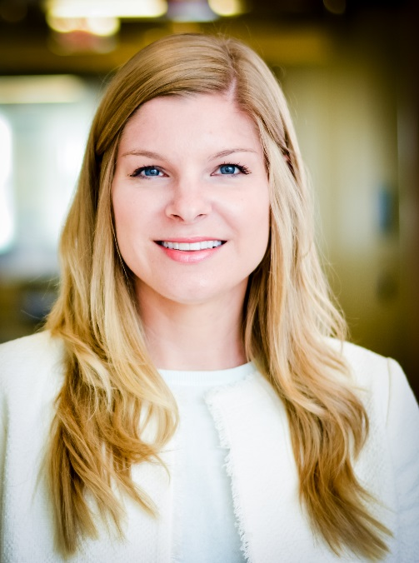
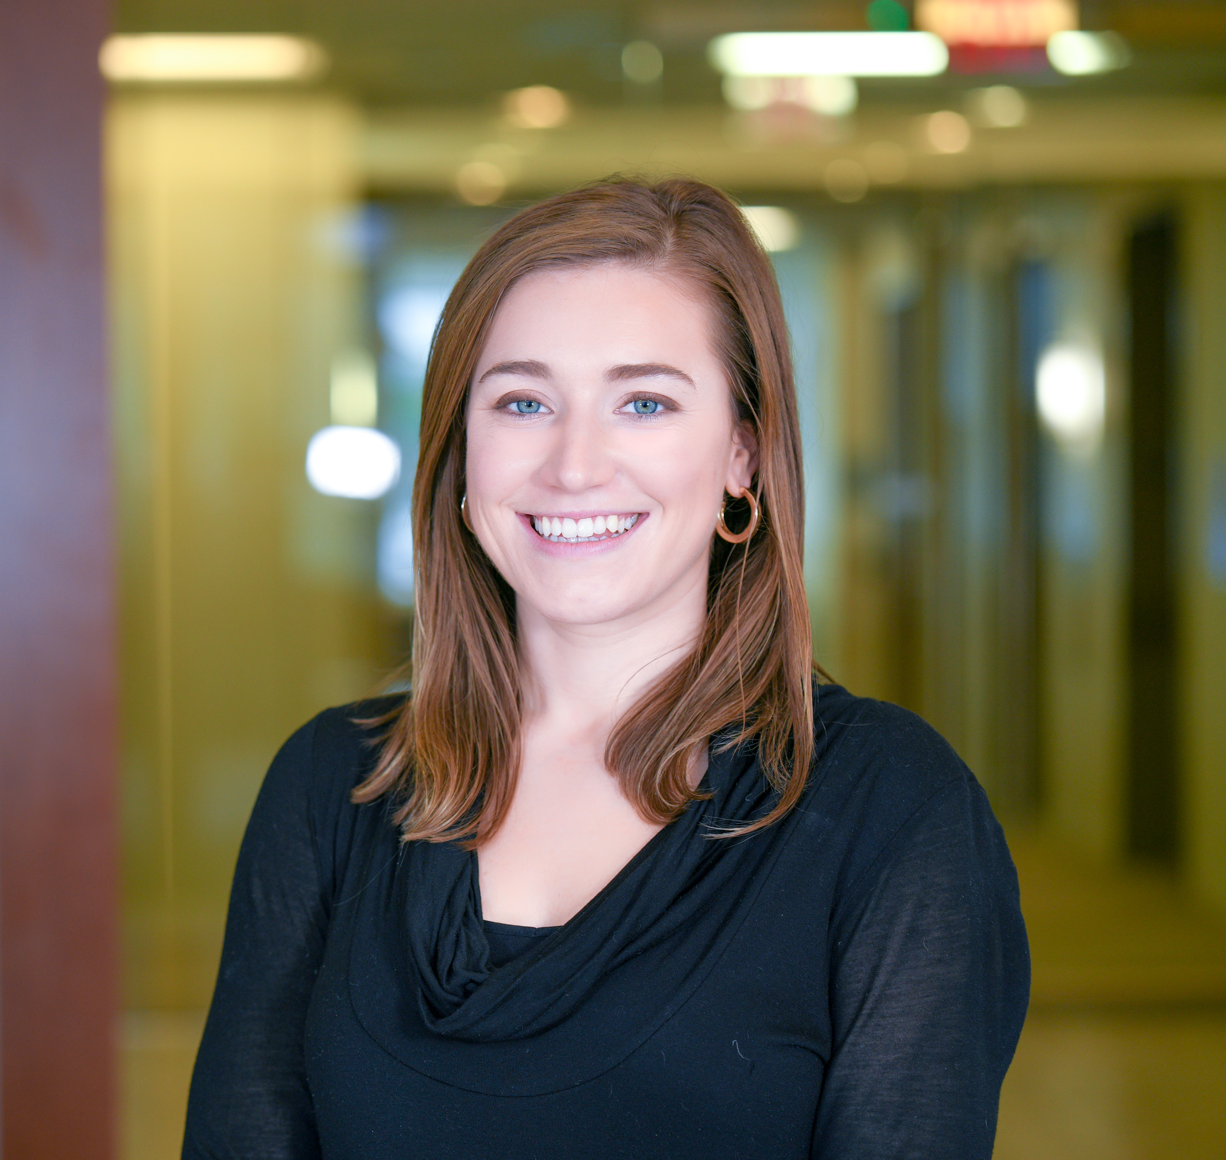
About
Us
Kristin Brackemyre Tori Ellington
Director, PAC and Government Relations Public Affairs Associate
PAC Best Practices
Notes:
We are a trade association that advocates for the public affairs profession through executive education, resource sharing, staff expertise and more to help public affairs professionals excel in their jobs
I specialize in PAC and advocacy, my background is in PAC management so what I’ll discuss today is near and dear to my heart

Slide 3
What is available to you as members?
Staff expertise/member requests
Members-only networks
Council Connect
Executive education programs
Access to resources/research
Skadden Arps legal partnership
Inside Elections political intelligence partnership
PAC Best Practices

Slide 4

PAC Benchmarking Reports
Comprehensive benchmarking report covering trends and best practices in PAC management, including
  Management and staffing
  Governance
  Executive engagement
  Fundraising and recognition strategies
  Participation and contribution rates
  Disbursement strategies and political involvement
160 participating corporations
Conducted every other year
PAC Best Practices
Notes:
-It’s often asked, why can’t the company just spend its own money to support political candidates, why does it need to raise money from its eligible employees? For this, it’s useful to talk a little about the history behind PACs.
-PACs are largely the product of Watergate-era campaign finance reform, the Federal Election Campaign Act (FECA) of 1974 is still largely the existing framework PACs are regulated by today. Under the Federal Election Campaign Act it is illegal for corporations to use general treasury funds to contribute directly to candidates. This leads companies to form a PAC that is comprised of and dependent on voluntary individual donations from their employees, which are subject to a $5,000 annual limit.
-I mentioned PACs rely on voluntary contributions, but there are also a lot of regulations around who is eligible to contribute to the corporate PAC. Companies are limited to relying on exempt employees with managerial and decision making responsibilities. So in many cases, there are huge companies that actually have very limited amounts of eligible employees with whom can give to the PAC. And this is largely determined by each individual company based on guidelines, so most companies skew on the conservative side when deciding who to consider a PAC-eligible employee. It is also illegal to use any form of coercion to fundraise for the PAC and again companies take that very seriously and put in place safeguards to avoid an employee ever feeling pressured or coerced in anyway.
-Lastly, PACs are legal, transparent and federally monitored. Every receipt a corporate PAC collects from an individual employee over $200 is disclosed to the Federal Election Commission (FEC). Similarly, every expenditure a PAC makes to a candidate or political committee is also disclosed to the FEC. Anyone with access to the internet can view these reports that are filed regularly with the Federal Election Commission and track every PAC contributor above that $200 threshold and every contribution made to federal candidates.

Slide 5
COVID-19 and the PAC
PACs that are experiencing growth are doing these things:
Consider pausing fundraising: take stock of your internal environment, mimic corporate communications, consult your stakeholders and trust your gut
Manage expectations and reevaluate your goals: adjust your goals accordingly, focus on other important projects, recreate your content calendar and think outside the box
Provide good government and show appreciation: GOTV efforts, cater your messaging to an “all in this together” approach, thank your members and continue to show appreciation
- Join us for a webinar, COVID-19 and the PAC, on April 16th! Pac.org/events!
PAC Best Practices

Slide 6
Best-in-Class Fundraising At-a-Glance
PACs that are experiencing growth are doing these things:
Planning ahead: successful campaigns require groundwork, plan ahead!
Using multiple mediums: there’s rarely one magic bullet– combine effective strategies such as a peer-to-peer program, in-person events, email solicitations, giveaways, etc.
Diversify your donor base: continually reevaluate your donor/eligible base, even if the pay-off is small at first, important to be engaging new eligible audiences
Make it as easy as possible: how do donors actually give? How easy is it for them?
PAC Best Practices

Slide 7
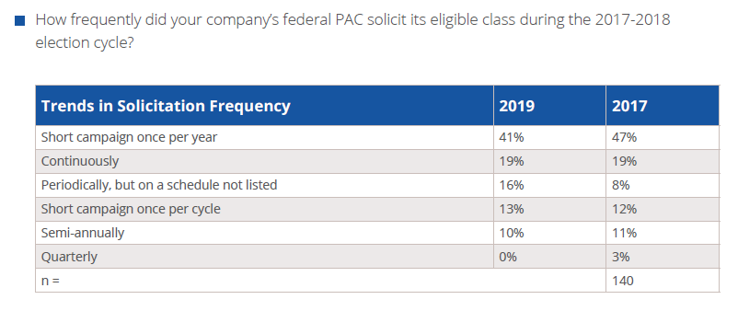
Fundraising – How Often?
PAC Best Practices
Notes:
Super PACs are the product of the 2010 Supreme Court Citizens United case.
The Citizens United decision does allow corporations to use general treasury funds to engage in independent expenditures of their own or support super PACs and nonprofit groups doing so, but again did not change the law that prohibits them from using corporate monies to contribute directly to a candidate for federal office. The Public Affairs Council’sPAC benchmarking data demonstrates that although corporations can now directly contribute to super PACs, the overwhelming majority have chosen not to.

Slide 8
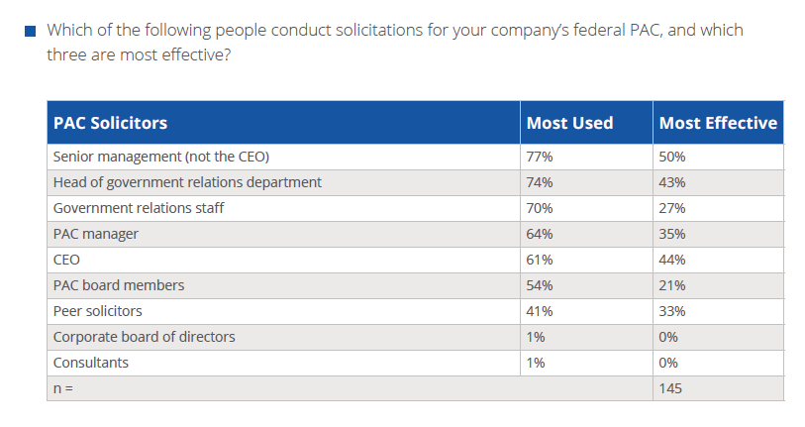
Find Your Champions - Top PAC Solicitors
PAC Best Practices
Notes:
Most used and then most effective: sr. management, CEO, head of GR, PAC manager and peer solicitors
-We saw senior management increase slightly from 72% to 77% in 2017 compared to 2019
-Head of GR dropped from 83% to 74%
-GR staff stayed about the same
-PAC manager increased from 55% to 64% from 2017 to 2019

Slide 9
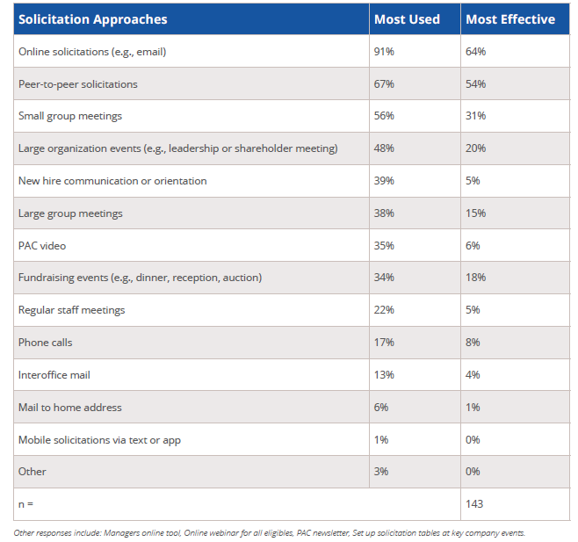
Fundraising:
Top Solicitation
Approaches
PAC Best Practices
Notes:
Most used and then most effective: sr. management, CEO, head of GR, PAC manager and peer solicitors
-We saw senior management increase slightly from 72% to 77% in 2017 compared to 2019
-Head of GR dropped from 83% to 74%
-GR staff stayed about the same
-PAC manager increased from 55% to 64% from 2017 to 2019

Slide 10
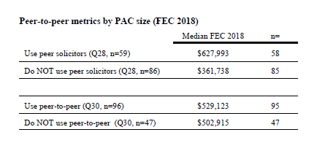
Peer-to-Peer: It Works
PAC Best Practices
Notes:
Most used and then most effective: sr. management, CEO, head of GR, PAC manager and peer solicitors
-We saw senior management increase slightly from 72% to 77% in 2017 compared to 2019
-Head of GR dropped from 83% to 74%
-GR staff stayed about the same
-PAC manager increased from 55% to 64% from 2017 to 2019

Slide 11
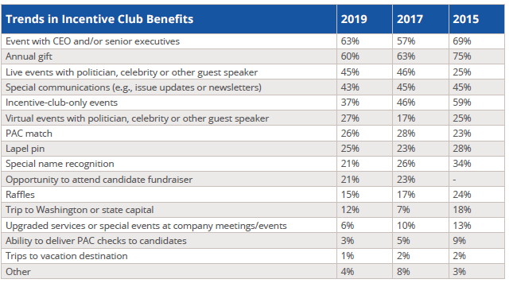
Incentive Club Benefits
PAC Best Practices
Notes:
Most used and then most effective: sr. management, CEO, head of GR, PAC manager and peer solicitors
-We saw senior management increase slightly from 72% to 77% in 2017 compared to 2019
-Head of GR dropped from 83% to 74%
-GR staff stayed about the same
-PAC manager increased from 55% to 64% from 2017 to 2019

Slide 12
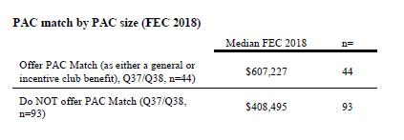
PAC Match: It Works
PAC Best Practices
Notes:
Most used and then most effective: sr. management, CEO, head of GR, PAC manager and peer solicitors
-We saw senior management increase slightly from 72% to 77% in 2017 compared to 2019
-Head of GR dropped from 83% to 74%
-GR staff stayed about the same
-PAC manager increased from 55% to 64% from 2017 to 2019

Slide 13
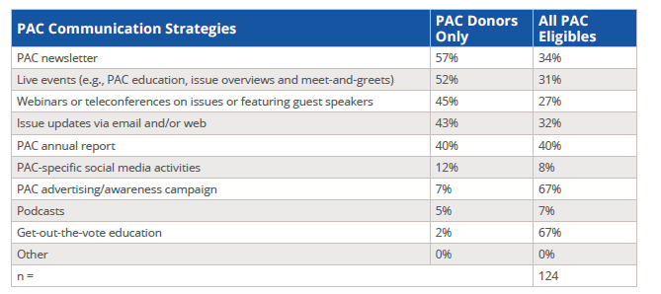
PAC Communications
PAC Best Practices
Notes:
Most used and then most effective: sr. management, CEO, head of GR, PAC manager and peer solicitors
-We saw senior management increase slightly from 72% to 77% in 2017 compared to 2019
-Head of GR dropped from 83% to 74%
-GR staff stayed about the same
-PAC manager increased from 55% to 64% from 2017 to 2019

Slide 14
PAC Communications: Best Practices
What to always include:
Email: keep it short and sweet, don’t overwhelm, personalize when possible
Get creative: use visuals, think outside the box to grab people’s attention
Events and personal engagement: build a brand!
PAC Best Practices

Slide 15
PAC Messaging: Always Educate
What to always include:
PAC basics: why the association has a PAC and its role
Put a face to the PAC: who contributes, how many donors, “member-funded”
Personalize the PAC: why should they care, why do others give?
What’s in it for them: highlight the benefits of joining
Tip: Link back to a toolkit, PAC website, intranet, etc. where they can learn more
PAC Best Practices

Slide 16
Creative Ideas for Engagement
Podcasts
PAC Carnival
PAC jeopardy or trivia games
“Found it” emails
PAC “office hours”
PAC Best Practices

Slide 17



PAC Best Practices

Slide 18
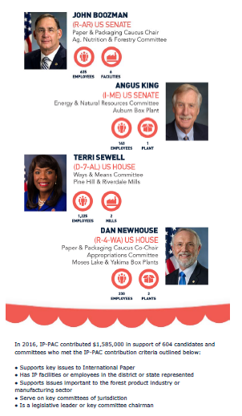


PAC Best Practices

Slide 19

www.jeopardylabs.com
PAC Best Practices

Slide 20

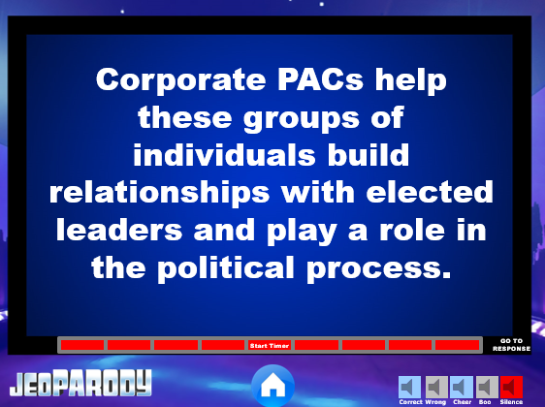
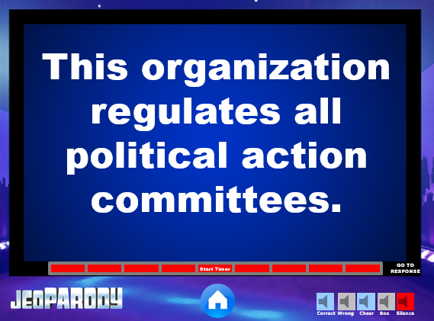

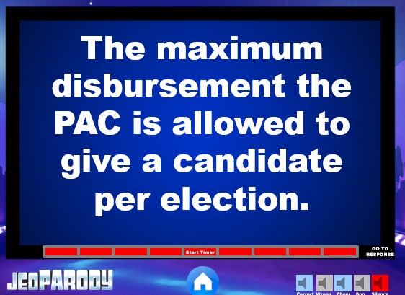

PAC Best Practices

Slide 21
All That Glitters is Not Gold
Other Incentives:
Truth: know your culture—it’s not always an expensive or flashy item that drives the most engagement
Drawing for a premier parking spot
Dunk the CEO/sr. executive, pie-throwing contest, eating contest
Hospitality lounge at meetings or events
Raffle a day-in-Washington or state capital
Exposure to CEO/leadership through Pancakes & Politics or similar events
PAC Best Practices

Slide 22
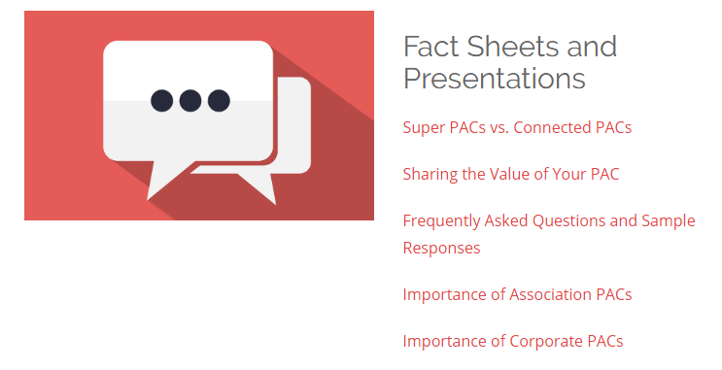
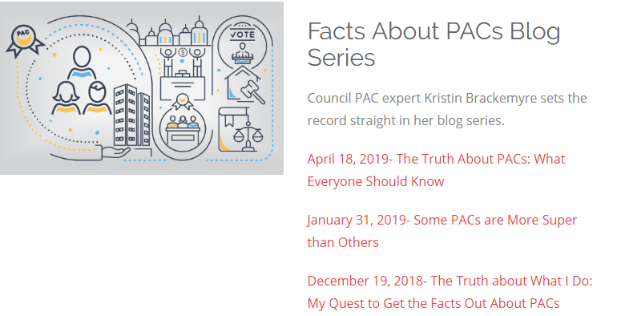
Council Resources
Council toolkit: pac.org/paceducation
PAC Best Practices

Slide 23
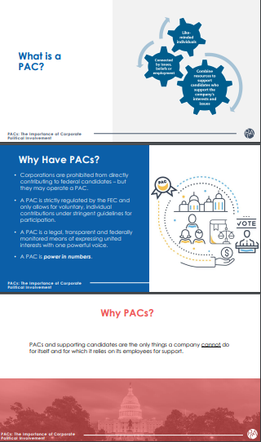
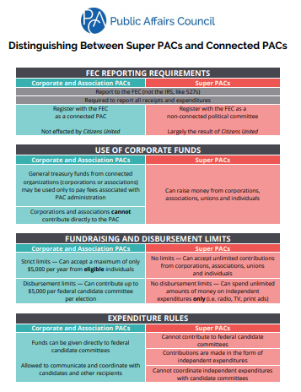
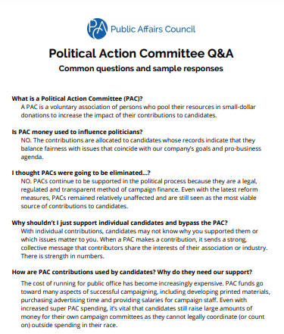
Council Resources
PAC Best Practices

Slide 24
Creating a Communications Plan
Make a calendar for the year
Consider potential delays
Account for board, executive, and other essential meetings
Plan deadlines for approval, creation of content, drafts and editing – do not just set dates for communications to be sent out.
Make staff or vendor assignments for each action item
Set follow up dates for personal outreach in order to meet goals
PAC Best Practices

Slide 25


Sample Q1: January 1 – March 31
Events & Meetings
Communications & Tasks
January 2020
  Early-January: Q1 Disbursements Meeting
  Late-January: Tom’s State of American Business Address
  January 27-28: Committee Meeting
February 2020
  Early-February: Small Business, Board and Committee mailers
  Executive Level In-Person Solicitations
  Staff PAC Education Reception
March 2020
  Early-March: Q2 Disbursements Meeting
  Board and Committee Meetings
    PAC Table
January 2020
  Share year-end report with USCC staff, Board of Directors, committee contributors
  Staff PAC Education Reception Teasers
  Invitation + Outlook Reminders to eligible staff for February Staff PAC Education Reception and Candidates Event
  Meeting requests for February Executive In-Person Solicitations
  Prep Board/Committee mailers for early-February send
February 2020
  Schedule Q2 Disbursements Meeting
  Late-February: Handwritten thank you notes + CEO thank you letter
  Prep for Board of Directors + Committee Meeting
March 2020
  Post Staff PAC Education Reception thank you email
  Invite: April Candidates Meet and Greet Event
  Finalize Q1 Report to all PAC contributors only – mid-April send

Slide 26
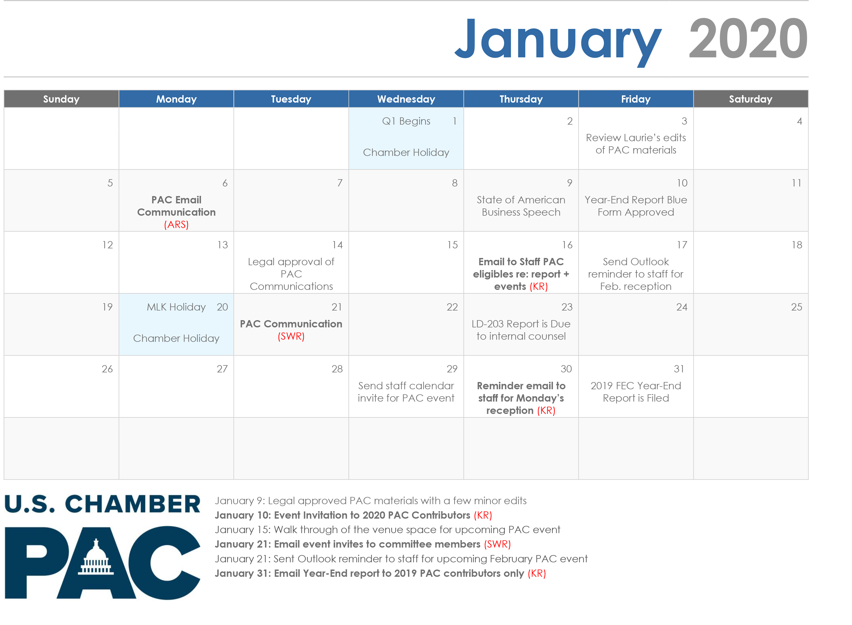
PAC Best Practices

Slide 27
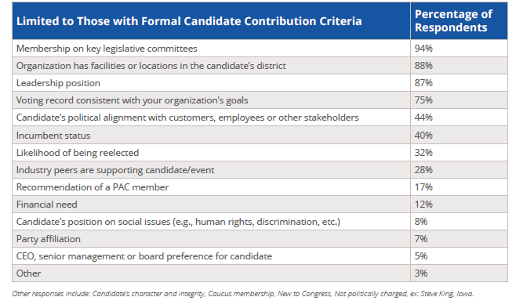
Strategic Support of Candidates
PAC Best Practices
Notes:
Key Takeaways:
The primary motivations for supporting a candidate are based on relevance to your organization. Best practice is to take these criteria and choose priorities based on your organizational goals, needs and culture then create a disbursement criteria entirely unique to your organization. Be specific so that you are as transparent as possible and always have an answer for why you chose to give to a certain candidate.

Slide 28
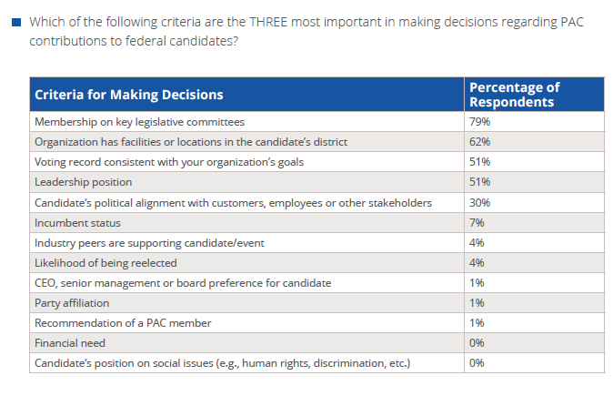
PAC Best Practices

Slide 29
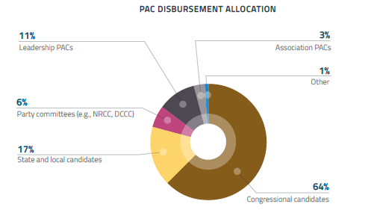
Strategic Support of Candidates
PAC Best Practices
Notes:
Key Takeaways:
Majority of PAC dollars still go towards supporting Congressional candidates, but

Slide 30
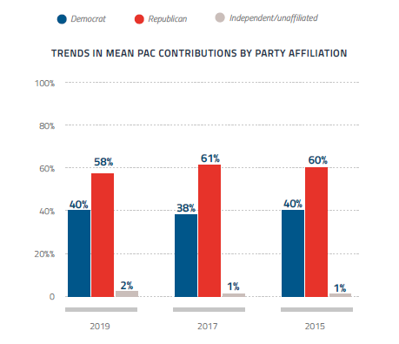
Trends in
Contributions
by Party
PAC Best Practices
Notes:
Only a slight decrease in average given towards Republicans, likely because of changes in number of incumbents and chances of re-election.

Slide 31
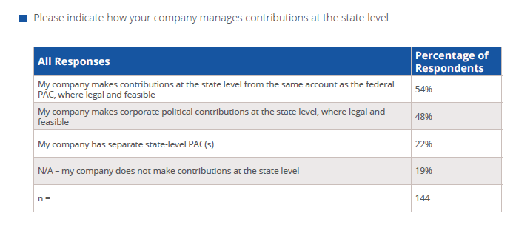
Contributions at the State Level
PAC Best Practices

Slide 32
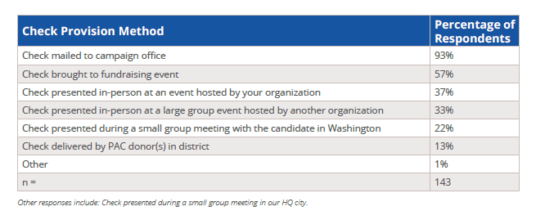
Check Provision Methods
PAC Best Practices
Notes:
Most checks sent via mail followed by in person at fundraising events. Work with your GR team to determine the best strategy – this might change from year to year, especially when it is an election year.

Slide 33
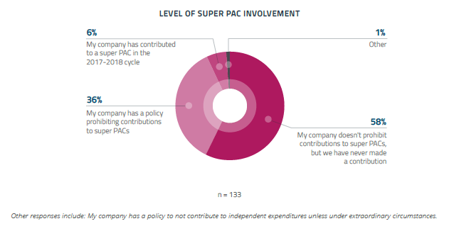
Super PAC Involvement
PAC Best Practices
Notes:
A lot of anti-PAC rhetoric is meant to target super PACs and not your average corporate or association PACs so assess how politically savvy your organization is and determine whether or not you could potentially receive backlash for super PAC involvement.

Slide 34
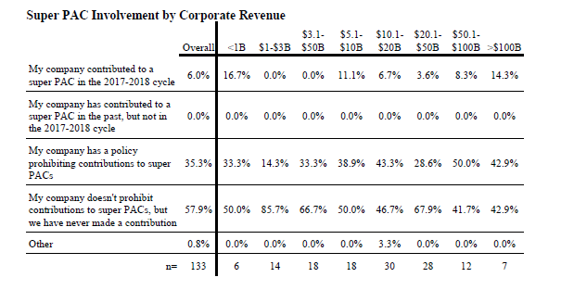
Super PAC Involvement by Revenue
PAC Best Practices
Notes:
Overall, majority of companies seem to avoid super PAC involvement.

Slide 35
Disbursement Strategies During an Election Year
Identify Your Goals
  Building relationships, maintaining transparency, increasing engagement
  Consider your organization’s identity, political outlook and priorities
  Involve other departments and teams
Seize Opportunity to Assess Processes & Procedures
Rank and Prioritize Spending
  Has to change from year to year based on realistic fundraising projection
Build Your Budget
  Guiding document – should be reassessed quarterly or even monthly
PAC Best Practices

Slide 36

Major Conclusions
Staffing has not changed much. The median corporate PAC still has 1 professional staff member and .5 administrative staff member(s) spending at least 50% of their time managing the PAC program.
CEO and senior leadership engagement in the PAC continues to rise and indicate the health of the PAC program.
Communications strategies are becoming more diverse and transparency is increasingly expected by donors and internal stakeholders.
PAC donors are incentivized by unique opportunities and experiences, such as PAC match, exclusive events, access to information and leaders above all else.
PAC Best Practices
Notes:
So as we wrap up just a few final points I’d like to make regarding the facts versus myths about corporate PACs.
We at the Council truly believe that PAC money is campaign finance that works. PACs represent the cleanest form of financial support in the campaign finance system because of four key factors.
PACs are regulated, voluntary, limited and disclosed.
-every contribution is voluntary
-the amount of support that can be given is limited, just $5,000 per year across the board and from the Council’s research the average contribution to a corporate PAC is $316…so I like to say that PACs are the original small dollar donors. On the flip side corporate PACs have a level playing field, each PAC can only give $5,000 per candidate, per election. Limits that have not been raised since the 1970s.
-Lastly, it’s all disclosed. Every dollar donated over the $200 threshold is reported, just like every disbursement to a candidate is reported and easily searchable.

Slide 37

Council Connect
Learn. Share. Connect!
Get connecting at community.pac.org
PAC Best Practices

Slide 38
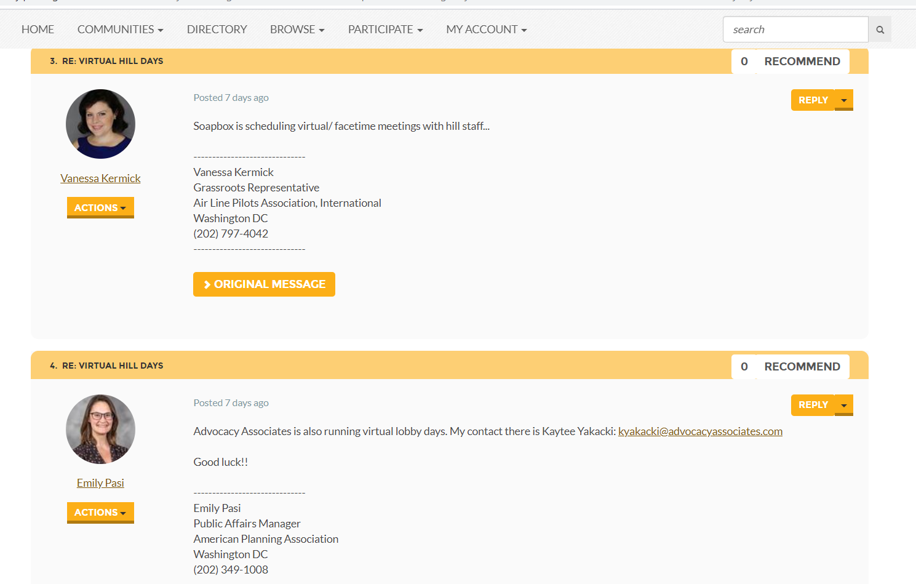
Council Connect
PAC Best Practices

Slide 39
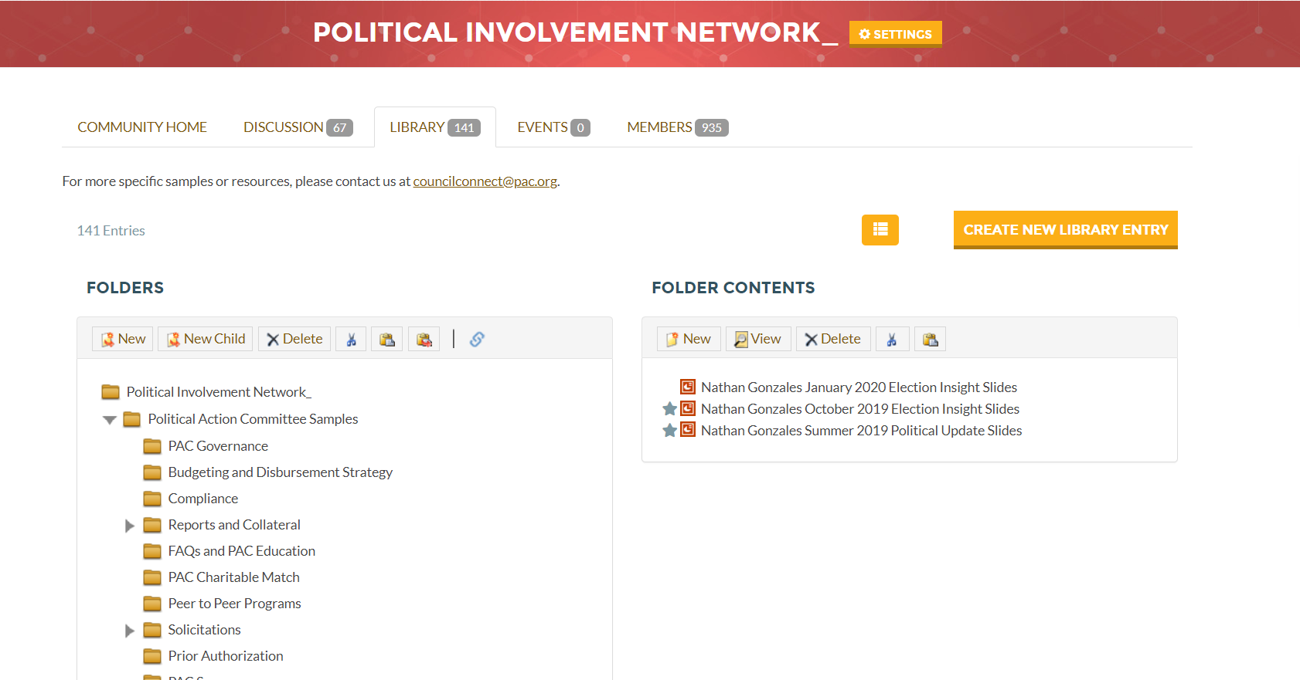
Council Connect
PAC Best Practices

Slide 40
Comparative Analysis
Example subsamples:
  Industry
  PAC size
  Location of corporate headquarters
  Corporate annual revenue
  Can run the whole survey or specific questions (ex. receipts, solicitation approaches, governance)
  Fee: starts at $500
  Timing: typically takes 3 – 4 business days
PAC Best Practices
Notes:
So as we wrap up just a few final points I’d like to make regarding the facts versus myths about corporate PACs.
We at the Council truly believe that PAC money is campaign finance that works. PACs represent the cleanest form of financial support in the campaign finance system because of four key factors.
PACs are regulated, voluntary, limited and disclosed.
-every contribution is voluntary
-the amount of support that can be given is limited, just $5,000 per year across the board and from the Council’s research the average contribution to a corporate PAC is $316…so I like to say that PACs are the original small dollar donors. On the flip side corporate PACs have a level playing field, each PAC can only give $5,000 per candidate, per election. Limits that have not been raised since the 1970s.
-Lastly, it’s all disclosed. Every dollar donated over the $200 threshold is reported, just like every disbursement to a candidate is reported and easily searchable.

Slide 41

Kristin Brackemyre
Director, PAC and Government Relations kbrackemyre@pac.org - 202.787.5969
Tori Ellington
Public Affairs Associate vellington@pac.org – 202.787.5975
Contact
Us
PAC Best Practices

