Slide 1
Creative Communications
Notes:
BI
The government affairs team has broad experience in the legislative and regulatory arenas and maintain strong relationships with elected and appointed government officials.
Govt. affairs makes a difference by…
Telling the T-Mobile story
Advocating for the adoption of government policies that allow T-Mobile to grow and succeed in a free marketplace. Stopping or mitigating policies that have a negative impact on our company and our industry.
Educating legislators, regulators, and the public through lobbying, speaking on panels and at town meetings, and filing comments in agency rulemaking proceedings.
Participating in industry forums and reach out to relevant organizations (consumer, public safety, spectrum, standards setting, disability access, etc.).
NOTE: Per what we heard from employee survey a few years ago, we need to say this in a way that does not create separation between the govt. affairs team and the rest of employees.

Slide 2
Established 2000 Acquired Metro PCS in 2012 Acquired Sprint in 2020 950 contributors → 5.5% participation 18,000+ eligible employees 2020 cycle receipts: $1.8 million 94% senior leader participation
About T-Mobile PAC (T-PAC)
Notes:
BI
The government affairs team has broad experience in the legislative and regulatory arenas and maintain strong relationships with elected and appointed government officials.
Govt. affairs makes a difference by…
Telling the T-Mobile story
Advocating for the adoption of government policies that allow T-Mobile to grow and succeed in a free marketplace. Stopping or mitigating policies that have a negative impact on our company and our industry.
Educating legislators, regulators, and the public through lobbying, speaking on panels and at town meetings, and filing comments in agency rulemaking proceedings.
Participating in industry forums and reach out to relevant organizations (consumer, public safety, spectrum, standards setting, disability access, etc.).
NOTE: Per what we heard from employee survey a few years ago, we need to say this in a way that does not create separation between the govt. affairs team and the rest of employees.

Slide 3
Our strategic pillars: Unlocking the potential of massive scale Building the World’s Best 5G Network Delivering the Best Experiences from the Best Team Solving customer pain points Customer crazed; employee committed
About T-Mobile
Notes:
By delivering on these pillars, we will bring a new level of competition to the wireless industry - finally freeing customers from the longstanding industry trade-off of having to choose a better network or a better value - with T-Mobile, we'll be able to get both!

Slide 4
T-PAC Campaign: The Making of a Superhero
Problem: How do we convey to our employees what the PAC can achieve for T-Mobile in a way that is engaging and in line with our corporate culture and out of the box thinking?
Solution: Develop something fun and relatable that will foster a willingness to learn about the role of Government Affairs and the PAC within T-Mobile.
Introducing the T-PAC Superheroes
Unstoppable!
Unbeatable!
The Unafraid Cowboy!
Notes:
Our goal in introducing the T-PAC super heroes was to walk both members and potential eligibles through complicated concepts and build understanding and appreciation for the PAC’s purpose within the community.
Our strategic focus was on developing fun and relatable communications that would fit our company culture, better connect with employees, and build a story around T-PAC and its importance for the company and employees. With CEO John Legere identifying himself as a Batman-like character on social media, serving as a “protector” of the consumer from the other “big, bad” carriers within the industry, it was only fitting to introduce our very own T-PAC super heroes to capture the power of the T-Mobile PAC.

Slide 5
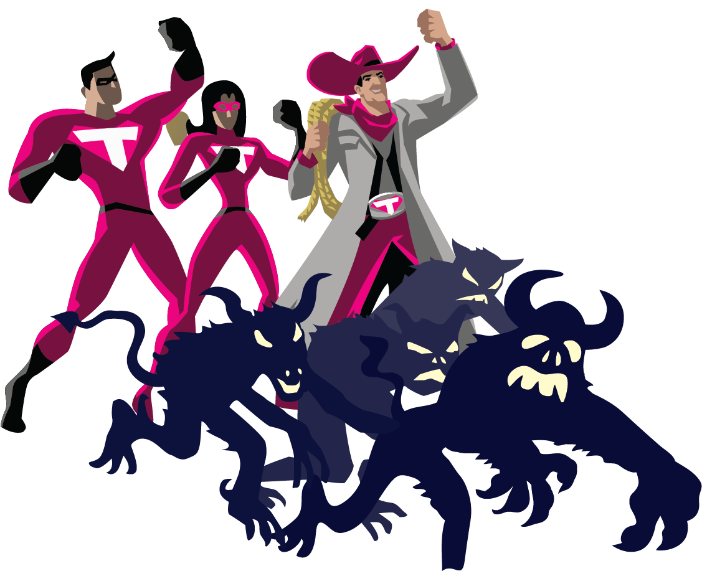
Setting Up for Success
Campaign 1: Meet the Superheroes
Targeted departmental e-mail campaign
Using PAC champions effectively
Campaign 2: The Unafraid Cowboy Rides in
Company wide e-mail and in-person campaign
Partnering with Senior Leaders
Campaign 3: You Can Be a Superhero Too
Proposed 2020 campaign
Highlighting lower donors and their impact
Up Next: Always Phase in Something New to Keep the Concept Fresh
Notes:
LS
Background on the creation of the our T-PAC superheroes
A way to make the connection of what our government affairs team does and how it filters down to the company level
Introduction of Unafraid Cowboy – created in Braxton’s image – his great support to T-PAC
T-PAC is one of the tools government affairs has in its arsenal

Slide 6
Knowing Your Audience
What is your company culture?
What types of content do your employees best respond to?
How often do they want/need to be contacted?
What do your members want to see, and what do you want them to remember?
Notes:
LS
Background on the creation of the our T-PAC superheroes
A way to make the connection of what our government affairs team does and how it filters down to the company level
Introduction of Unafraid Cowboy – created in Braxton’s image – his great support to T-PAC
T-PAC is one of the tools government affairs has in its arsenal

Slide 7
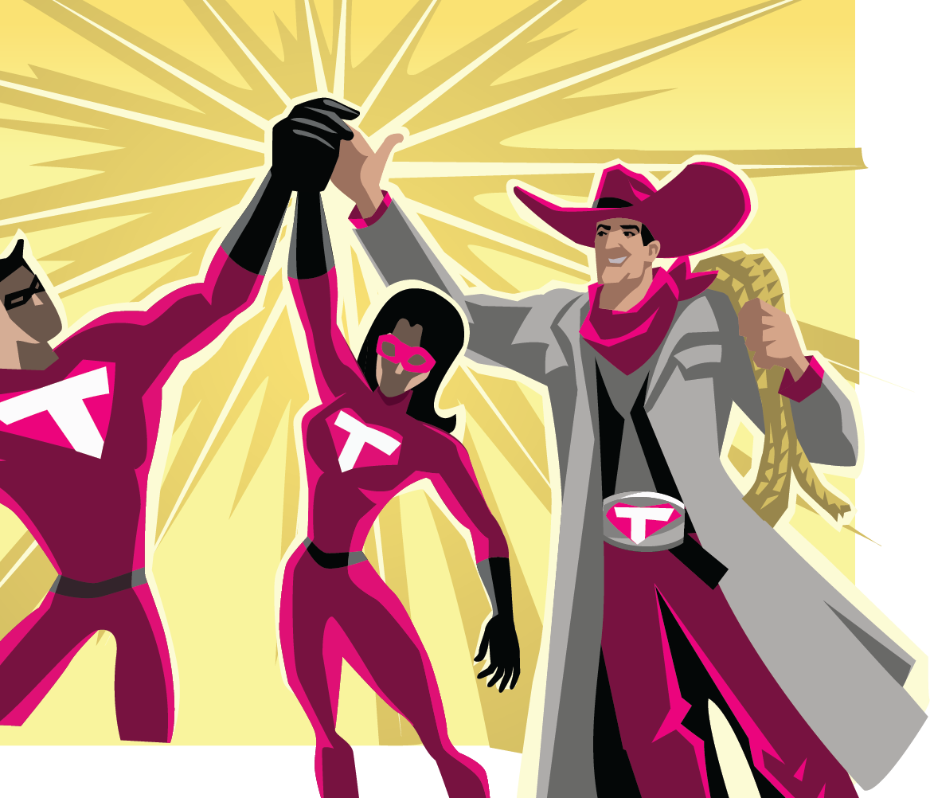
PACs at a Crossroads and Moving Forward
T-PAC solicitations, and most PAC communications, have been paused since March 2020.
When re-engaging with your PAC members and eligible class in this political environment, do your communication methods change?
How do you “sell” the PACs importance while still maintaining the seriousness of the events of the past 18 months?
Is your company helping or hindering your efforts?

Slide 8
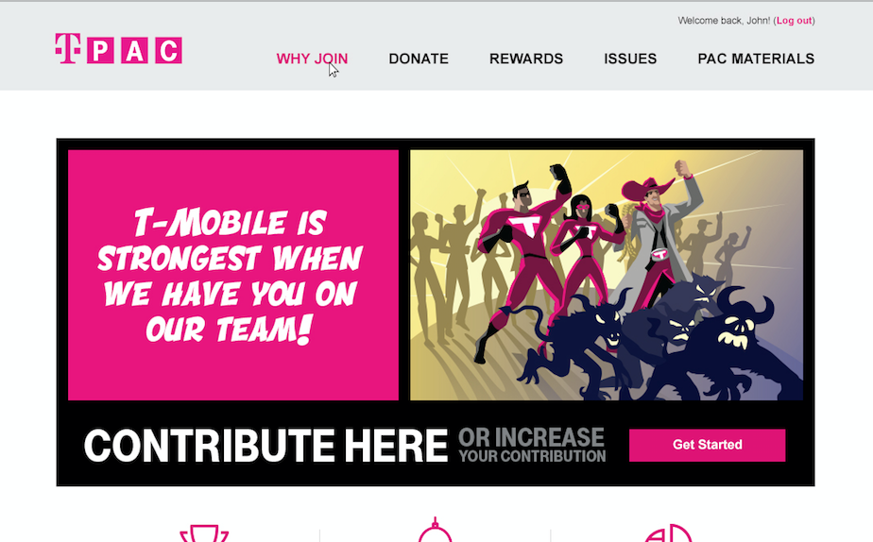
Questions? Contact Information Lisa Strikowsky Gillman Lisa.Strikowsky1@t-mobile.com
Notes:
BI
The government affairs team has broad experience in the legislative and regulatory arenas and maintain strong relationships with elected and appointed government officials.
Govt. affairs makes a difference by…
Telling the T-Mobile story
Advocating for the adoption of government policies that allow T-Mobile to grow and succeed in a free marketplace. Stopping or mitigating policies that have a negative impact on our company and our industry.
Educating legislators, regulators, and the public through lobbying, speaking on panels and at town meetings, and filing comments in agency rulemaking proceedings.
Participating in industry forums and reach out to relevant organizations (consumer, public safety, spectrum, standards setting, disability access, etc.).
NOTE: Per what we heard from employee survey a few years ago, we need to say this in a way that does not create separation between the govt. affairs team and the rest of employees.

